Slide 1
Thank You
This PowerPoint document contains the images that you requested.
Copyright Notice
All materials on this Site are protected by United States copyright law and may not be reproduced, distributed, transmitted, displayed, or otherwise published without the prior written permission of Wolters Kluwer. You may not alter or remove any trademark, copyright or other notice.
However, provided that you maintain all copyright, trademark and other notices contained therein, you may download material (one machine readable copy and one print copy per page) for your personal, non-commercial use only. Please refer to this link for further information on how to
apply for permission for re-use
Any information posted to discussion forums (moderated and un-moderated) is for informational purposes only. We are not responsible for the information or the result of its practice.

Slide 2
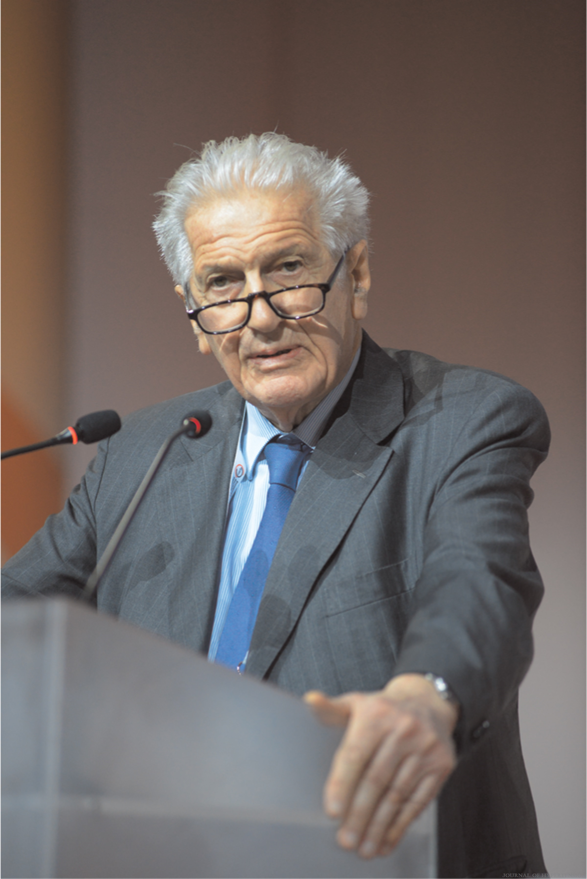
FIGURE 1
2023 ESH Guidelines for the management of arterial hypertension The Task Force for the management of arterial hypertension of the European Society of Hypertension Endorsed by the European Renal Association (ERA) and the International Society of Hypertension (ISH)
Mancia(Chairperson), Giuseppe; Kreutz(Co-Chair), Reinhold; Brunström, Mattias; Burnier, Michel; Grassi, Guido; Januszewicz, Andrzej; Muiesan, Maria Lorenza; Tsioufis, Konstantinos; Agabiti-Rosei, Enrico; Algharably, Engi Abd Elhady; Azizi, Michel; Benetos, Athanase; Borghi, Claudio; Hitij, Jana Brguljan; Cifkova, Renata; Coca, Antonio; Cornelissen, Veronique; Cruickshank, Kennedy; Cunha, Pedro G.; Danser, A.H. Jan; de Pinho, Rosa Maria; Delles, Christian; Dominiczak, Anna F.; Dorobantu, Maria; Doumas, Michalis; Fernández-Alfonso, María S.; Halimi, Jean-Michel; Járai, Zoltán; Jelaković, Bojan; Jordan, Jens; Kuznetsova, Tatiana; Laurent, Stephane; Lovic, Dragan; Lurbe, Empar; Mahfoud, Felix; Manolis, Athanasios; Miglinas, Marius; Narkiewicz, Krzystof; Niiranen, Teemu; Palatini, Paolo; Parati, Gianfranco; Pathak, Atul; Persu, Alexandre; Polonia, Jorge; Redon, Josep; Sarafidis, Pantelis; Schmieder, Roland; Spronck, Bart; Stabouli, Stella; Stergiou, George; Taddei, Stefano; Thomopoulos, Costas; Tomaszewski, Maciej; Van de Borne, Philippe; Wanner, Christoph; Weber, Thomas; Williams, Bryan; Zhang, Zhen-Yu; Kjeldsen, Sverre E.
Journal of Hypertension : June 21, 2023
doi: 10.1097/HJH.0000000000003480
Alberto Zanchetti.

Slide 3
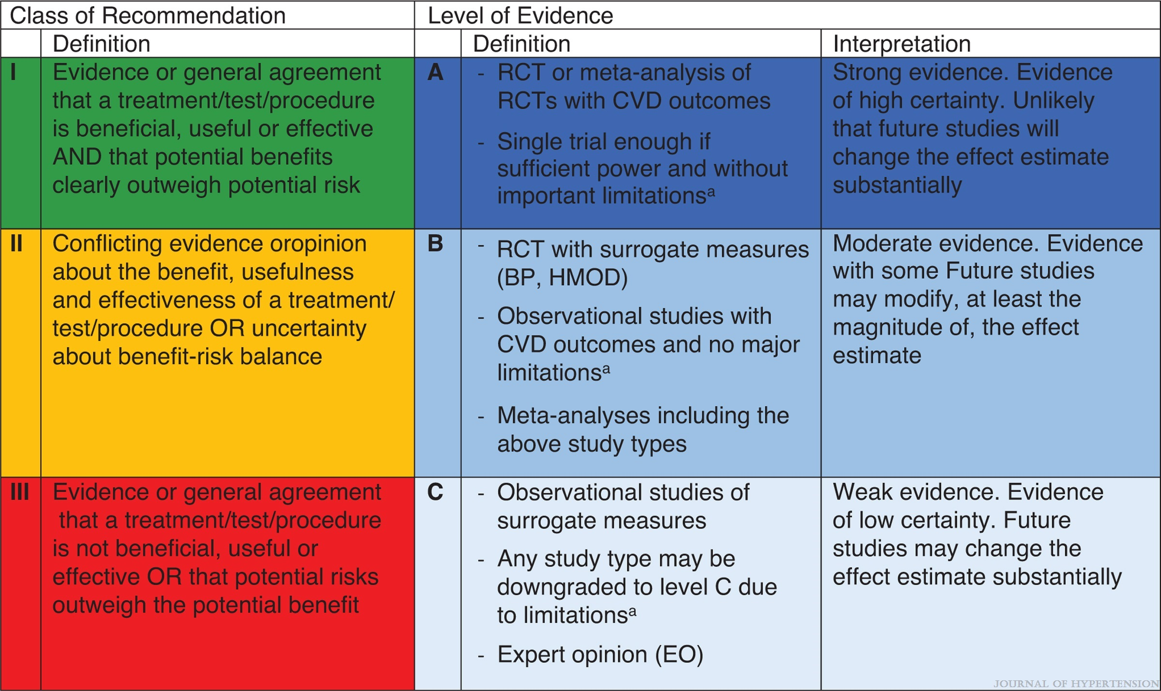
FIGURE 2
2023 ESH Guidelines for the management of arterial hypertension The Task Force for the management of arterial hypertension of the European Society of Hypertension Endorsed by the European Renal Association (ERA) and the International Society of Hypertension (ISH)
Mancia(Chairperson), Giuseppe; Kreutz(Co-Chair), Reinhold; Brunström, Mattias; Burnier, Michel; Grassi, Guido; Januszewicz, Andrzej; Muiesan, Maria Lorenza; Tsioufis, Konstantinos; Agabiti-Rosei, Enrico; Algharably, Engi Abd Elhady; Azizi, Michel; Benetos, Athanase; Borghi, Claudio; Hitij, Jana Brguljan; Cifkova, Renata; Coca, Antonio; Cornelissen, Veronique; Cruickshank, Kennedy; Cunha, Pedro G.; Danser, A.H. Jan; de Pinho, Rosa Maria; Delles, Christian; Dominiczak, Anna F.; Dorobantu, Maria; Doumas, Michalis; Fernández-Alfonso, María S.; Halimi, Jean-Michel; Járai, Zoltán; Jelaković, Bojan; Jordan, Jens; Kuznetsova, Tatiana; Laurent, Stephane; Lovic, Dragan; Lurbe, Empar; Mahfoud, Felix; Manolis, Athanasios; Miglinas, Marius; Narkiewicz, Krzystof; Niiranen, Teemu; Palatini, Paolo; Parati, Gianfranco; Pathak, Atul; Persu, Alexandre; Polonia, Jorge; Redon, Josep; Sarafidis, Pantelis; Schmieder, Roland; Spronck, Bart; Stabouli, Stella; Stergiou, George; Taddei, Stefano; Thomopoulos, Costas; Tomaszewski, Maciej; Van de Borne, Philippe; Wanner, Christoph; Weber, Thomas; Williams, Bryan; Zhang, Zhen-Yu; Kjeldsen, Sverre E.
Journal of Hypertension : June 21, 2023
doi: 10.1097/HJH.0000000000003480
Class of recommendation (CoR) and level of evidence (LoE). BP, blood pressure, CVD, cardiovascular disease, HMOD, hypertension mediated organ damage, RCT, randomized controlled trial. aLimitations affecting level of evidence include (but may not be limited to) high risk of bias, inability to account for important confounding factors in observational studies, questionable external validity and uncertain effect estimates (confidence intervals including negligible effect).

Slide 4
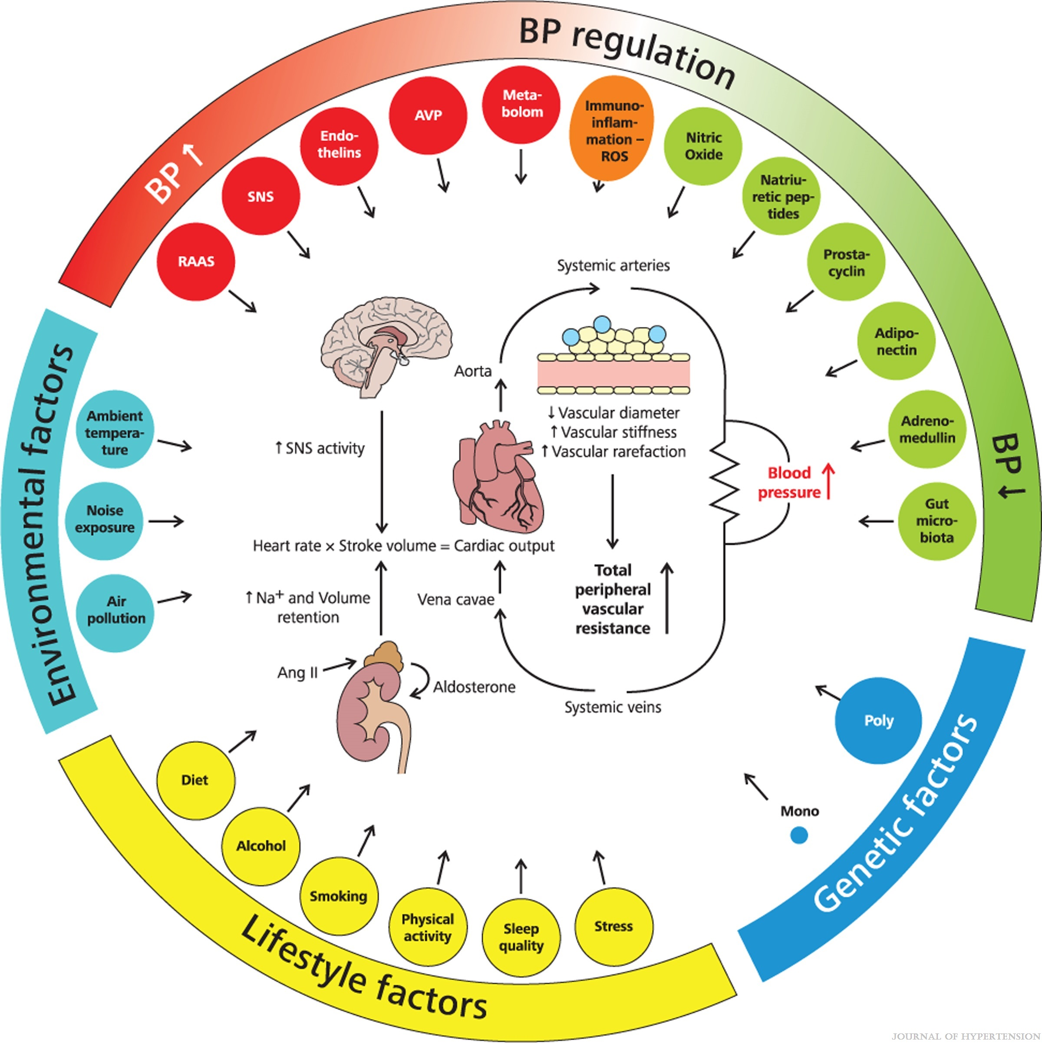
FIGURE 3
2023 ESH Guidelines for the management of arterial hypertension The Task Force for the management of arterial hypertension of the European Society of Hypertension Endorsed by the European Renal Association (ERA) and the International Society of Hypertension (ISH)
Mancia(Chairperson), Giuseppe; Kreutz(Co-Chair), Reinhold; Brunström, Mattias; Burnier, Michel; Grassi, Guido; Januszewicz, Andrzej; Muiesan, Maria Lorenza; Tsioufis, Konstantinos; Agabiti-Rosei, Enrico; Algharably, Engi Abd Elhady; Azizi, Michel; Benetos, Athanase; Borghi, Claudio; Hitij, Jana Brguljan; Cifkova, Renata; Coca, Antonio; Cornelissen, Veronique; Cruickshank, Kennedy; Cunha, Pedro G.; Danser, A.H. Jan; de Pinho, Rosa Maria; Delles, Christian; Dominiczak, Anna F.; Dorobantu, Maria; Doumas, Michalis; Fernández-Alfonso, María S.; Halimi, Jean-Michel; Járai, Zoltán; Jelaković, Bojan; Jordan, Jens; Kuznetsova, Tatiana; Laurent, Stephane; Lovic, Dragan; Lurbe, Empar; Mahfoud, Felix; Manolis, Athanasios; Miglinas, Marius; Narkiewicz, Krzystof; Niiranen, Teemu; Palatini, Paolo; Parati, Gianfranco; Pathak, Atul; Persu, Alexandre; Polonia, Jorge; Redon, Josep; Sarafidis, Pantelis; Schmieder, Roland; Spronck, Bart; Stabouli, Stella; Stergiou, George; Taddei, Stefano; Thomopoulos, Costas; Tomaszewski, Maciej; Van de Borne, Philippe; Wanner, Christoph; Weber, Thomas; Williams, Bryan; Zhang, Zhen-Yu; Kjeldsen, Sverre E.
Journal of Hypertension : June 21, 2023
doi: 10.1097/HJH.0000000000003480
Mechanisms involved in BP reguation and the pathophysiology of hypertension.

Slide 5
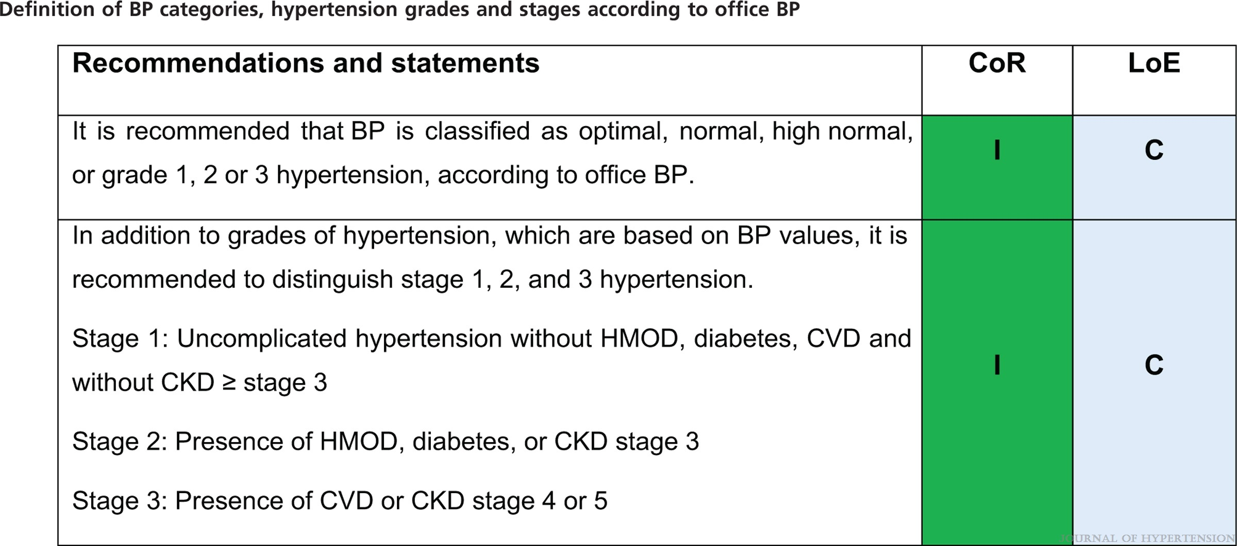
2023 ESH Guidelines for the management of arterial hypertension The Task Force for the management of arterial hypertension of the European Society of Hypertension Endorsed by the European Renal Association (ERA) and the International Society of Hypertension (ISH)
Mancia(Chairperson), Giuseppe; Kreutz(Co-Chair), Reinhold; Brunström, Mattias; Burnier, Michel; Grassi, Guido; Januszewicz, Andrzej; Muiesan, Maria Lorenza; Tsioufis, Konstantinos; Agabiti-Rosei, Enrico; Algharably, Engi Abd Elhady; Azizi, Michel; Benetos, Athanase; Borghi, Claudio; Hitij, Jana Brguljan; Cifkova, Renata; Coca, Antonio; Cornelissen, Veronique; Cruickshank, Kennedy; Cunha, Pedro G.; Danser, A.H. Jan; de Pinho, Rosa Maria; Delles, Christian; Dominiczak, Anna F.; Dorobantu, Maria; Doumas, Michalis; Fernández-Alfonso, María S.; Halimi, Jean-Michel; Járai, Zoltán; Jelaković, Bojan; Jordan, Jens; Kuznetsova, Tatiana; Laurent, Stephane; Lovic, Dragan; Lurbe, Empar; Mahfoud, Felix; Manolis, Athanasios; Miglinas, Marius; Narkiewicz, Krzystof; Niiranen, Teemu; Palatini, Paolo; Parati, Gianfranco; Pathak, Atul; Persu, Alexandre; Polonia, Jorge; Redon, Josep; Sarafidis, Pantelis; Schmieder, Roland; Spronck, Bart; Stabouli, Stella; Stergiou, George; Taddei, Stefano; Thomopoulos, Costas; Tomaszewski, Maciej; Van de Borne, Philippe; Wanner, Christoph; Weber, Thomas; Williams, Bryan; Zhang, Zhen-Yu; Kjeldsen, Sverre E.
Journal of Hypertension : June 21, 2023
doi: 10.1097/HJH.0000000000003480

Slide 6
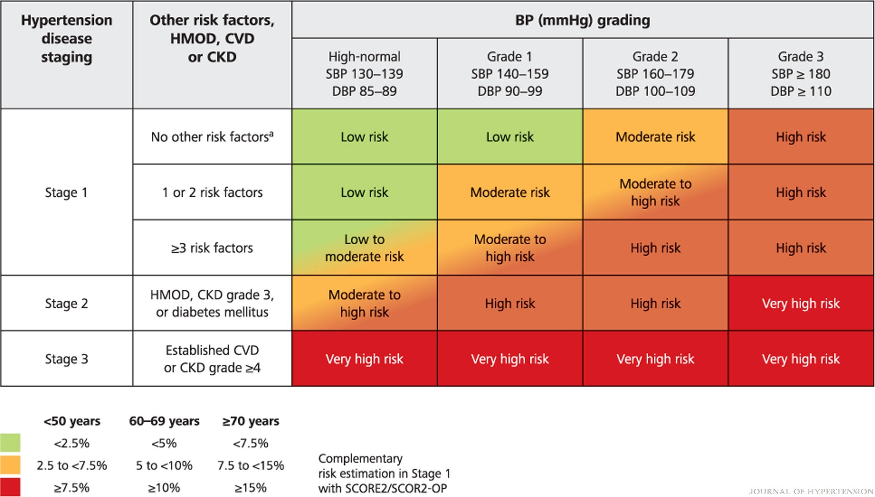
FIGURE 4
2023 ESH Guidelines for the management of arterial hypertension The Task Force for the management of arterial hypertension of the European Society of Hypertension Endorsed by the European Renal Association (ERA) and the International Society of Hypertension (ISH)
Mancia(Chairperson), Giuseppe; Kreutz(Co-Chair), Reinhold; Brunström, Mattias; Burnier, Michel; Grassi, Guido; Januszewicz, Andrzej; Muiesan, Maria Lorenza; Tsioufis, Konstantinos; Agabiti-Rosei, Enrico; Algharably, Engi Abd Elhady; Azizi, Michel; Benetos, Athanase; Borghi, Claudio; Hitij, Jana Brguljan; Cifkova, Renata; Coca, Antonio; Cornelissen, Veronique; Cruickshank, Kennedy; Cunha, Pedro G.; Danser, A.H. Jan; de Pinho, Rosa Maria; Delles, Christian; Dominiczak, Anna F.; Dorobantu, Maria; Doumas, Michalis; Fernández-Alfonso, María S.; Halimi, Jean-Michel; Járai, Zoltán; Jelaković, Bojan; Jordan, Jens; Kuznetsova, Tatiana; Laurent, Stephane; Lovic, Dragan; Lurbe, Empar; Mahfoud, Felix; Manolis, Athanasios; Miglinas, Marius; Narkiewicz, Krzystof; Niiranen, Teemu; Palatini, Paolo; Parati, Gianfranco; Pathak, Atul; Persu, Alexandre; Polonia, Jorge; Redon, Josep; Sarafidis, Pantelis; Schmieder, Roland; Spronck, Bart; Stabouli, Stella; Stergiou, George; Taddei, Stefano; Thomopoulos, Costas; Tomaszewski, Maciej; Van de Borne, Philippe; Wanner, Christoph; Weber, Thomas; Williams, Bryan; Zhang, Zhen-Yu; Kjeldsen, Sverre E.
Journal of Hypertension : June 21, 2023
doi: 10.1097/HJH.0000000000003480
Cardiovascular risk according to grade and stage of hypertension.

Slide 7
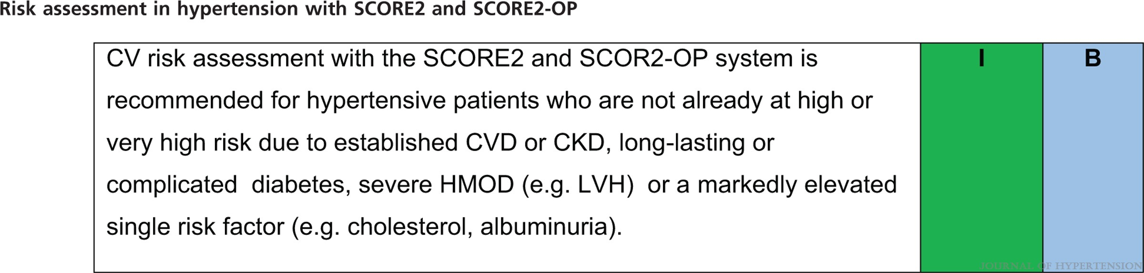
2023 ESH Guidelines for the management of arterial hypertension The Task Force for the management of arterial hypertension of the European Society of Hypertension Endorsed by the European Renal Association (ERA) and the International Society of Hypertension (ISH)
Mancia(Chairperson), Giuseppe; Kreutz(Co-Chair), Reinhold; Brunström, Mattias; Burnier, Michel; Grassi, Guido; Januszewicz, Andrzej; Muiesan, Maria Lorenza; Tsioufis, Konstantinos; Agabiti-Rosei, Enrico; Algharably, Engi Abd Elhady; Azizi, Michel; Benetos, Athanase; Borghi, Claudio; Hitij, Jana Brguljan; Cifkova, Renata; Coca, Antonio; Cornelissen, Veronique; Cruickshank, Kennedy; Cunha, Pedro G.; Danser, A.H. Jan; de Pinho, Rosa Maria; Delles, Christian; Dominiczak, Anna F.; Dorobantu, Maria; Doumas, Michalis; Fernández-Alfonso, María S.; Halimi, Jean-Michel; Járai, Zoltán; Jelaković, Bojan; Jordan, Jens; Kuznetsova, Tatiana; Laurent, Stephane; Lovic, Dragan; Lurbe, Empar; Mahfoud, Felix; Manolis, Athanasios; Miglinas, Marius; Narkiewicz, Krzystof; Niiranen, Teemu; Palatini, Paolo; Parati, Gianfranco; Pathak, Atul; Persu, Alexandre; Polonia, Jorge; Redon, Josep; Sarafidis, Pantelis; Schmieder, Roland; Spronck, Bart; Stabouli, Stella; Stergiou, George; Taddei, Stefano; Thomopoulos, Costas; Tomaszewski, Maciej; Van de Borne, Philippe; Wanner, Christoph; Weber, Thomas; Williams, Bryan; Zhang, Zhen-Yu; Kjeldsen, Sverre E.
Journal of Hypertension : June 21, 2023
doi: 10.1097/HJH.0000000000003480

Slide 8
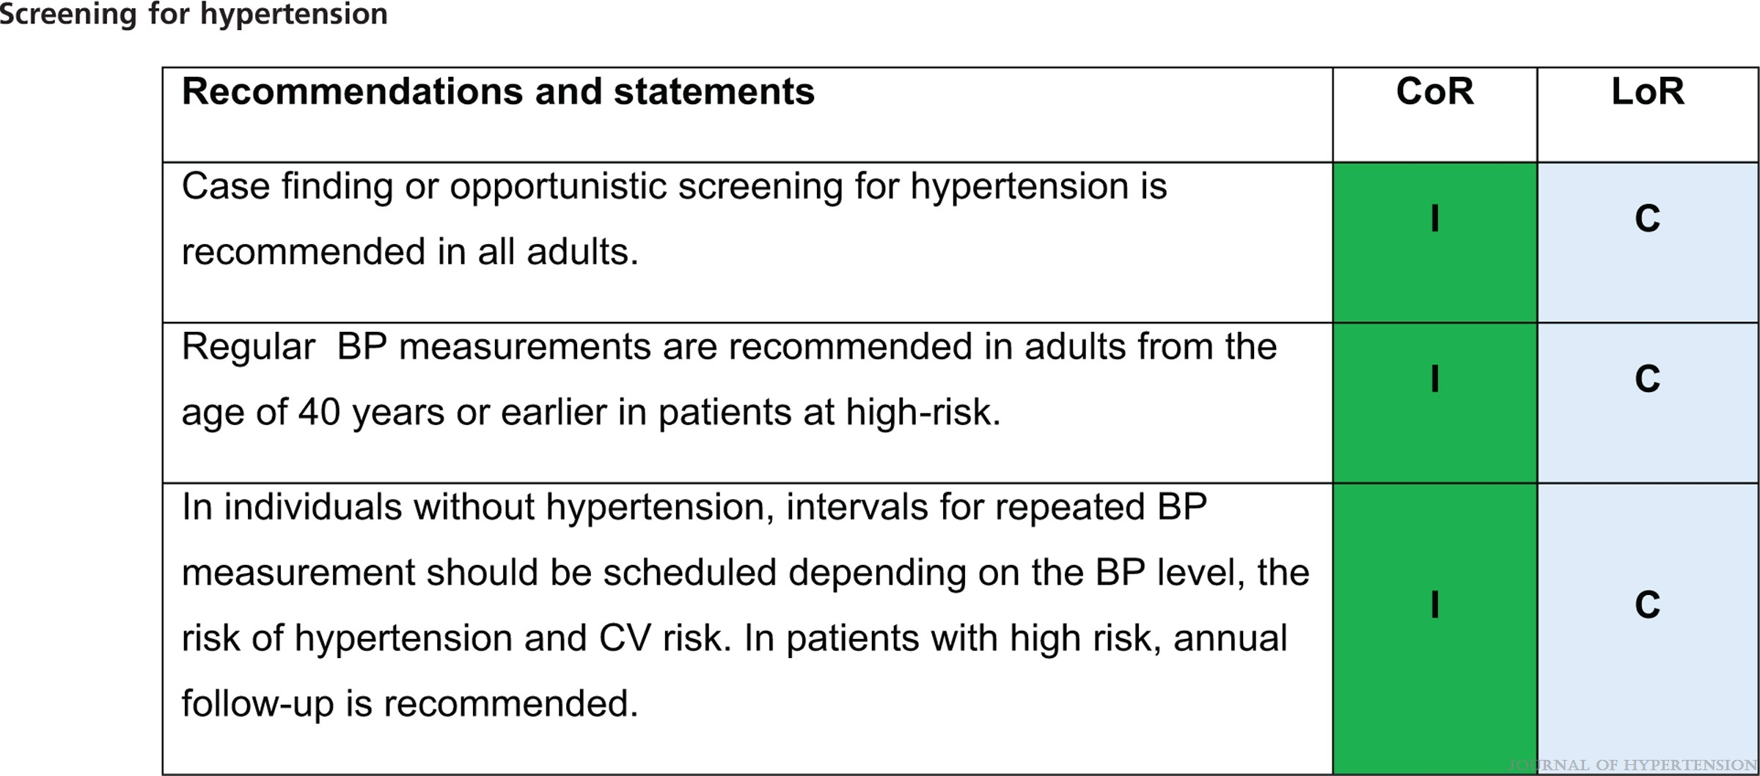
2023 ESH Guidelines for the management of arterial hypertension The Task Force for the management of arterial hypertension of the European Society of Hypertension Endorsed by the European Renal Association (ERA) and the International Society of Hypertension (ISH)
Mancia(Chairperson), Giuseppe; Kreutz(Co-Chair), Reinhold; Brunström, Mattias; Burnier, Michel; Grassi, Guido; Januszewicz, Andrzej; Muiesan, Maria Lorenza; Tsioufis, Konstantinos; Agabiti-Rosei, Enrico; Algharably, Engi Abd Elhady; Azizi, Michel; Benetos, Athanase; Borghi, Claudio; Hitij, Jana Brguljan; Cifkova, Renata; Coca, Antonio; Cornelissen, Veronique; Cruickshank, Kennedy; Cunha, Pedro G.; Danser, A.H. Jan; de Pinho, Rosa Maria; Delles, Christian; Dominiczak, Anna F.; Dorobantu, Maria; Doumas, Michalis; Fernández-Alfonso, María S.; Halimi, Jean-Michel; Járai, Zoltán; Jelaković, Bojan; Jordan, Jens; Kuznetsova, Tatiana; Laurent, Stephane; Lovic, Dragan; Lurbe, Empar; Mahfoud, Felix; Manolis, Athanasios; Miglinas, Marius; Narkiewicz, Krzystof; Niiranen, Teemu; Palatini, Paolo; Parati, Gianfranco; Pathak, Atul; Persu, Alexandre; Polonia, Jorge; Redon, Josep; Sarafidis, Pantelis; Schmieder, Roland; Spronck, Bart; Stabouli, Stella; Stergiou, George; Taddei, Stefano; Thomopoulos, Costas; Tomaszewski, Maciej; Van de Borne, Philippe; Wanner, Christoph; Weber, Thomas; Williams, Bryan; Zhang, Zhen-Yu; Kjeldsen, Sverre E.
Journal of Hypertension : June 21, 2023
doi: 10.1097/HJH.0000000000003480

Slide 9
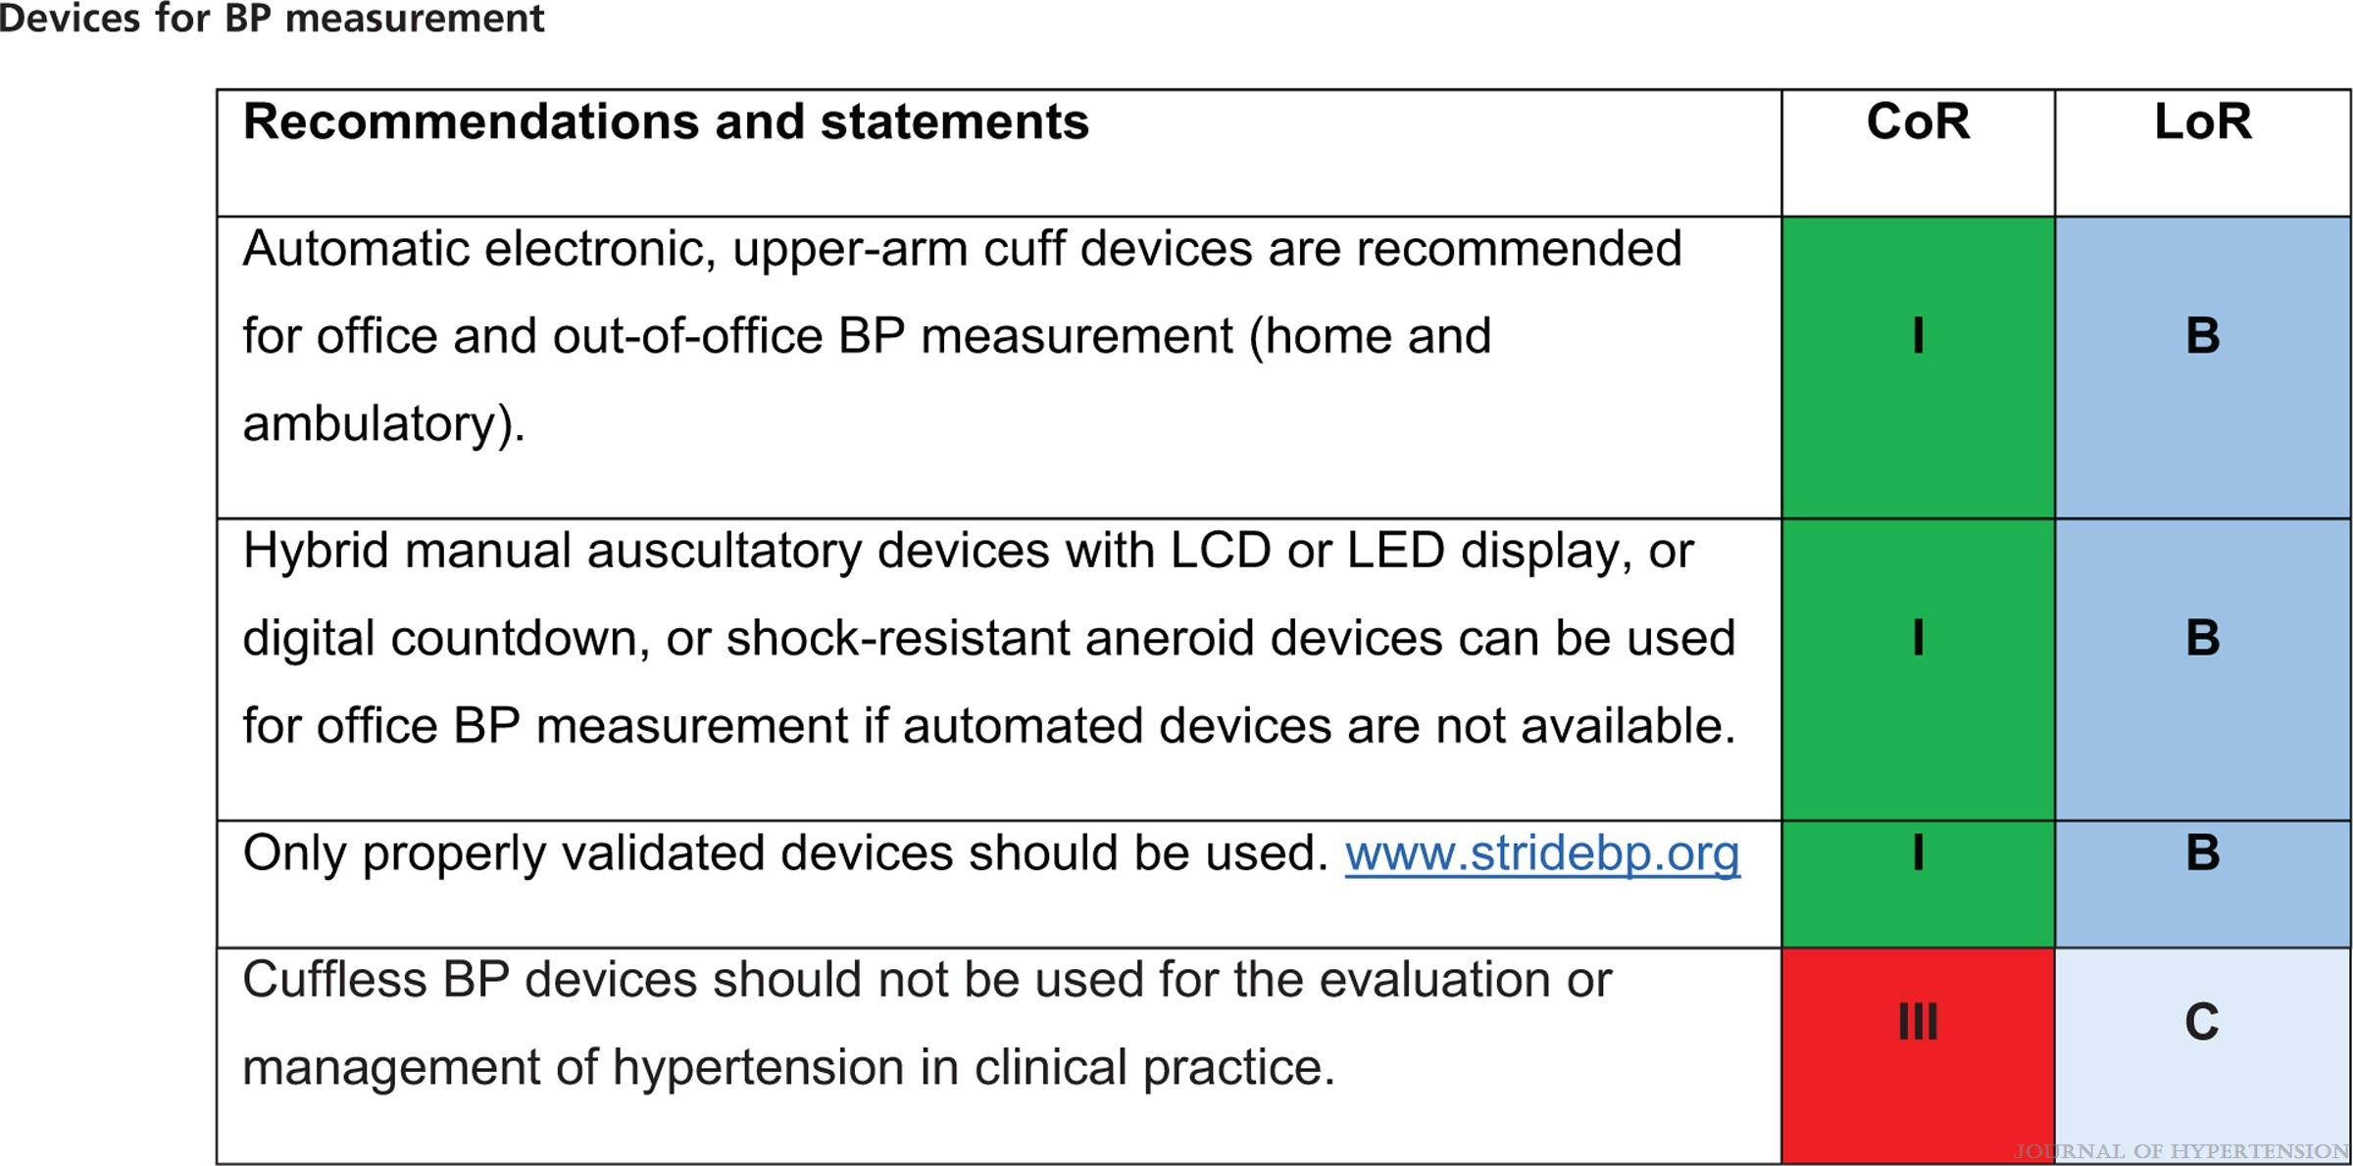
2023 ESH Guidelines for the management of arterial hypertension The Task Force for the management of arterial hypertension of the European Society of Hypertension Endorsed by the European Renal Association (ERA) and the International Society of Hypertension (ISH)
Mancia(Chairperson), Giuseppe; Kreutz(Co-Chair), Reinhold; Brunström, Mattias; Burnier, Michel; Grassi, Guido; Januszewicz, Andrzej; Muiesan, Maria Lorenza; Tsioufis, Konstantinos; Agabiti-Rosei, Enrico; Algharably, Engi Abd Elhady; Azizi, Michel; Benetos, Athanase; Borghi, Claudio; Hitij, Jana Brguljan; Cifkova, Renata; Coca, Antonio; Cornelissen, Veronique; Cruickshank, Kennedy; Cunha, Pedro G.; Danser, A.H. Jan; de Pinho, Rosa Maria; Delles, Christian; Dominiczak, Anna F.; Dorobantu, Maria; Doumas, Michalis; Fernández-Alfonso, María S.; Halimi, Jean-Michel; Járai, Zoltán; Jelaković, Bojan; Jordan, Jens; Kuznetsova, Tatiana; Laurent, Stephane; Lovic, Dragan; Lurbe, Empar; Mahfoud, Felix; Manolis, Athanasios; Miglinas, Marius; Narkiewicz, Krzystof; Niiranen, Teemu; Palatini, Paolo; Parati, Gianfranco; Pathak, Atul; Persu, Alexandre; Polonia, Jorge; Redon, Josep; Sarafidis, Pantelis; Schmieder, Roland; Spronck, Bart; Stabouli, Stella; Stergiou, George; Taddei, Stefano; Thomopoulos, Costas; Tomaszewski, Maciej; Van de Borne, Philippe; Wanner, Christoph; Weber, Thomas; Williams, Bryan; Zhang, Zhen-Yu; Kjeldsen, Sverre E.
Journal of Hypertension : June 21, 2023
doi: 10.1097/HJH.0000000000003480

Slide 10
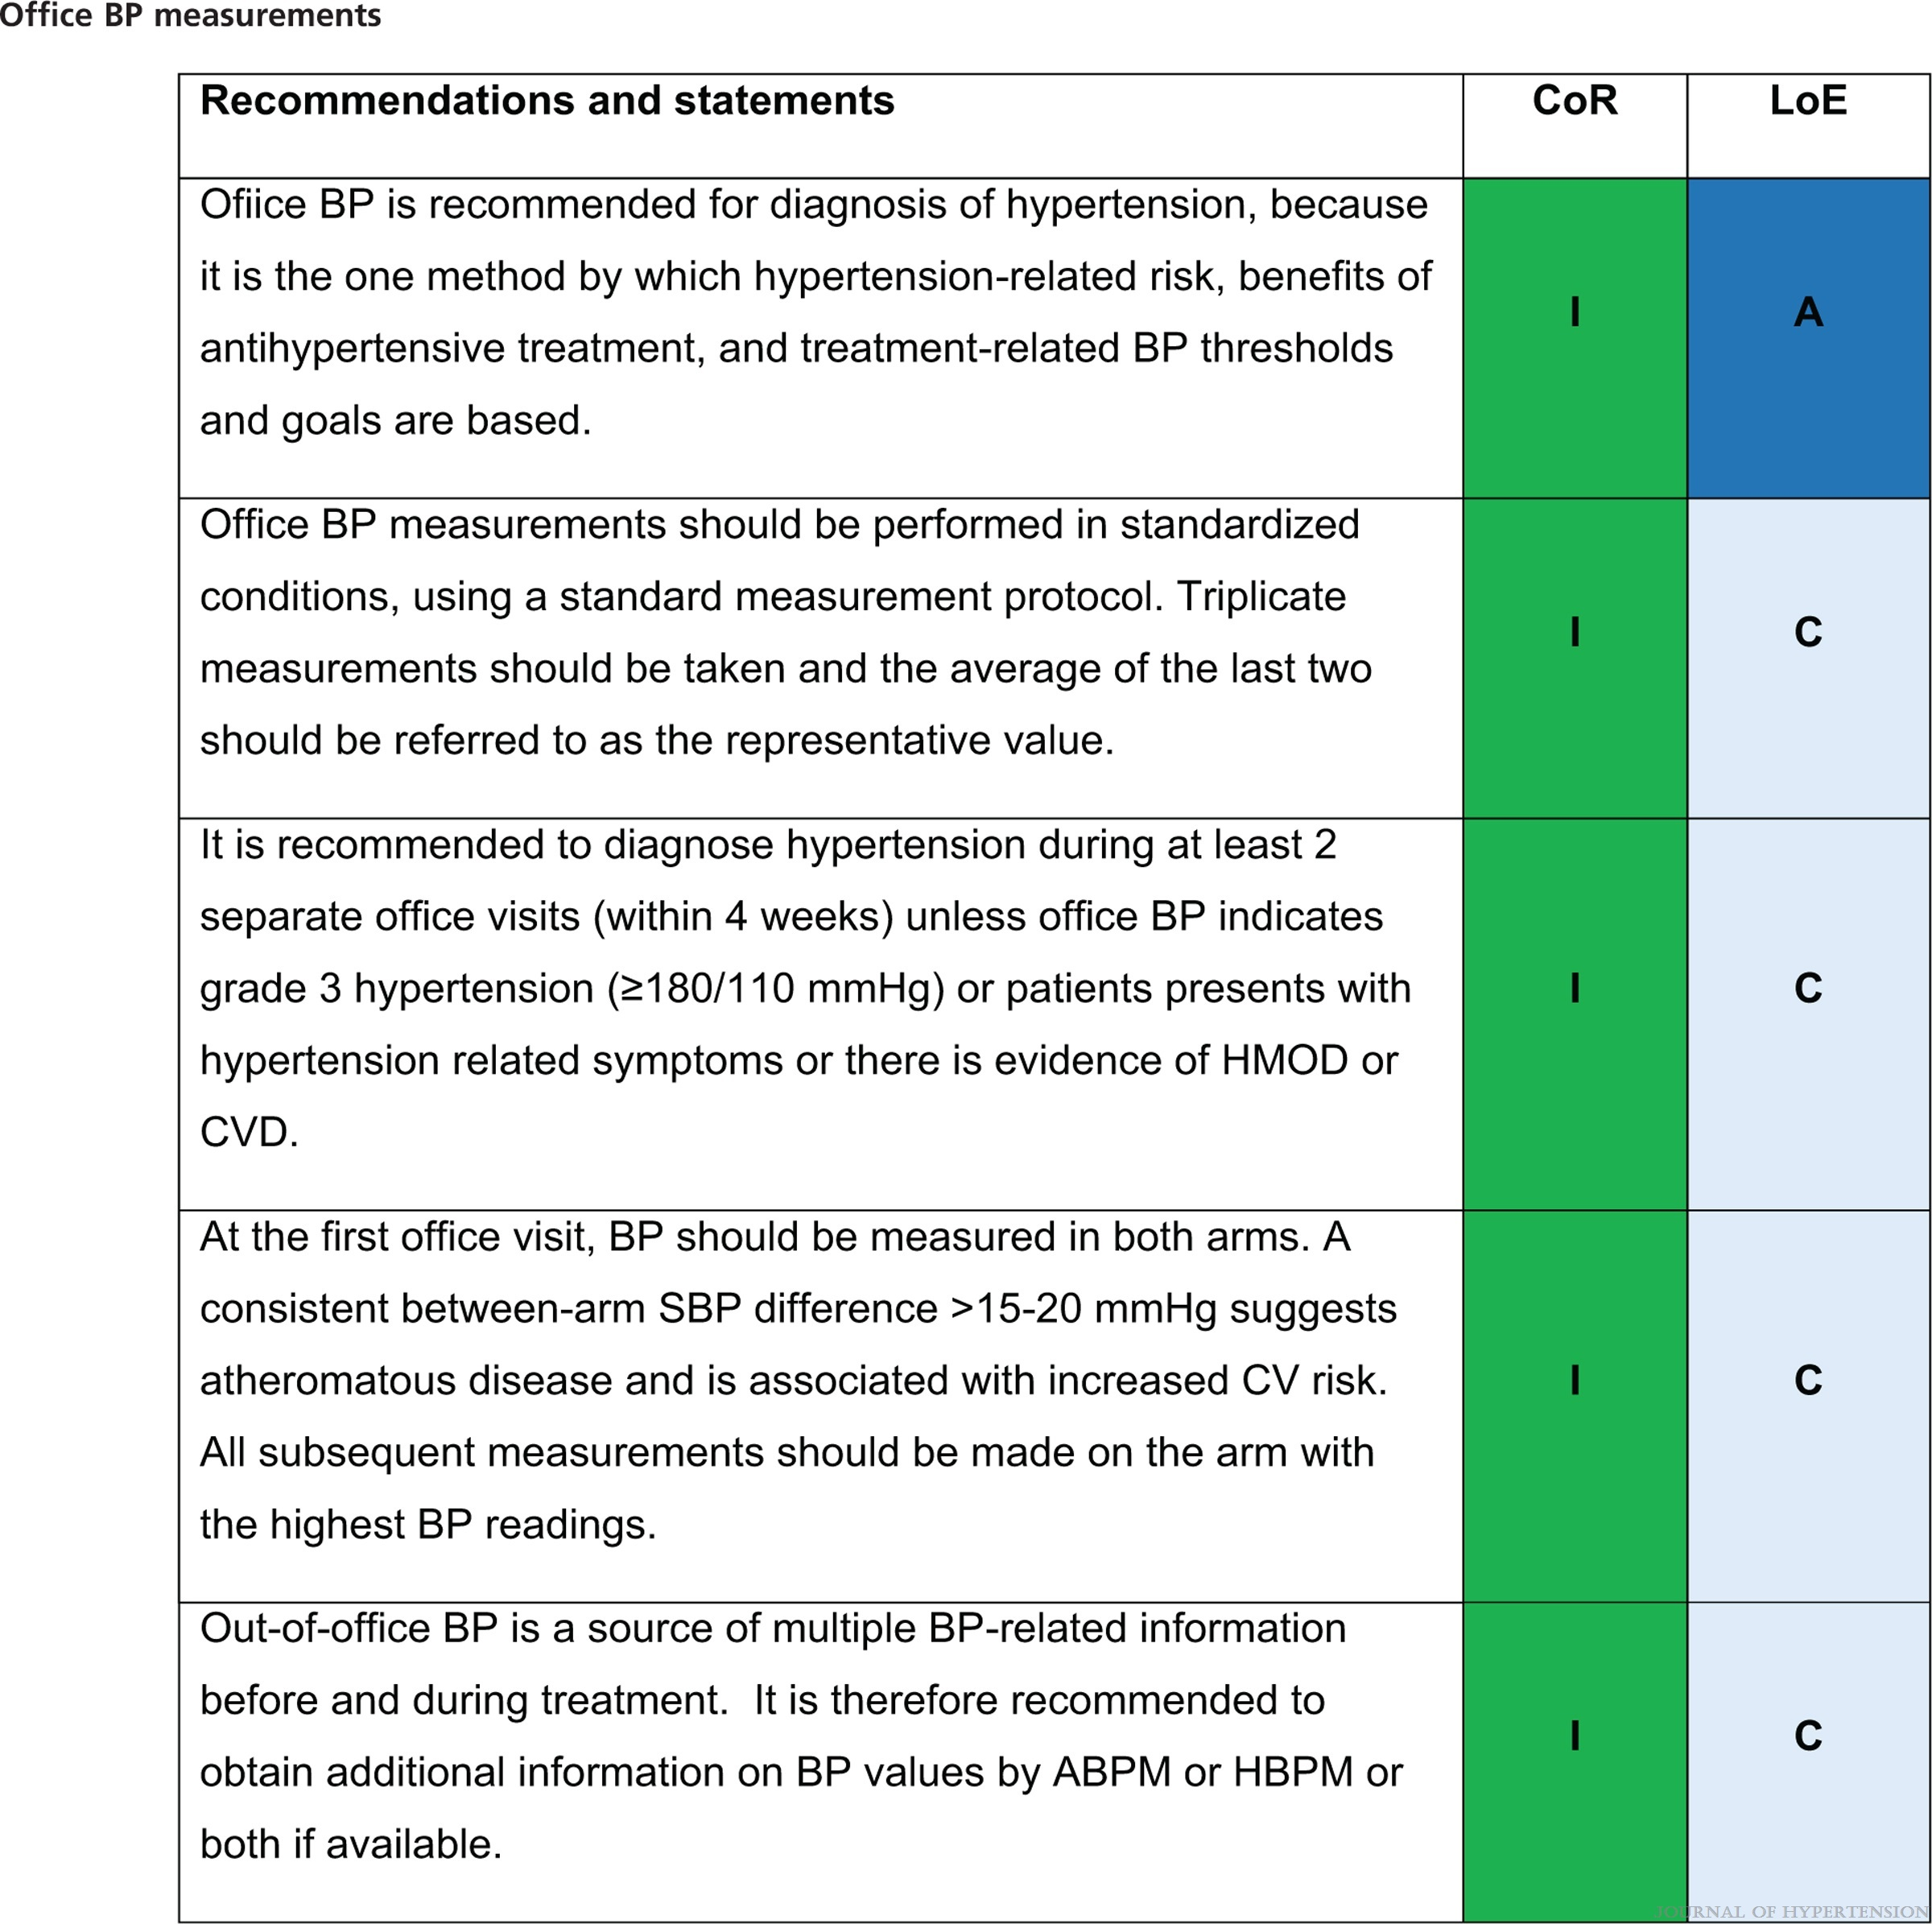
2023 ESH Guidelines for the management of arterial hypertension The Task Force for the management of arterial hypertension of the European Society of Hypertension Endorsed by the European Renal Association (ERA) and the International Society of Hypertension (ISH)
Mancia(Chairperson), Giuseppe; Kreutz(Co-Chair), Reinhold; Brunström, Mattias; Burnier, Michel; Grassi, Guido; Januszewicz, Andrzej; Muiesan, Maria Lorenza; Tsioufis, Konstantinos; Agabiti-Rosei, Enrico; Algharably, Engi Abd Elhady; Azizi, Michel; Benetos, Athanase; Borghi, Claudio; Hitij, Jana Brguljan; Cifkova, Renata; Coca, Antonio; Cornelissen, Veronique; Cruickshank, Kennedy; Cunha, Pedro G.; Danser, A.H. Jan; de Pinho, Rosa Maria; Delles, Christian; Dominiczak, Anna F.; Dorobantu, Maria; Doumas, Michalis; Fernández-Alfonso, María S.; Halimi, Jean-Michel; Járai, Zoltán; Jelaković, Bojan; Jordan, Jens; Kuznetsova, Tatiana; Laurent, Stephane; Lovic, Dragan; Lurbe, Empar; Mahfoud, Felix; Manolis, Athanasios; Miglinas, Marius; Narkiewicz, Krzystof; Niiranen, Teemu; Palatini, Paolo; Parati, Gianfranco; Pathak, Atul; Persu, Alexandre; Polonia, Jorge; Redon, Josep; Sarafidis, Pantelis; Schmieder, Roland; Spronck, Bart; Stabouli, Stella; Stergiou, George; Taddei, Stefano; Thomopoulos, Costas; Tomaszewski, Maciej; Van de Borne, Philippe; Wanner, Christoph; Weber, Thomas; Williams, Bryan; Zhang, Zhen-Yu; Kjeldsen, Sverre E.
Journal of Hypertension : June 21, 2023
doi: 10.1097/HJH.0000000000003480

Slide 11
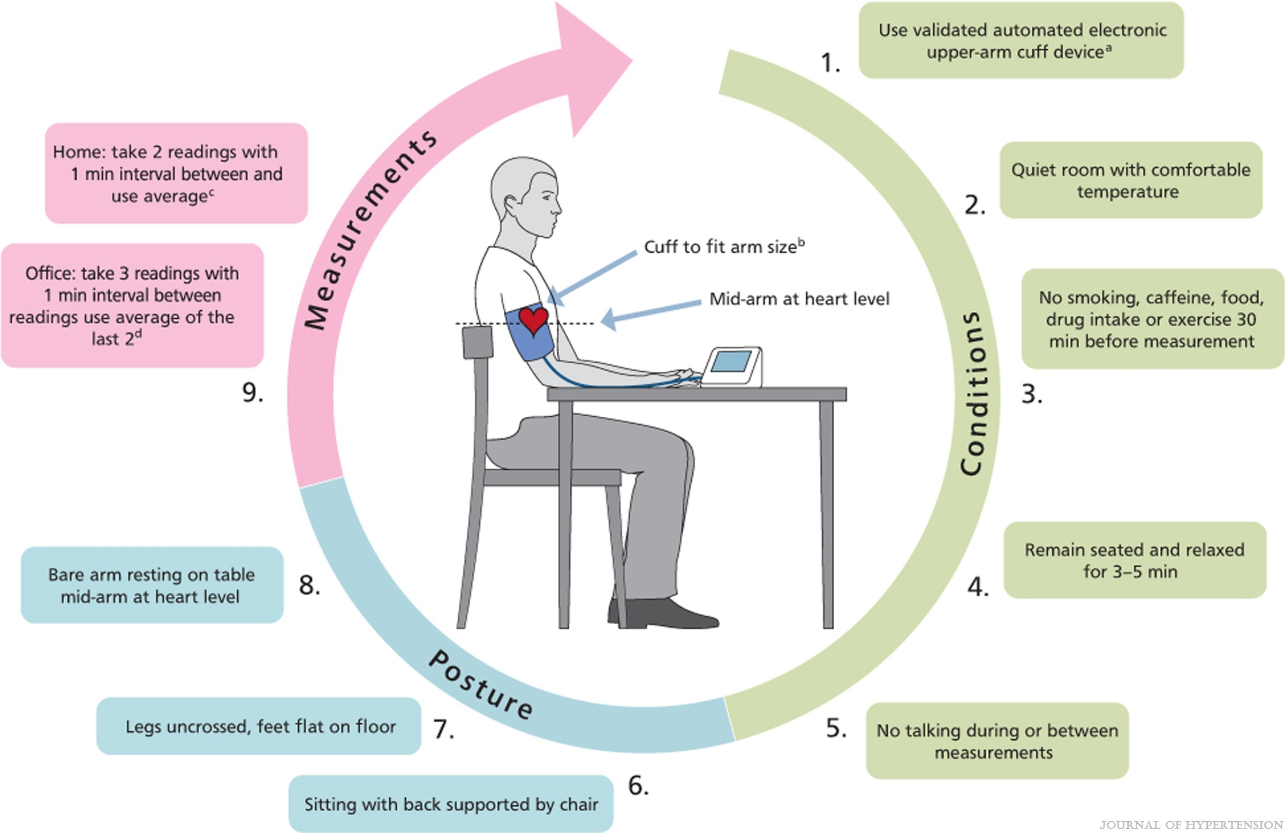
FIGURE 5
2023 ESH Guidelines for the management of arterial hypertension The Task Force for the management of arterial hypertension of the European Society of Hypertension Endorsed by the European Renal Association (ERA) and the International Society of Hypertension (ISH)
Mancia(Chairperson), Giuseppe; Kreutz(Co-Chair), Reinhold; Brunström, Mattias; Burnier, Michel; Grassi, Guido; Januszewicz, Andrzej; Muiesan, Maria Lorenza; Tsioufis, Konstantinos; Agabiti-Rosei, Enrico; Algharably, Engi Abd Elhady; Azizi, Michel; Benetos, Athanase; Borghi, Claudio; Hitij, Jana Brguljan; Cifkova, Renata; Coca, Antonio; Cornelissen, Veronique; Cruickshank, Kennedy; Cunha, Pedro G.; Danser, A.H. Jan; de Pinho, Rosa Maria; Delles, Christian; Dominiczak, Anna F.; Dorobantu, Maria; Doumas, Michalis; Fernández-Alfonso, María S.; Halimi, Jean-Michel; Járai, Zoltán; Jelaković, Bojan; Jordan, Jens; Kuznetsova, Tatiana; Laurent, Stephane; Lovic, Dragan; Lurbe, Empar; Mahfoud, Felix; Manolis, Athanasios; Miglinas, Marius; Narkiewicz, Krzystof; Niiranen, Teemu; Palatini, Paolo; Parati, Gianfranco; Pathak, Atul; Persu, Alexandre; Polonia, Jorge; Redon, Josep; Sarafidis, Pantelis; Schmieder, Roland; Spronck, Bart; Stabouli, Stella; Stergiou, George; Taddei, Stefano; Thomopoulos, Costas; Tomaszewski, Maciej; Van de Borne, Philippe; Wanner, Christoph; Weber, Thomas; Williams, Bryan; Zhang, Zhen-Yu; Kjeldsen, Sverre E.
Journal of Hypertension : June 21, 2023
doi: 10.1097/HJH.0000000000003480
Recommendations for BP measurements in the office and at home. Adapted from [62]. aUse an automated electronic (oscillometric) device, which is validated according to an established protocol (www.stridebp.org). A device that takes triplicate readings automatically is preferred. bThe selection of an appropriate cuff size is crucial for accurate BP measurement and depends on the arm circumference of each individual – a smaller than required cuff overestimates BP and a larger underestimates BP. Using automated electronic devices select cuff size according to the device's instructions. At the initial visit, measure BP in both arms. cMeasure in the morning and the evening for 3–7 days. Use the average of all readings excluding the first day. dStrong data linking OBP with CVD. Used in most observational and interventional outcome trials in hypertension.

Slide 12
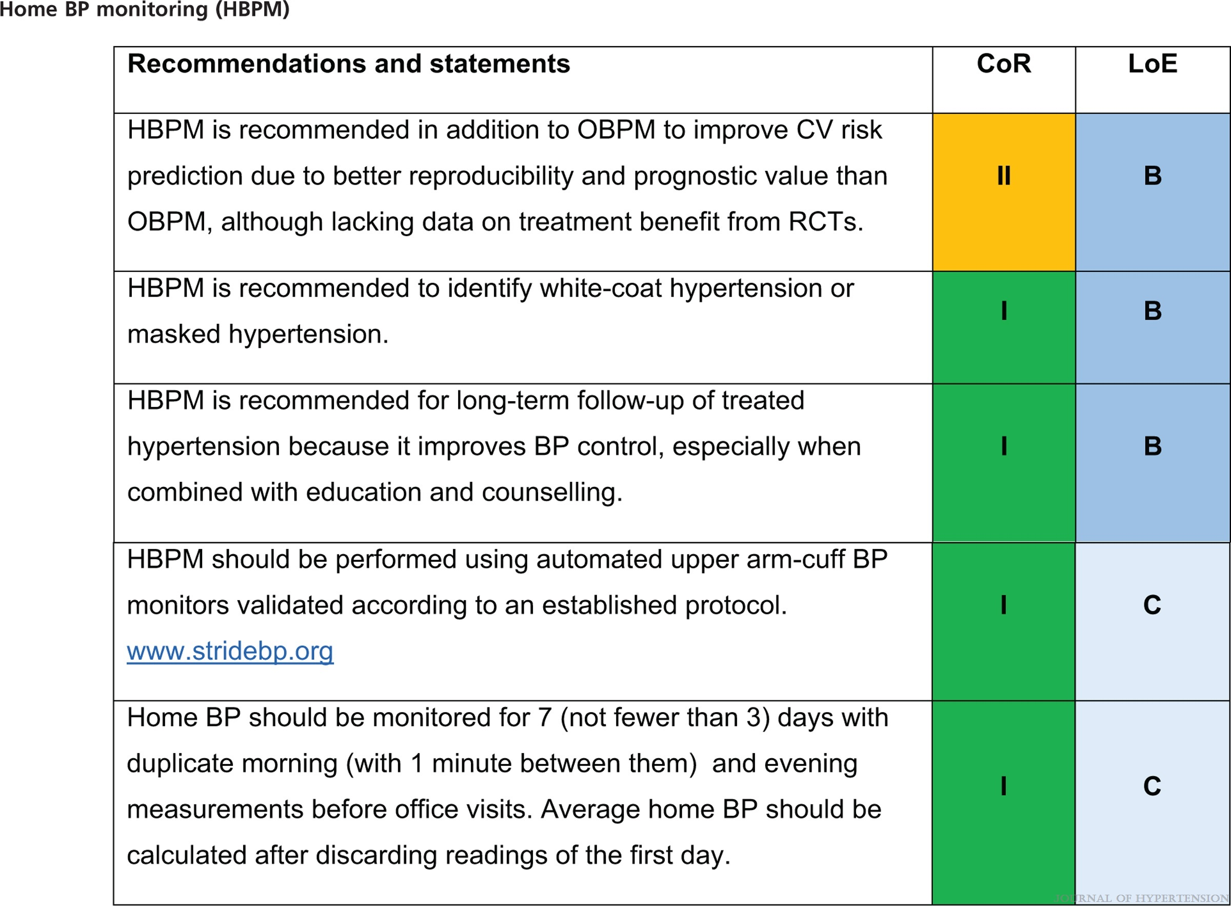
2023 ESH Guidelines for the management of arterial hypertension The Task Force for the management of arterial hypertension of the European Society of Hypertension Endorsed by the European Renal Association (ERA) and the International Society of Hypertension (ISH)
Mancia(Chairperson), Giuseppe; Kreutz(Co-Chair), Reinhold; Brunström, Mattias; Burnier, Michel; Grassi, Guido; Januszewicz, Andrzej; Muiesan, Maria Lorenza; Tsioufis, Konstantinos; Agabiti-Rosei, Enrico; Algharably, Engi Abd Elhady; Azizi, Michel; Benetos, Athanase; Borghi, Claudio; Hitij, Jana Brguljan; Cifkova, Renata; Coca, Antonio; Cornelissen, Veronique; Cruickshank, Kennedy; Cunha, Pedro G.; Danser, A.H. Jan; de Pinho, Rosa Maria; Delles, Christian; Dominiczak, Anna F.; Dorobantu, Maria; Doumas, Michalis; Fernández-Alfonso, María S.; Halimi, Jean-Michel; Járai, Zoltán; Jelaković, Bojan; Jordan, Jens; Kuznetsova, Tatiana; Laurent, Stephane; Lovic, Dragan; Lurbe, Empar; Mahfoud, Felix; Manolis, Athanasios; Miglinas, Marius; Narkiewicz, Krzystof; Niiranen, Teemu; Palatini, Paolo; Parati, Gianfranco; Pathak, Atul; Persu, Alexandre; Polonia, Jorge; Redon, Josep; Sarafidis, Pantelis; Schmieder, Roland; Spronck, Bart; Stabouli, Stella; Stergiou, George; Taddei, Stefano; Thomopoulos, Costas; Tomaszewski, Maciej; Van de Borne, Philippe; Wanner, Christoph; Weber, Thomas; Williams, Bryan; Zhang, Zhen-Yu; Kjeldsen, Sverre E.
Journal of Hypertension : June 21, 2023
doi: 10.1097/HJH.0000000000003480

Slide 13
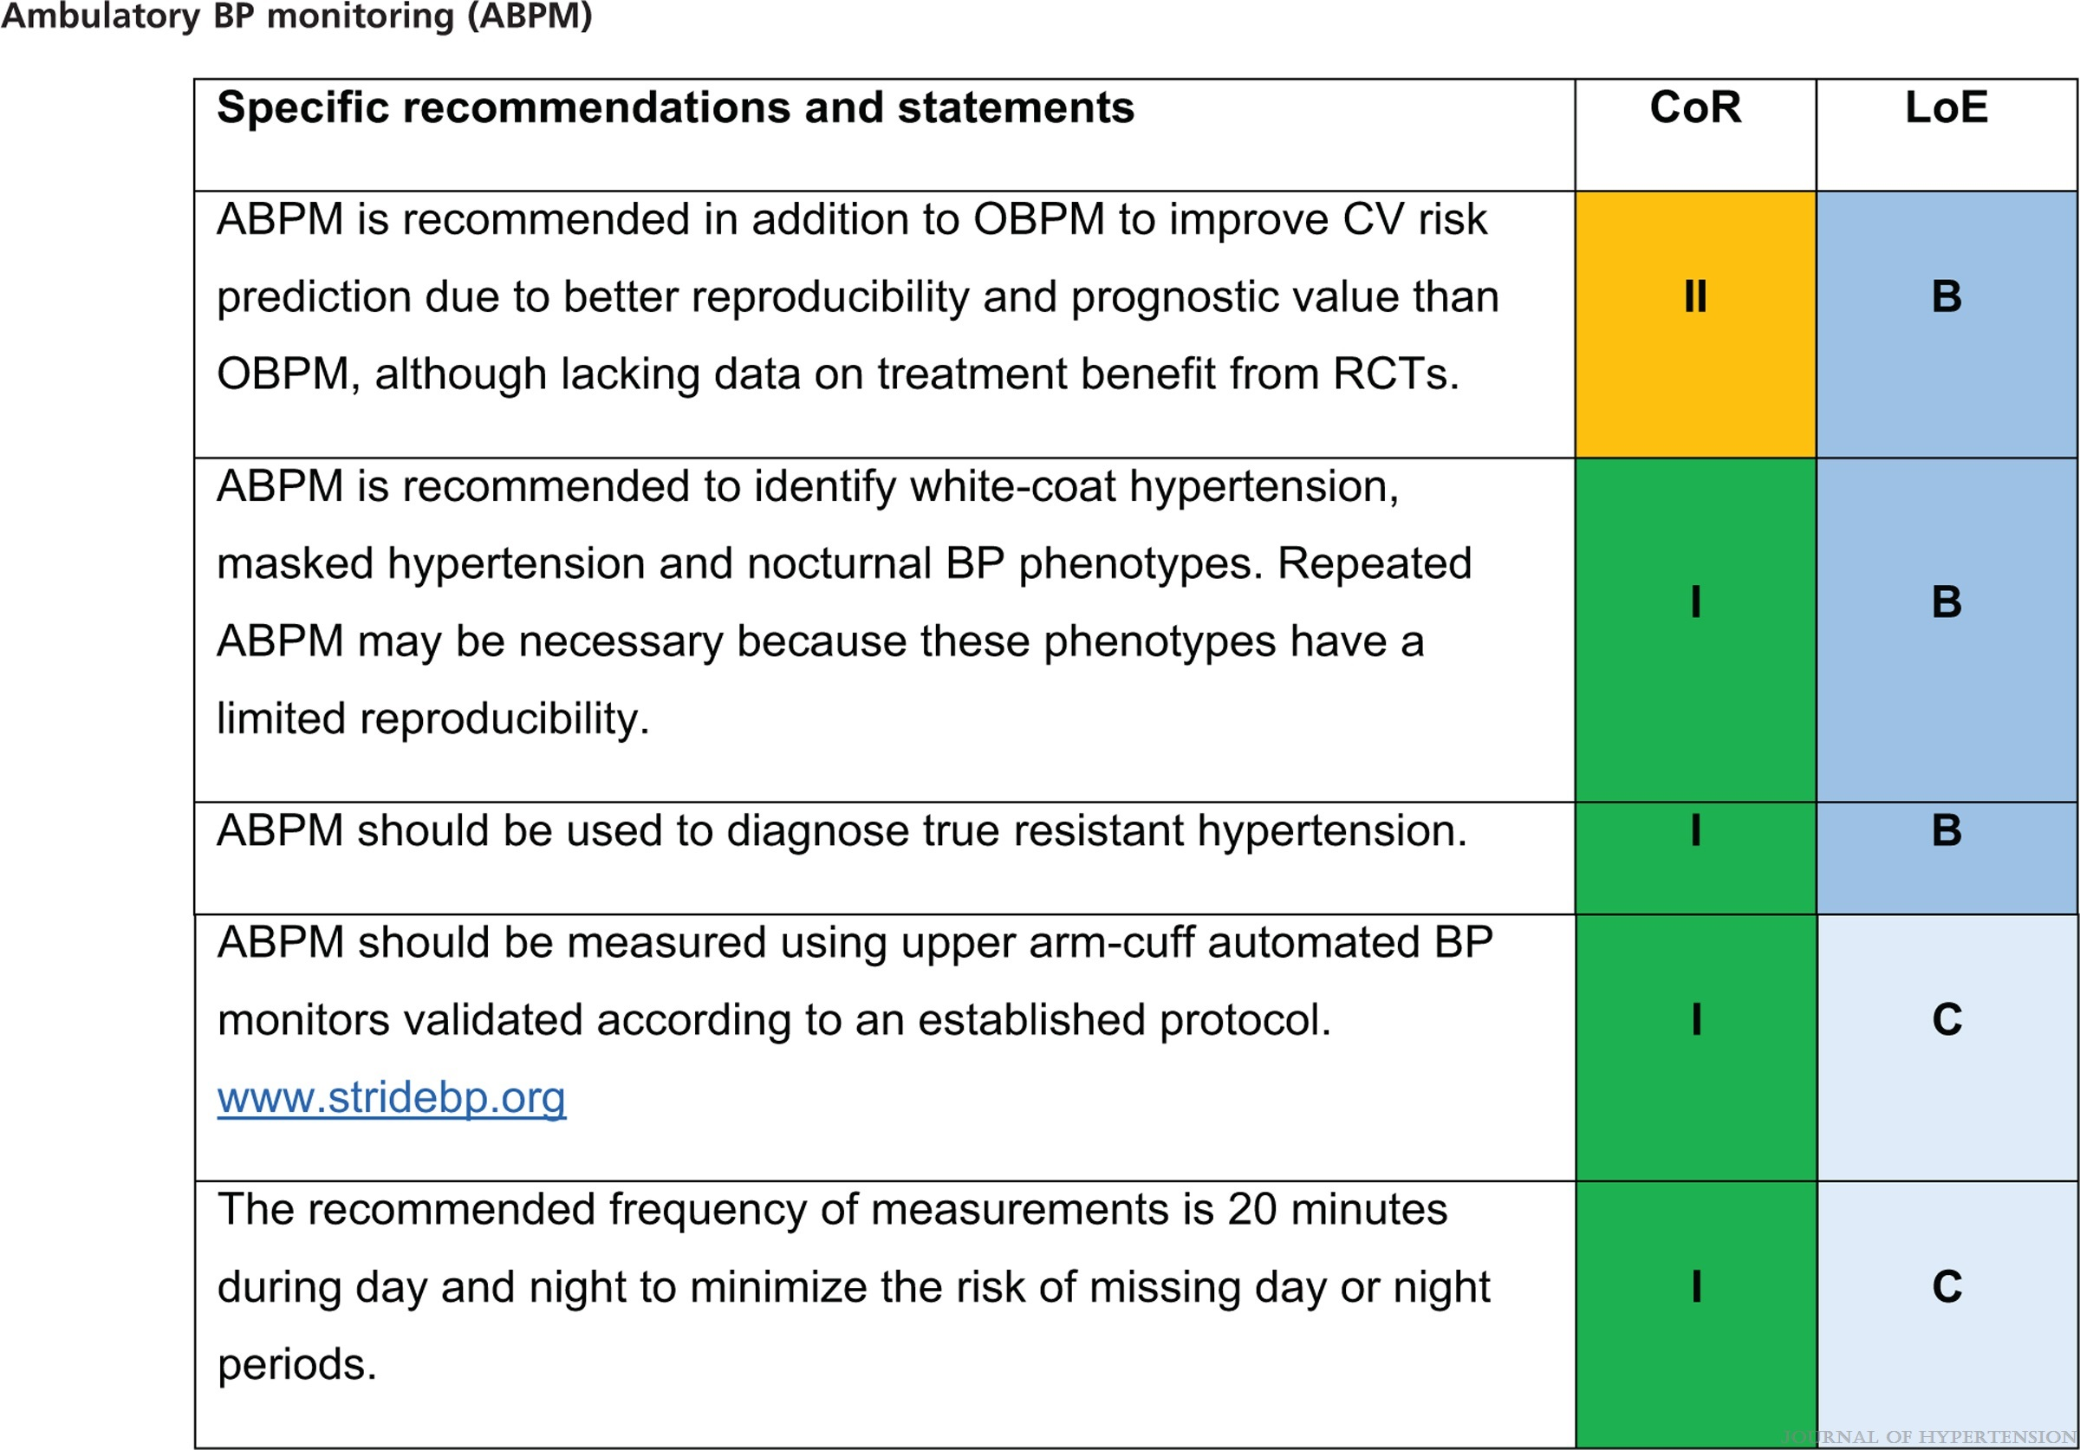
2023 ESH Guidelines for the management of arterial hypertension The Task Force for the management of arterial hypertension of the European Society of Hypertension Endorsed by the European Renal Association (ERA) and the International Society of Hypertension (ISH)
Mancia(Chairperson), Giuseppe; Kreutz(Co-Chair), Reinhold; Brunström, Mattias; Burnier, Michel; Grassi, Guido; Januszewicz, Andrzej; Muiesan, Maria Lorenza; Tsioufis, Konstantinos; Agabiti-Rosei, Enrico; Algharably, Engi Abd Elhady; Azizi, Michel; Benetos, Athanase; Borghi, Claudio; Hitij, Jana Brguljan; Cifkova, Renata; Coca, Antonio; Cornelissen, Veronique; Cruickshank, Kennedy; Cunha, Pedro G.; Danser, A.H. Jan; de Pinho, Rosa Maria; Delles, Christian; Dominiczak, Anna F.; Dorobantu, Maria; Doumas, Michalis; Fernández-Alfonso, María S.; Halimi, Jean-Michel; Járai, Zoltán; Jelaković, Bojan; Jordan, Jens; Kuznetsova, Tatiana; Laurent, Stephane; Lovic, Dragan; Lurbe, Empar; Mahfoud, Felix; Manolis, Athanasios; Miglinas, Marius; Narkiewicz, Krzystof; Niiranen, Teemu; Palatini, Paolo; Parati, Gianfranco; Pathak, Atul; Persu, Alexandre; Polonia, Jorge; Redon, Josep; Sarafidis, Pantelis; Schmieder, Roland; Spronck, Bart; Stabouli, Stella; Stergiou, George; Taddei, Stefano; Thomopoulos, Costas; Tomaszewski, Maciej; Van de Borne, Philippe; Wanner, Christoph; Weber, Thomas; Williams, Bryan; Zhang, Zhen-Yu; Kjeldsen, Sverre E.
Journal of Hypertension : June 21, 2023
doi: 10.1097/HJH.0000000000003480

Slide 14
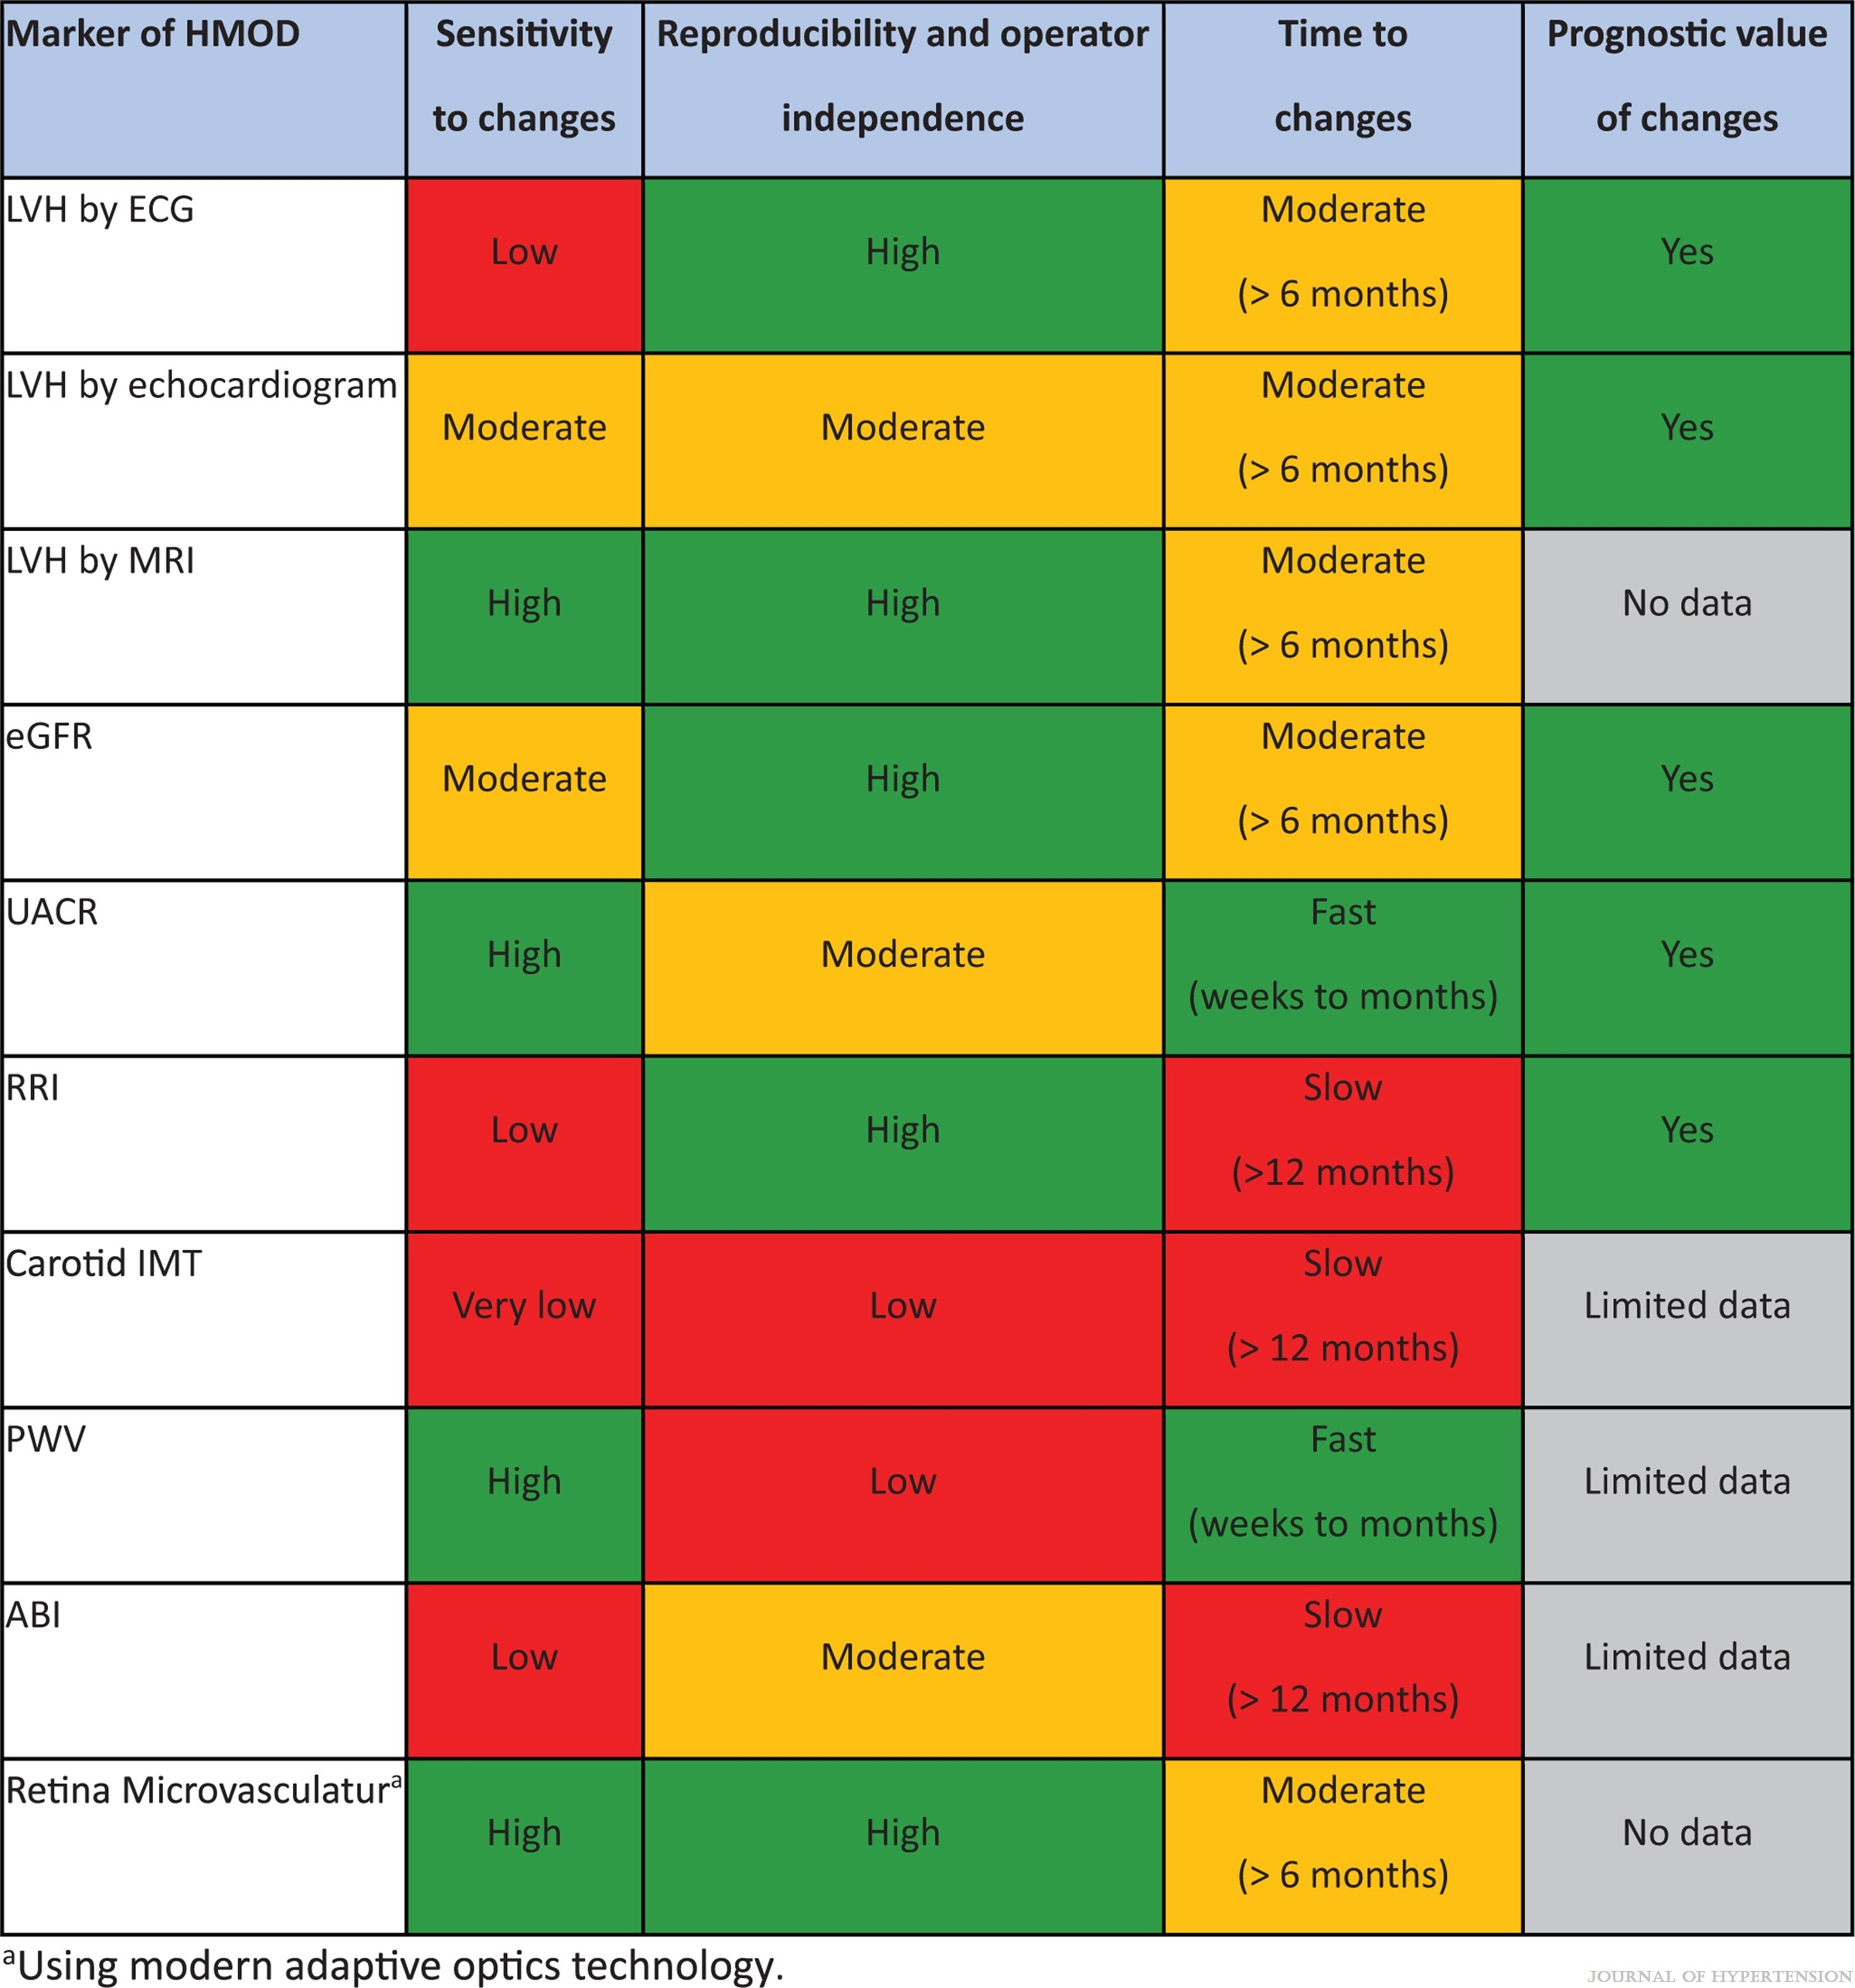
FIGURE 6
2023 ESH Guidelines for the management of arterial hypertension The Task Force for the management of arterial hypertension of the European Society of Hypertension Endorsed by the European Renal Association (ERA) and the International Society of Hypertension (ISH)
Mancia(Chairperson), Giuseppe; Kreutz(Co-Chair), Reinhold; Brunström, Mattias; Burnier, Michel; Grassi, Guido; Januszewicz, Andrzej; Muiesan, Maria Lorenza; Tsioufis, Konstantinos; Agabiti-Rosei, Enrico; Algharably, Engi Abd Elhady; Azizi, Michel; Benetos, Athanase; Borghi, Claudio; Hitij, Jana Brguljan; Cifkova, Renata; Coca, Antonio; Cornelissen, Veronique; Cruickshank, Kennedy; Cunha, Pedro G.; Danser, A.H. Jan; de Pinho, Rosa Maria; Delles, Christian; Dominiczak, Anna F.; Dorobantu, Maria; Doumas, Michalis; Fernández-Alfonso, María S.; Halimi, Jean-Michel; Járai, Zoltán; Jelaković, Bojan; Jordan, Jens; Kuznetsova, Tatiana; Laurent, Stephane; Lovic, Dragan; Lurbe, Empar; Mahfoud, Felix; Manolis, Athanasios; Miglinas, Marius; Narkiewicz, Krzystof; Niiranen, Teemu; Palatini, Paolo; Parati, Gianfranco; Pathak, Atul; Persu, Alexandre; Polonia, Jorge; Redon, Josep; Sarafidis, Pantelis; Schmieder, Roland; Spronck, Bart; Stabouli, Stella; Stergiou, George; Taddei, Stefano; Thomopoulos, Costas; Tomaszewski, Maciej; Van de Borne, Philippe; Wanner, Christoph; Weber, Thomas; Williams, Bryan; Zhang, Zhen-Yu; Kjeldsen, Sverre E.
Journal of Hypertension : June 21, 2023
doi: 10.1097/HJH.0000000000003480
Characteristics of the most frequent markers of HMOD in hypertension. aUsing modern adaptive optics technology.

Slide 15
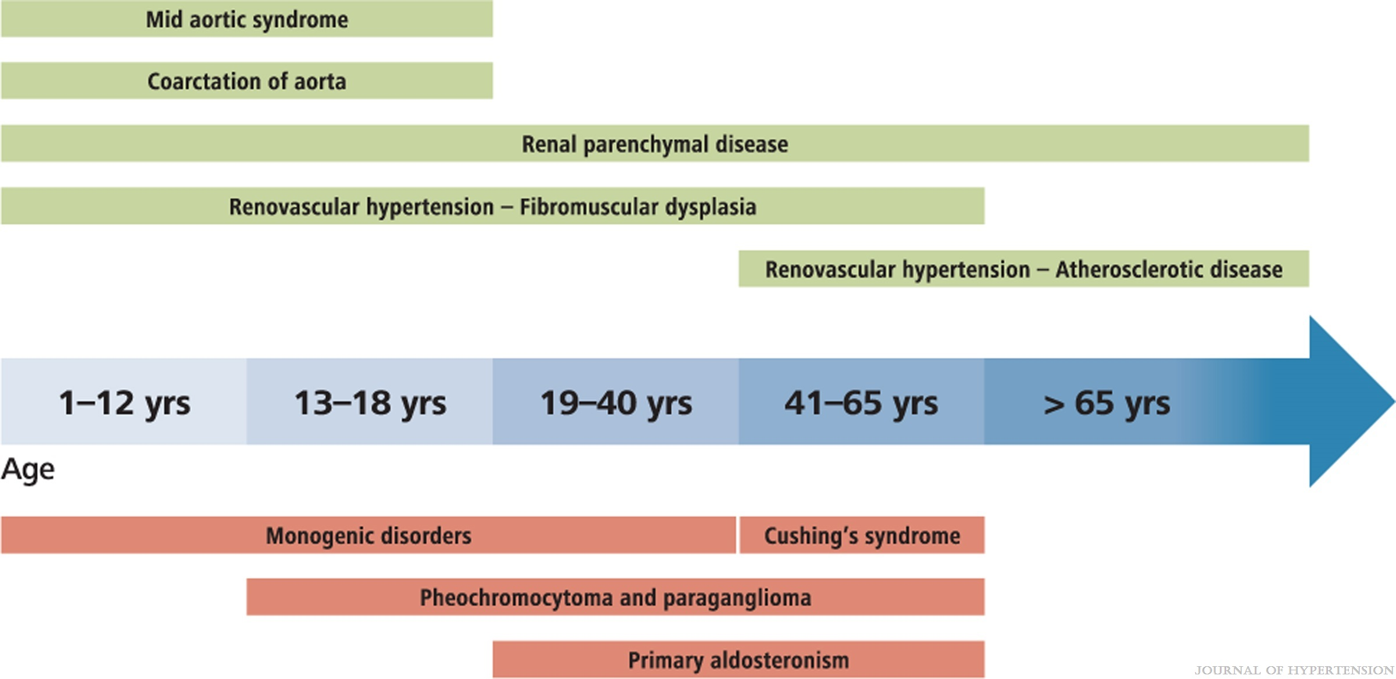
FIGURE 7
2023 ESH Guidelines for the management of arterial hypertension The Task Force for the management of arterial hypertension of the European Society of Hypertension Endorsed by the European Renal Association (ERA) and the International Society of Hypertension (ISH)
Mancia(Chairperson), Giuseppe; Kreutz(Co-Chair), Reinhold; Brunström, Mattias; Burnier, Michel; Grassi, Guido; Januszewicz, Andrzej; Muiesan, Maria Lorenza; Tsioufis, Konstantinos; Agabiti-Rosei, Enrico; Algharably, Engi Abd Elhady; Azizi, Michel; Benetos, Athanase; Borghi, Claudio; Hitij, Jana Brguljan; Cifkova, Renata; Coca, Antonio; Cornelissen, Veronique; Cruickshank, Kennedy; Cunha, Pedro G.; Danser, A.H. Jan; de Pinho, Rosa Maria; Delles, Christian; Dominiczak, Anna F.; Dorobantu, Maria; Doumas, Michalis; Fernández-Alfonso, María S.; Halimi, Jean-Michel; Járai, Zoltán; Jelaković, Bojan; Jordan, Jens; Kuznetsova, Tatiana; Laurent, Stephane; Lovic, Dragan; Lurbe, Empar; Mahfoud, Felix; Manolis, Athanasios; Miglinas, Marius; Narkiewicz, Krzystof; Niiranen, Teemu; Palatini, Paolo; Parati, Gianfranco; Pathak, Atul; Persu, Alexandre; Polonia, Jorge; Redon, Josep; Sarafidis, Pantelis; Schmieder, Roland; Spronck, Bart; Stabouli, Stella; Stergiou, George; Taddei, Stefano; Thomopoulos, Costas; Tomaszewski, Maciej; Van de Borne, Philippe; Wanner, Christoph; Weber, Thomas; Williams, Bryan; Zhang, Zhen-Yu; Kjeldsen, Sverre E.
Journal of Hypertension : June 21, 2023
doi: 10.1097/HJH.0000000000003480
Incidence of selected forms of secondary hypertension according to age.

Slide 16
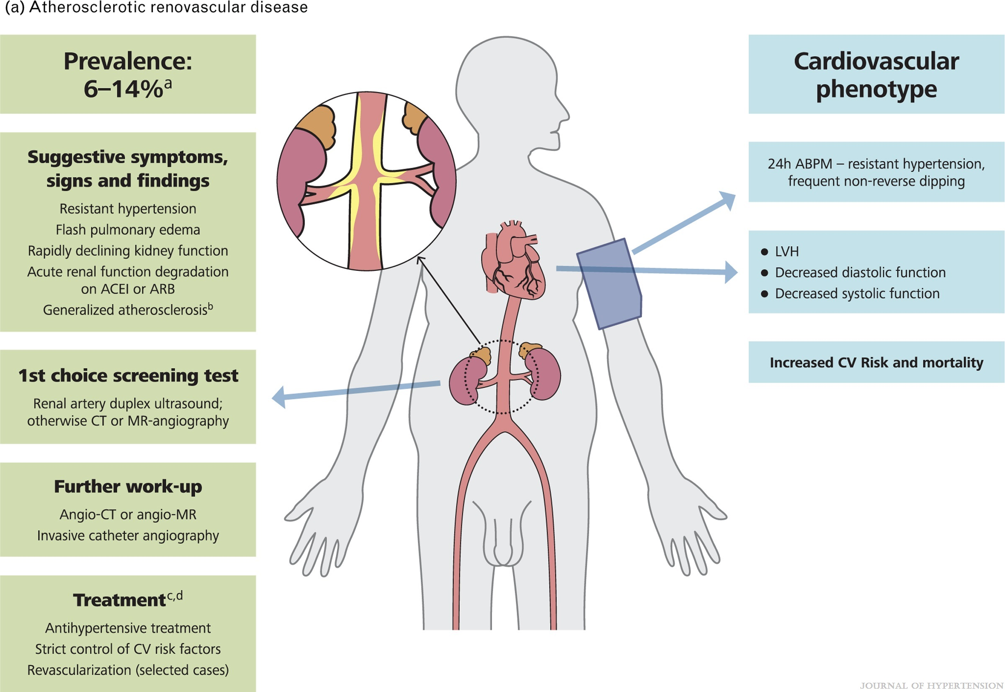
FIGURE 8
2023 ESH Guidelines for the management of arterial hypertension The Task Force for the management of arterial hypertension of the European Society of Hypertension Endorsed by the European Renal Association (ERA) and the International Society of Hypertension (ISH)
Mancia(Chairperson), Giuseppe; Kreutz(Co-Chair), Reinhold; Brunström, Mattias; Burnier, Michel; Grassi, Guido; Januszewicz, Andrzej; Muiesan, Maria Lorenza; Tsioufis, Konstantinos; Agabiti-Rosei, Enrico; Algharably, Engi Abd Elhady; Azizi, Michel; Benetos, Athanase; Borghi, Claudio; Hitij, Jana Brguljan; Cifkova, Renata; Coca, Antonio; Cornelissen, Veronique; Cruickshank, Kennedy; Cunha, Pedro G.; Danser, A.H. Jan; de Pinho, Rosa Maria; Delles, Christian; Dominiczak, Anna F.; Dorobantu, Maria; Doumas, Michalis; Fernández-Alfonso, María S.; Halimi, Jean-Michel; Járai, Zoltán; Jelaković, Bojan; Jordan, Jens; Kuznetsova, Tatiana; Laurent, Stephane; Lovic, Dragan; Lurbe, Empar; Mahfoud, Felix; Manolis, Athanasios; Miglinas, Marius; Narkiewicz, Krzystof; Niiranen, Teemu; Palatini, Paolo; Parati, Gianfranco; Pathak, Atul; Persu, Alexandre; Polonia, Jorge; Redon, Josep; Sarafidis, Pantelis; Schmieder, Roland; Spronck, Bart; Stabouli, Stella; Stergiou, George; Taddei, Stefano; Thomopoulos, Costas; Tomaszewski, Maciej; Van de Borne, Philippe; Wanner, Christoph; Weber, Thomas; Williams, Bryan; Zhang, Zhen-Yu; Kjeldsen, Sverre E.
Journal of Hypertension : June 21, 2023
doi: 10.1097/HJH.0000000000003480
A Atherosclerotic renovascular disease (ARVD). (a) The prevalence of ARVD differs considerably between studied populations – in a population-based cohort >65 years of age, ARVD (defined as >60% stenosis) was identified in 6.8%. Among hypertensives, the prevalence of ARVD is probably around 1% in patients with mild hypertension, but may be as high as 14%–24% in patients with severe or resistant hypertension. (b) In view of the frequent association with atherosclerotic lesions in other arterial beds, a cardiovascular work-up should be considered. (c) Medical management of ARVD should aim to reduction of CV risk and protection of kidney function; hypertension control is a prominent goal. With regard to antihypertensive treatment, an ACEI or an ARB are considered as first-line option (contraindicated in bilateral renal artery stenosis or stenosis in a solitary kidney). (d) Observational data showed that renal artery stenting in addition to medical therapy is associated with renal and CV benefits in patients presenting with high-risk ARVD phenotypes – resistant hypertension, recurrent pulmonary oedema, heart failure and deterioration of kidney function.

Slide 17
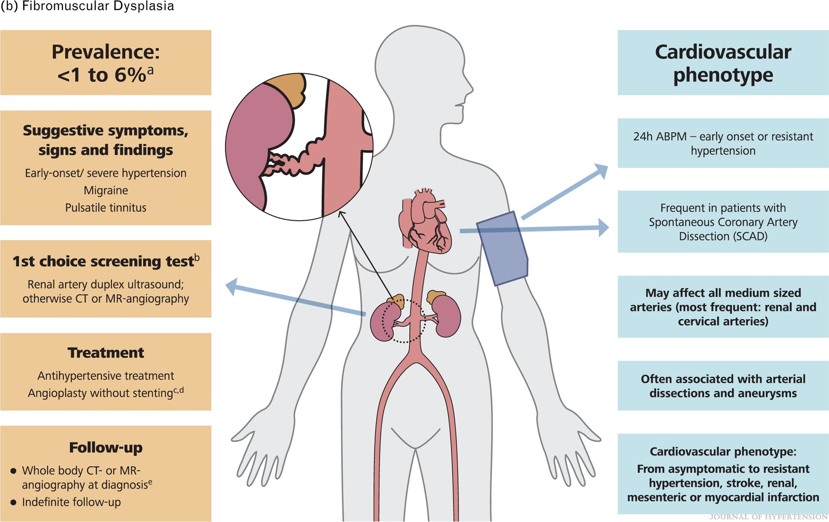
FIGURE 8
2023 ESH Guidelines for the management of arterial hypertension The Task Force for the management of arterial hypertension of the European Society of Hypertension Endorsed by the European Renal Association (ERA) and the International Society of Hypertension (ISH)
Mancia(Chairperson), Giuseppe; Kreutz(Co-Chair), Reinhold; Brunström, Mattias; Burnier, Michel; Grassi, Guido; Januszewicz, Andrzej; Muiesan, Maria Lorenza; Tsioufis, Konstantinos; Agabiti-Rosei, Enrico; Algharably, Engi Abd Elhady; Azizi, Michel; Benetos, Athanase; Borghi, Claudio; Hitij, Jana Brguljan; Cifkova, Renata; Coca, Antonio; Cornelissen, Veronique; Cruickshank, Kennedy; Cunha, Pedro G.; Danser, A.H. Jan; de Pinho, Rosa Maria; Delles, Christian; Dominiczak, Anna F.; Dorobantu, Maria; Doumas, Michalis; Fernández-Alfonso, María S.; Halimi, Jean-Michel; Járai, Zoltán; Jelaković, Bojan; Jordan, Jens; Kuznetsova, Tatiana; Laurent, Stephane; Lovic, Dragan; Lurbe, Empar; Mahfoud, Felix; Manolis, Athanasios; Miglinas, Marius; Narkiewicz, Krzystof; Niiranen, Teemu; Palatini, Paolo; Parati, Gianfranco; Pathak, Atul; Persu, Alexandre; Polonia, Jorge; Redon, Josep; Sarafidis, Pantelis; Schmieder, Roland; Spronck, Bart; Stabouli, Stella; Stergiou, George; Taddei, Stefano; Thomopoulos, Costas; Tomaszewski, Maciej; Van de Borne, Philippe; Wanner, Christoph; Weber, Thomas; Williams, Bryan; Zhang, Zhen-Yu; Kjeldsen, Sverre E.
Journal of Hypertension : June 21, 2023
doi: 10.1097/HJH.0000000000003480
B Fibromuscular Dysplasia (FMD). (a) FMD occurs predominantly in young or middle-aged women. However it may be diagnosed at any age, both in women and men. Renal FMD is the second cause of renovascular hypertension after atherosclerotic renal artery stenosis. (b) Two subtypes of FMD have been described: multifocal FMD (80–90% of cases) and focal FMD (10–20% of cases). The characteristic lesion of multifocal FMD is the “string of beads”, characterized by alternating areas of stenosis and dilatation in the mid and distal portions of the artery. Focal FMD is characterized by focal stenosis of variable length, which may occur in any part of the artery and requires exclusion of atherosclerosis, inflammatory or genetic arteriopathies. (c) In a meta-analysis, the rate of cure of hypertension after angioplasty was 36% (range 14–85%) but may be much higher in younger patients with recent onset hypertension. Angioplasty deserves also to be considered in patients with renal FMD and resistant hypertension. (d) Stent kinking and fracture have been reported in the setting of renal FMD. Accordingly, stenting is usually not recommended in renal FMD and reserved for treatment of flow-limiting per-procedural dissection or in case of renal artery aneurysm. (e) In over 50% of cases, patients with renal FMD have lesions in one or more other arterial beds (multivessel FMD). Patients with FMD also often have arterial dissections, aneurysms or marked arterial tortuosity. For these reasons, it is recommended to perform at least once a life-time from head to pelvis angio CT or if contra-indicated MR-angiography in all patients with FMD.

Slide 18
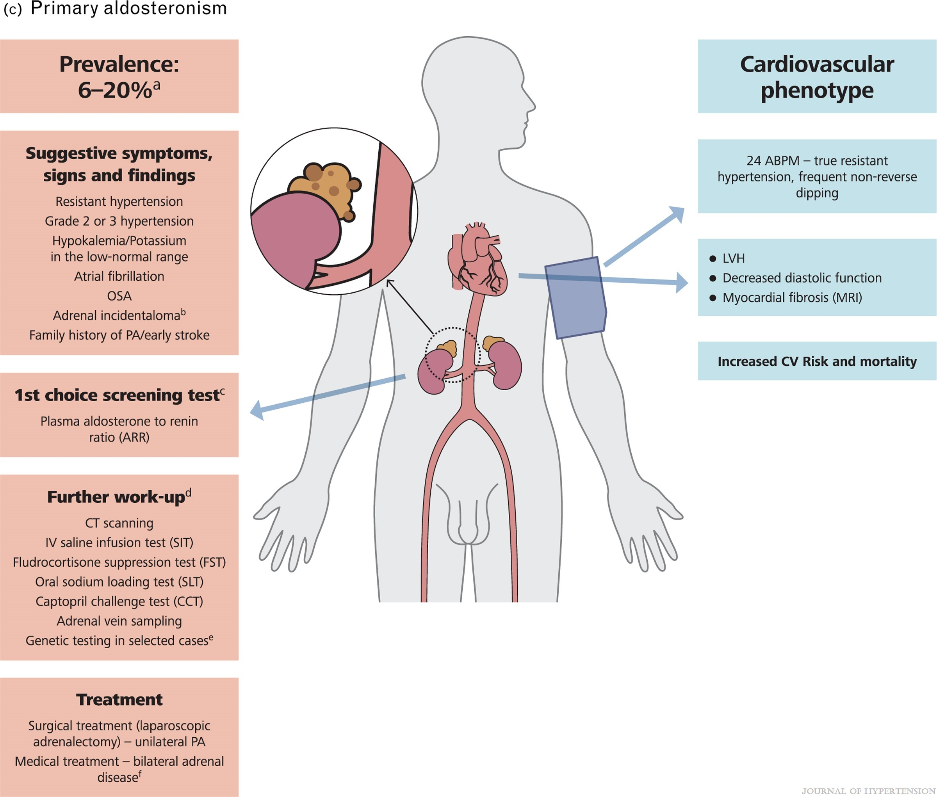
FIGURE 8
2023 ESH Guidelines for the management of arterial hypertension The Task Force for the management of arterial hypertension of the European Society of Hypertension Endorsed by the European Renal Association (ERA) and the International Society of Hypertension (ISH)
Mancia(Chairperson), Giuseppe; Kreutz(Co-Chair), Reinhold; Brunström, Mattias; Burnier, Michel; Grassi, Guido; Januszewicz, Andrzej; Muiesan, Maria Lorenza; Tsioufis, Konstantinos; Agabiti-Rosei, Enrico; Algharably, Engi Abd Elhady; Azizi, Michel; Benetos, Athanase; Borghi, Claudio; Hitij, Jana Brguljan; Cifkova, Renata; Coca, Antonio; Cornelissen, Veronique; Cruickshank, Kennedy; Cunha, Pedro G.; Danser, A.H. Jan; de Pinho, Rosa Maria; Delles, Christian; Dominiczak, Anna F.; Dorobantu, Maria; Doumas, Michalis; Fernández-Alfonso, María S.; Halimi, Jean-Michel; Járai, Zoltán; Jelaković, Bojan; Jordan, Jens; Kuznetsova, Tatiana; Laurent, Stephane; Lovic, Dragan; Lurbe, Empar; Mahfoud, Felix; Manolis, Athanasios; Miglinas, Marius; Narkiewicz, Krzystof; Niiranen, Teemu; Palatini, Paolo; Parati, Gianfranco; Pathak, Atul; Persu, Alexandre; Polonia, Jorge; Redon, Josep; Sarafidis, Pantelis; Schmieder, Roland; Spronck, Bart; Stabouli, Stella; Stergiou, George; Taddei, Stefano; Thomopoulos, Costas; Tomaszewski, Maciej; Van de Borne, Philippe; Wanner, Christoph; Weber, Thomas; Williams, Bryan; Zhang, Zhen-Yu; Kjeldsen, Sverre E.
Journal of Hypertension : June 21, 2023
doi: 10.1097/HJH.0000000000003480
C Primary aldosteronism (PA). (a) Depends on the population screened – ranges from 3.2% to 12.7% in primary practice and from 1% to 30% in referral centers; prevalence increases with the severity of hypertension to 20%. (b) PA prevalence in patients with adrenal incidentaloma ranges from 1.6% to 4.3%. (c) ARR requires at least normalization of plasma potassium and interruption of existing treatment with spironolactone and beta-blockers. (d) Overall, seated SIT appears reliable and less complicated than FST and SLT. CCT may be a good alternative in patients at risk of potential fluid overload (patients with kidney failure or HF). (e) Although the majority of primary aldosteronism cases are sporadic, up to 5% of patients may have a familial form of the disease. Genetic testing should be performed in all patients with early onset primary aldosteronism (i.e. <20 years of age), irrespective of the severity of the clinical phenotype, and in patients with a family history of primary aldosteronism. (f) Steroidal MRAs are the treatment of choice for primary aldosteronism in patients with bilateral adrenal disease or unilateral disease that cannot be surgically treated.

Slide 19
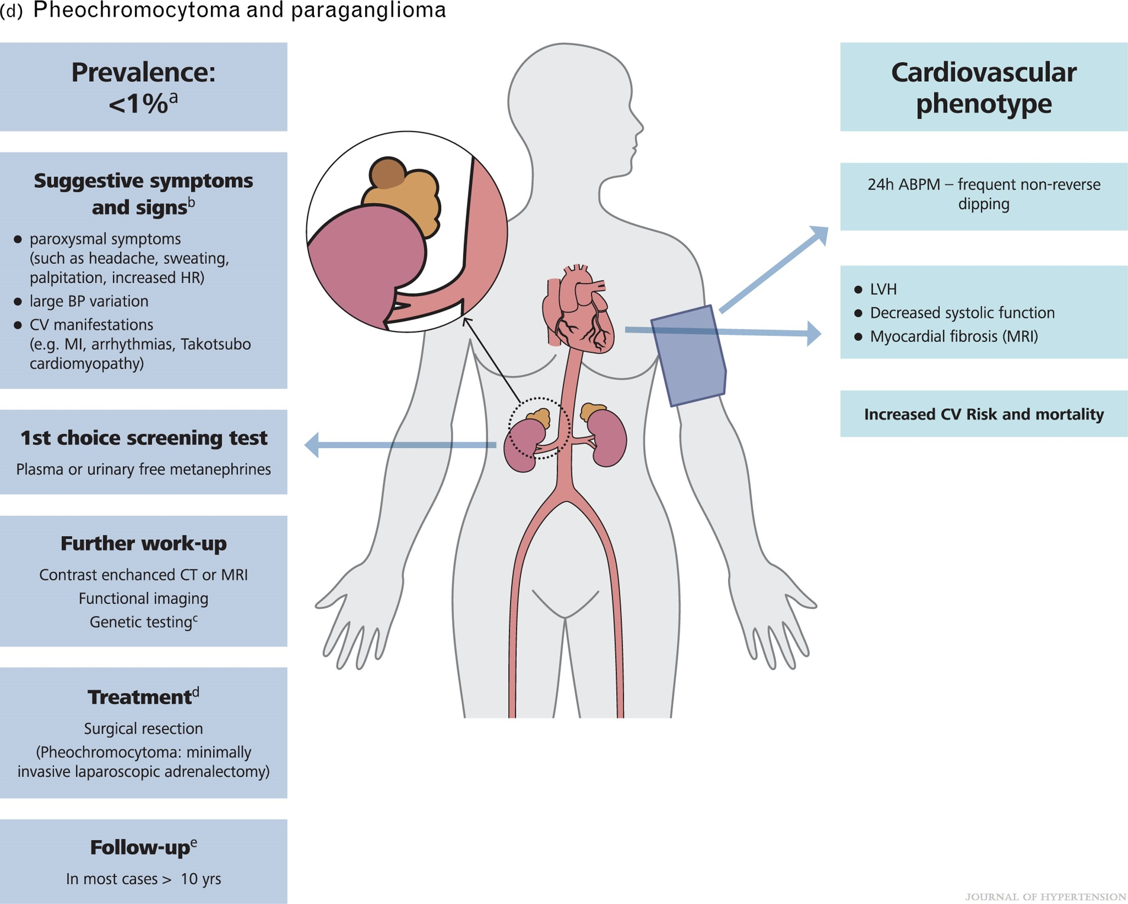
FIGURE 8
2023 ESH Guidelines for the management of arterial hypertension The Task Force for the management of arterial hypertension of the European Society of Hypertension Endorsed by the European Renal Association (ERA) and the International Society of Hypertension (ISH)
Mancia(Chairperson), Giuseppe; Kreutz(Co-Chair), Reinhold; Brunström, Mattias; Burnier, Michel; Grassi, Guido; Januszewicz, Andrzej; Muiesan, Maria Lorenza; Tsioufis, Konstantinos; Agabiti-Rosei, Enrico; Algharably, Engi Abd Elhady; Azizi, Michel; Benetos, Athanase; Borghi, Claudio; Hitij, Jana Brguljan; Cifkova, Renata; Coca, Antonio; Cornelissen, Veronique; Cruickshank, Kennedy; Cunha, Pedro G.; Danser, A.H. Jan; de Pinho, Rosa Maria; Delles, Christian; Dominiczak, Anna F.; Dorobantu, Maria; Doumas, Michalis; Fernández-Alfonso, María S.; Halimi, Jean-Michel; Járai, Zoltán; Jelaković, Bojan; Jordan, Jens; Kuznetsova, Tatiana; Laurent, Stephane; Lovic, Dragan; Lurbe, Empar; Mahfoud, Felix; Manolis, Athanasios; Miglinas, Marius; Narkiewicz, Krzystof; Niiranen, Teemu; Palatini, Paolo; Parati, Gianfranco; Pathak, Atul; Persu, Alexandre; Polonia, Jorge; Redon, Josep; Sarafidis, Pantelis; Schmieder, Roland; Spronck, Bart; Stabouli, Stella; Stergiou, George; Taddei, Stefano; Thomopoulos, Costas; Tomaszewski, Maciej; Van de Borne, Philippe; Wanner, Christoph; Weber, Thomas; Williams, Bryan; Zhang, Zhen-Yu; Kjeldsen, Sverre E.
Journal of Hypertension : June 21, 2023
doi: 10.1097/HJH.0000000000003480
D Pheochromocytoma and paraganglioma (PPGL). (a) Varying from 0.2% to 0.6% in hypertensive patients to less than 0.05% in the general population. (b) These symptoms are most commonly reported whereas other (pallor, tremor, nausea, panic/anxiety) occur at a much lower frequency. (c) Routine genetic testing is recommended in all PPGL. The most frequently involved genes include SDHB, SDHD, VHL, RET and NF1. PPGL in patients with a known SDHB mutation do carry higher malignant potential and so require close follow-up with regular imaging and biochemical screening. (d) Presurgical medical preparation using an alpha-1 receptor blocker (doxazosin or phenoxybenzamine) as first choice is always required for preventing life-threatening perioperative cardiovascular complications. (e) All patients operated for a PPGL should be followed up annually for at least 10 years. The first follow-up should be at 2–6 weeks after surgery to verify completeness of surgical resection.

Slide 20
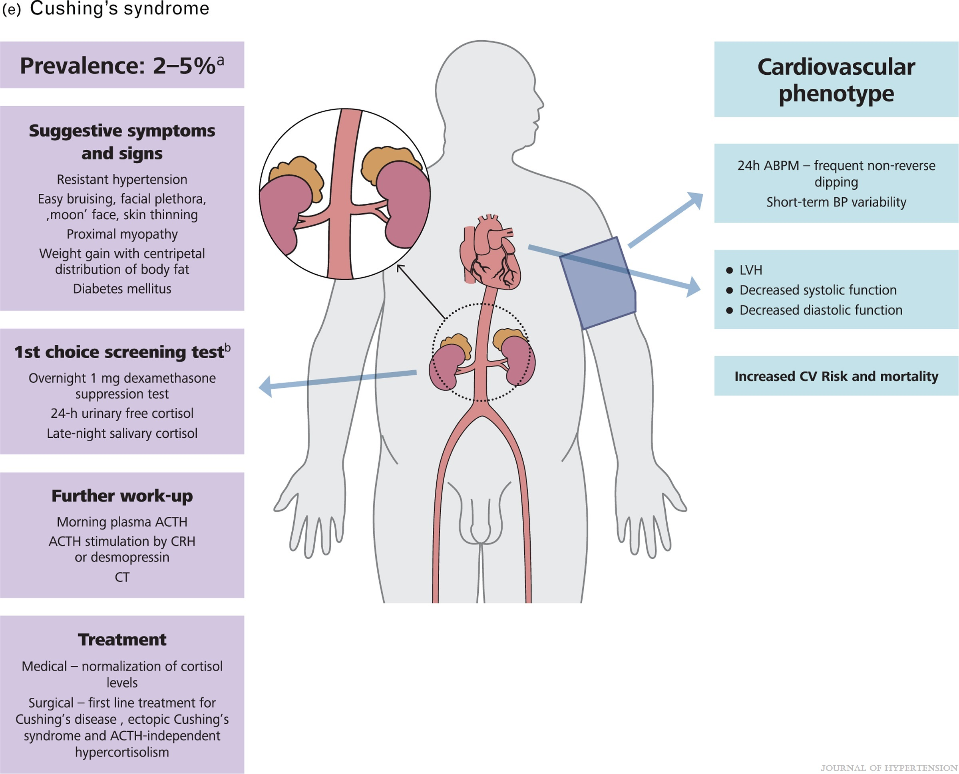
FIGURE 8
2023 ESH Guidelines for the management of arterial hypertension The Task Force for the management of arterial hypertension of the European Society of Hypertension Endorsed by the European Renal Association (ERA) and the International Society of Hypertension (ISH)
Mancia(Chairperson), Giuseppe; Kreutz(Co-Chair), Reinhold; Brunström, Mattias; Burnier, Michel; Grassi, Guido; Januszewicz, Andrzej; Muiesan, Maria Lorenza; Tsioufis, Konstantinos; Agabiti-Rosei, Enrico; Algharably, Engi Abd Elhady; Azizi, Michel; Benetos, Athanase; Borghi, Claudio; Hitij, Jana Brguljan; Cifkova, Renata; Coca, Antonio; Cornelissen, Veronique; Cruickshank, Kennedy; Cunha, Pedro G.; Danser, A.H. Jan; de Pinho, Rosa Maria; Delles, Christian; Dominiczak, Anna F.; Dorobantu, Maria; Doumas, Michalis; Fernández-Alfonso, María S.; Halimi, Jean-Michel; Járai, Zoltán; Jelaković, Bojan; Jordan, Jens; Kuznetsova, Tatiana; Laurent, Stephane; Lovic, Dragan; Lurbe, Empar; Mahfoud, Felix; Manolis, Athanasios; Miglinas, Marius; Narkiewicz, Krzystof; Niiranen, Teemu; Palatini, Paolo; Parati, Gianfranco; Pathak, Atul; Persu, Alexandre; Polonia, Jorge; Redon, Josep; Sarafidis, Pantelis; Schmieder, Roland; Spronck, Bart; Stabouli, Stella; Stergiou, George; Taddei, Stefano; Thomopoulos, Costas; Tomaszewski, Maciej; Van de Borne, Philippe; Wanner, Christoph; Weber, Thomas; Williams, Bryan; Zhang, Zhen-Yu; Kjeldsen, Sverre E.
Journal of Hypertension : June 21, 2023
doi: 10.1097/HJH.0000000000003480
8 E Cushing's syndrome. (a) In specific populations including patients with difficult to control hypertension or type 2 diabetes. The incidence in the general population is 0.7-2.4 per million per year. (b) In case of abnormal initial result of a first screening test, positivity of at least one of the remaining screening tests is required to establish the diagnosis.

Slide 21
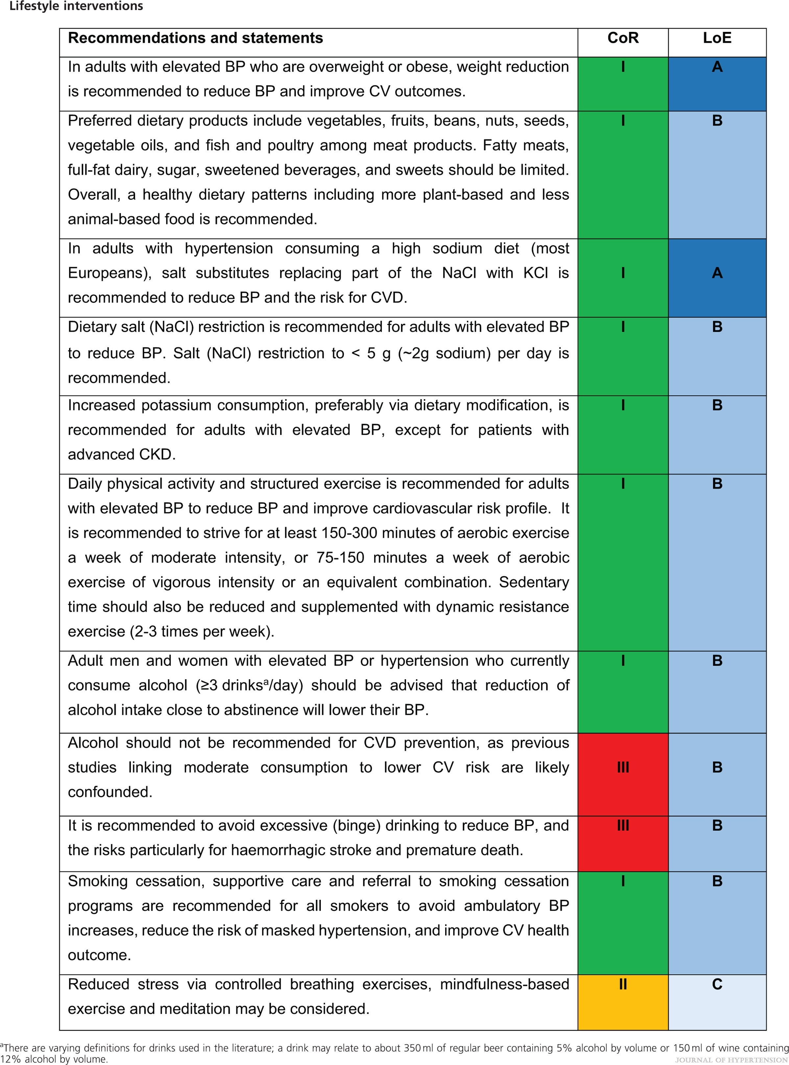
2023 ESH Guidelines for the management of arterial hypertension The Task Force for the management of arterial hypertension of the European Society of Hypertension Endorsed by the European Renal Association (ERA) and the International Society of Hypertension (ISH)
Mancia(Chairperson), Giuseppe; Kreutz(Co-Chair), Reinhold; Brunström, Mattias; Burnier, Michel; Grassi, Guido; Januszewicz, Andrzej; Muiesan, Maria Lorenza; Tsioufis, Konstantinos; Agabiti-Rosei, Enrico; Algharably, Engi Abd Elhady; Azizi, Michel; Benetos, Athanase; Borghi, Claudio; Hitij, Jana Brguljan; Cifkova, Renata; Coca, Antonio; Cornelissen, Veronique; Cruickshank, Kennedy; Cunha, Pedro G.; Danser, A.H. Jan; de Pinho, Rosa Maria; Delles, Christian; Dominiczak, Anna F.; Dorobantu, Maria; Doumas, Michalis; Fernández-Alfonso, María S.; Halimi, Jean-Michel; Járai, Zoltán; Jelaković, Bojan; Jordan, Jens; Kuznetsova, Tatiana; Laurent, Stephane; Lovic, Dragan; Lurbe, Empar; Mahfoud, Felix; Manolis, Athanasios; Miglinas, Marius; Narkiewicz, Krzystof; Niiranen, Teemu; Palatini, Paolo; Parati, Gianfranco; Pathak, Atul; Persu, Alexandre; Polonia, Jorge; Redon, Josep; Sarafidis, Pantelis; Schmieder, Roland; Spronck, Bart; Stabouli, Stella; Stergiou, George; Taddei, Stefano; Thomopoulos, Costas; Tomaszewski, Maciej; Van de Borne, Philippe; Wanner, Christoph; Weber, Thomas; Williams, Bryan; Zhang, Zhen-Yu; Kjeldsen, Sverre E.
Journal of Hypertension : June 21, 2023
doi: 10.1097/HJH.0000000000003480

Slide 22
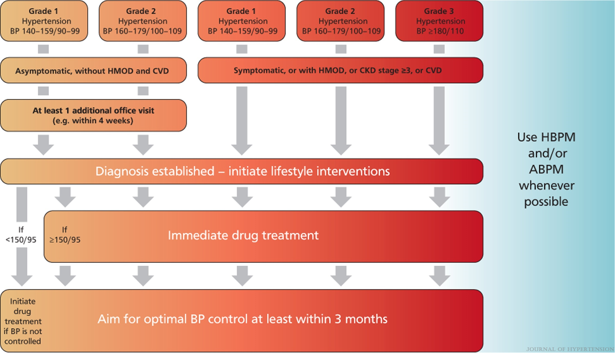
FIGURE 9
2023 ESH Guidelines for the management of arterial hypertension The Task Force for the management of arterial hypertension of the European Society of Hypertension Endorsed by the European Renal Association (ERA) and the International Society of Hypertension (ISH)
Mancia(Chairperson), Giuseppe; Kreutz(Co-Chair), Reinhold; Brunström, Mattias; Burnier, Michel; Grassi, Guido; Januszewicz, Andrzej; Muiesan, Maria Lorenza; Tsioufis, Konstantinos; Agabiti-Rosei, Enrico; Algharably, Engi Abd Elhady; Azizi, Michel; Benetos, Athanase; Borghi, Claudio; Hitij, Jana Brguljan; Cifkova, Renata; Coca, Antonio; Cornelissen, Veronique; Cruickshank, Kennedy; Cunha, Pedro G.; Danser, A.H. Jan; de Pinho, Rosa Maria; Delles, Christian; Dominiczak, Anna F.; Dorobantu, Maria; Doumas, Michalis; Fernández-Alfonso, María S.; Halimi, Jean-Michel; Járai, Zoltán; Jelaković, Bojan; Jordan, Jens; Kuznetsova, Tatiana; Laurent, Stephane; Lovic, Dragan; Lurbe, Empar; Mahfoud, Felix; Manolis, Athanasios; Miglinas, Marius; Narkiewicz, Krzystof; Niiranen, Teemu; Palatini, Paolo; Parati, Gianfranco; Pathak, Atul; Persu, Alexandre; Polonia, Jorge; Redon, Josep; Sarafidis, Pantelis; Schmieder, Roland; Spronck, Bart; Stabouli, Stella; Stergiou, George; Taddei, Stefano; Thomopoulos, Costas; Tomaszewski, Maciej; Van de Borne, Philippe; Wanner, Christoph; Weber, Thomas; Williams, Bryan; Zhang, Zhen-Yu; Kjeldsen, Sverre E.
Journal of Hypertension : June 21, 2023
doi: 10.1097/HJH.0000000000003480
Diagnosis by office BP and initial management of hypertension.

Slide 23
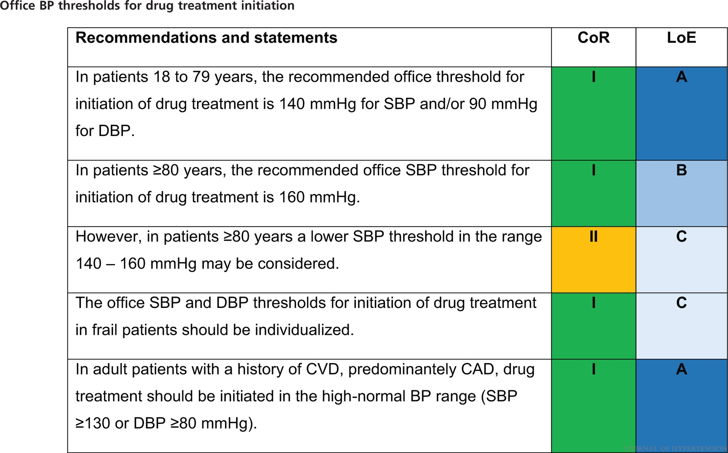
2023 ESH Guidelines for the management of arterial hypertension The Task Force for the management of arterial hypertension of the European Society of Hypertension Endorsed by the European Renal Association (ERA) and the International Society of Hypertension (ISH)
Mancia(Chairperson), Giuseppe; Kreutz(Co-Chair), Reinhold; Brunström, Mattias; Burnier, Michel; Grassi, Guido; Januszewicz, Andrzej; Muiesan, Maria Lorenza; Tsioufis, Konstantinos; Agabiti-Rosei, Enrico; Algharably, Engi Abd Elhady; Azizi, Michel; Benetos, Athanase; Borghi, Claudio; Hitij, Jana Brguljan; Cifkova, Renata; Coca, Antonio; Cornelissen, Veronique; Cruickshank, Kennedy; Cunha, Pedro G.; Danser, A.H. Jan; de Pinho, Rosa Maria; Delles, Christian; Dominiczak, Anna F.; Dorobantu, Maria; Doumas, Michalis; Fernández-Alfonso, María S.; Halimi, Jean-Michel; Járai, Zoltán; Jelaković, Bojan; Jordan, Jens; Kuznetsova, Tatiana; Laurent, Stephane; Lovic, Dragan; Lurbe, Empar; Mahfoud, Felix; Manolis, Athanasios; Miglinas, Marius; Narkiewicz, Krzystof; Niiranen, Teemu; Palatini, Paolo; Parati, Gianfranco; Pathak, Atul; Persu, Alexandre; Polonia, Jorge; Redon, Josep; Sarafidis, Pantelis; Schmieder, Roland; Spronck, Bart; Stabouli, Stella; Stergiou, George; Taddei, Stefano; Thomopoulos, Costas; Tomaszewski, Maciej; Van de Borne, Philippe; Wanner, Christoph; Weber, Thomas; Williams, Bryan; Zhang, Zhen-Yu; Kjeldsen, Sverre E.
Journal of Hypertension : June 21, 2023
doi: 10.1097/HJH.0000000000003480

Slide 24
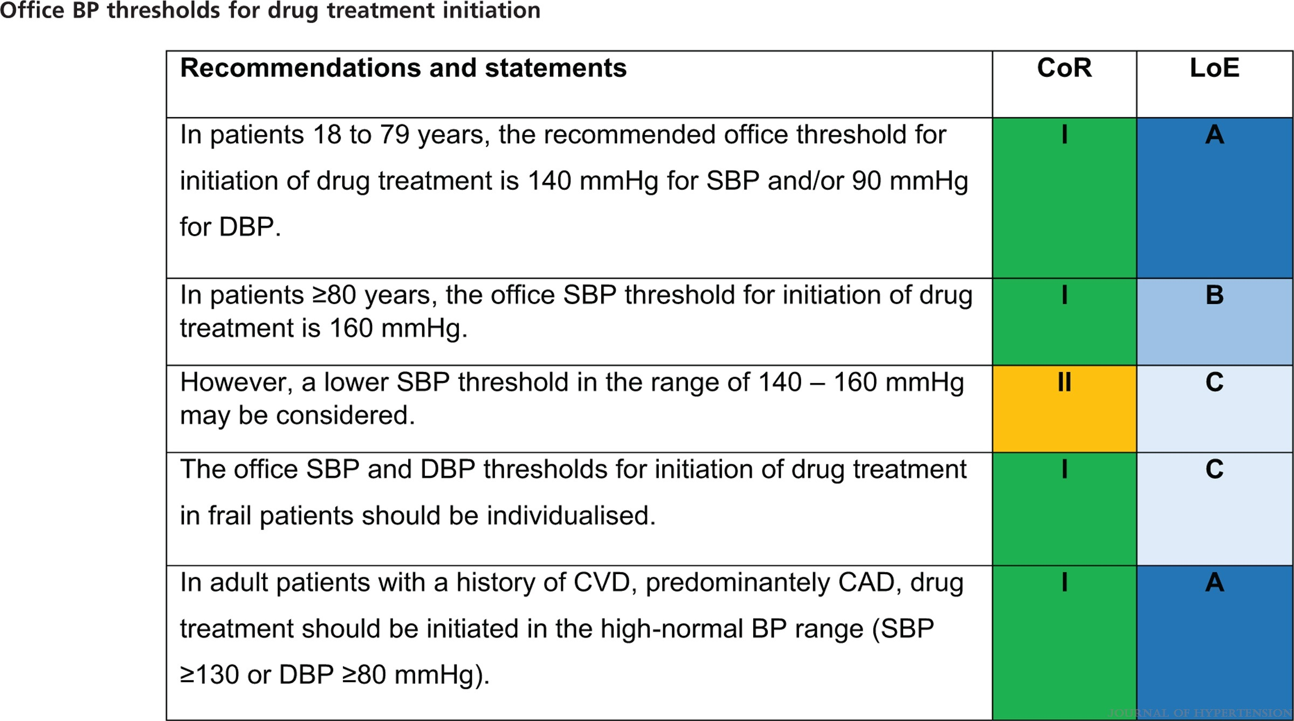
2023 ESH Guidelines for the management of arterial hypertension The Task Force for the management of arterial hypertension of the European Society of Hypertension Endorsed by the European Renal Association (ERA) and the International Society of Hypertension (ISH)
Mancia(Chairperson), Giuseppe; Kreutz(Co-Chair), Reinhold; Brunström, Mattias; Burnier, Michel; Grassi, Guido; Januszewicz, Andrzej; Muiesan, Maria Lorenza; Tsioufis, Konstantinos; Agabiti-Rosei, Enrico; Algharably, Engi Abd Elhady; Azizi, Michel; Benetos, Athanase; Borghi, Claudio; Hitij, Jana Brguljan; Cifkova, Renata; Coca, Antonio; Cornelissen, Veronique; Cruickshank, Kennedy; Cunha, Pedro G.; Danser, A.H. Jan; de Pinho, Rosa Maria; Delles, Christian; Dominiczak, Anna F.; Dorobantu, Maria; Doumas, Michalis; Fernández-Alfonso, María S.; Halimi, Jean-Michel; Járai, Zoltán; Jelaković, Bojan; Jordan, Jens; Kuznetsova, Tatiana; Laurent, Stephane; Lovic, Dragan; Lurbe, Empar; Mahfoud, Felix; Manolis, Athanasios; Miglinas, Marius; Narkiewicz, Krzystof; Niiranen, Teemu; Palatini, Paolo; Parati, Gianfranco; Pathak, Atul; Persu, Alexandre; Polonia, Jorge; Redon, Josep; Sarafidis, Pantelis; Schmieder, Roland; Spronck, Bart; Stabouli, Stella; Stergiou, George; Taddei, Stefano; Thomopoulos, Costas; Tomaszewski, Maciej; Van de Borne, Philippe; Wanner, Christoph; Weber, Thomas; Williams, Bryan; Zhang, Zhen-Yu; Kjeldsen, Sverre E.
Journal of Hypertension : June 21, 2023
doi: 10.1097/HJH.0000000000003480

Slide 25
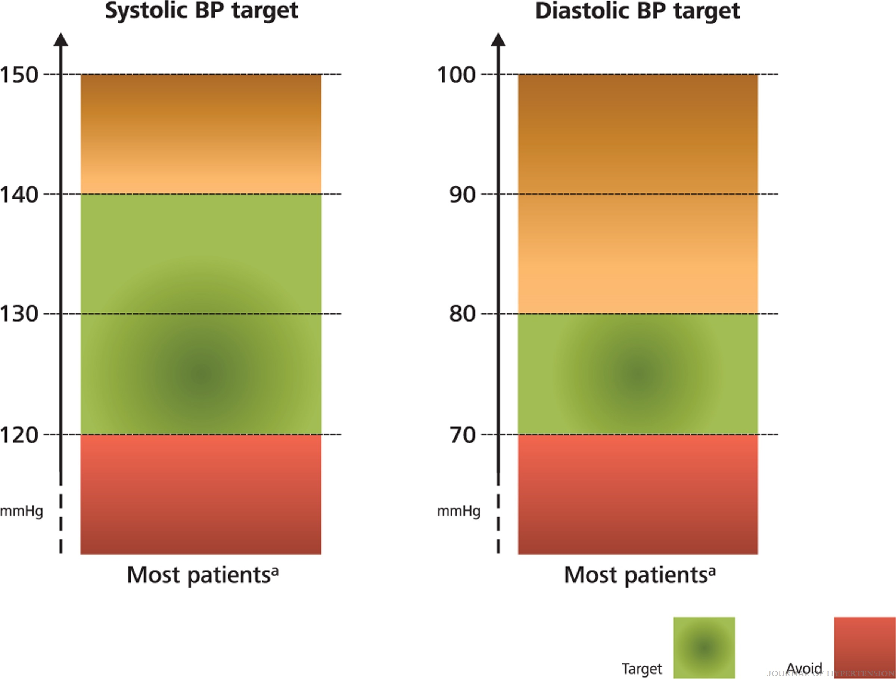
FIGURE 10
2023 ESH Guidelines for the management of arterial hypertension The Task Force for the management of arterial hypertension of the European Society of Hypertension Endorsed by the European Renal Association (ERA) and the International Society of Hypertension (ISH)
Mancia(Chairperson), Giuseppe; Kreutz(Co-Chair), Reinhold; Brunström, Mattias; Burnier, Michel; Grassi, Guido; Januszewicz, Andrzej; Muiesan, Maria Lorenza; Tsioufis, Konstantinos; Agabiti-Rosei, Enrico; Algharably, Engi Abd Elhady; Azizi, Michel; Benetos, Athanase; Borghi, Claudio; Hitij, Jana Brguljan; Cifkova, Renata; Coca, Antonio; Cornelissen, Veronique; Cruickshank, Kennedy; Cunha, Pedro G.; Danser, A.H. Jan; de Pinho, Rosa Maria; Delles, Christian; Dominiczak, Anna F.; Dorobantu, Maria; Doumas, Michalis; Fernández-Alfonso, María S.; Halimi, Jean-Michel; Járai, Zoltán; Jelaković, Bojan; Jordan, Jens; Kuznetsova, Tatiana; Laurent, Stephane; Lovic, Dragan; Lurbe, Empar; Mahfoud, Felix; Manolis, Athanasios; Miglinas, Marius; Narkiewicz, Krzystof; Niiranen, Teemu; Palatini, Paolo; Parati, Gianfranco; Pathak, Atul; Persu, Alexandre; Polonia, Jorge; Redon, Josep; Sarafidis, Pantelis; Schmieder, Roland; Spronck, Bart; Stabouli, Stella; Stergiou, George; Taddei, Stefano; Thomopoulos, Costas; Tomaszewski, Maciej; Van de Borne, Philippe; Wanner, Christoph; Weber, Thomas; Williams, Bryan; Zhang, Zhen-Yu; Kjeldsen, Sverre E.
Journal of Hypertension : June 21, 2023
doi: 10.1097/HJH.0000000000003480
Office BP targets in the general adult hypertensive population.aThe first objective of antihypertensive treatment should be to lower BP to <140/80 mmHg in most patients, because this accounts for the major portion of the protective effect of BP-lowering.aIf drug treatment is well tolerated, treated SBP values should be targeted to 130 mmHg or lower in most patients up to 79 years old.aDespite the smaller incremental benefit, an effort should be made to reach a BP range of 120–129/70–79 mmHg in patients up to 79 years old, but only if treatment is well tolerated. Evidence on the advantages of this lower BP target range is not available or unequivocal in a number of clinically important subgroups of patients (e.g. patients with LVH, CKD, or ISH). These issues are discussed in the sections on special conditions (Sections 17 to 20).aIn patients at least 80 years old who are not frail, the first objective of antihypertensive treatment is to lower BP below 150/80 mmHg. However, a SBP target range between 130-139 mmHg may be considered, if well tolerated.aIn very frail patients, treatment targets should be individualized.

Slide 26
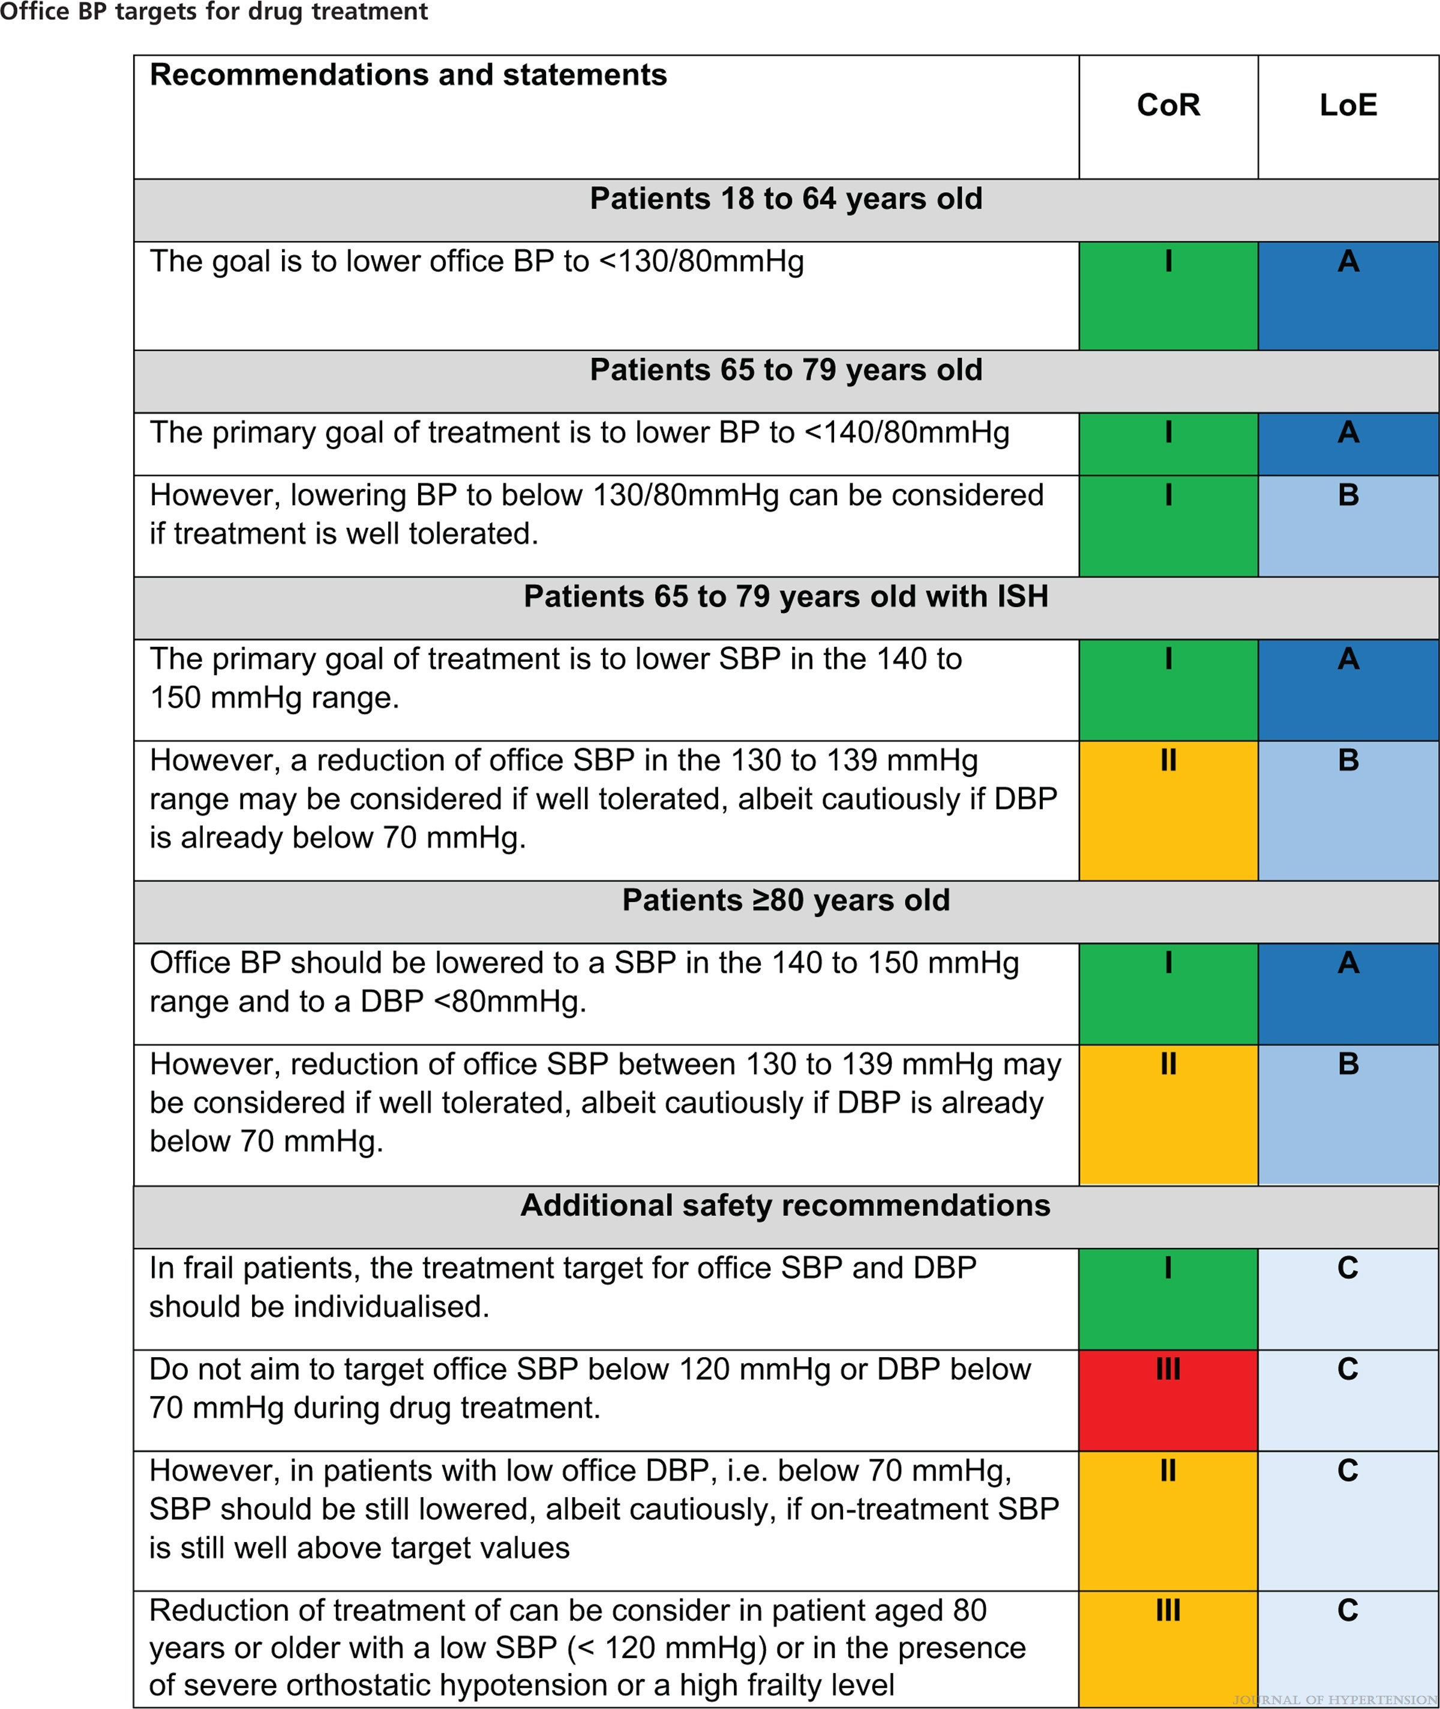
2023 ESH Guidelines for the management of arterial hypertension The Task Force for the management of arterial hypertension of the European Society of Hypertension Endorsed by the European Renal Association (ERA) and the International Society of Hypertension (ISH)
Mancia(Chairperson), Giuseppe; Kreutz(Co-Chair), Reinhold; Brunström, Mattias; Burnier, Michel; Grassi, Guido; Januszewicz, Andrzej; Muiesan, Maria Lorenza; Tsioufis, Konstantinos; Agabiti-Rosei, Enrico; Algharably, Engi Abd Elhady; Azizi, Michel; Benetos, Athanase; Borghi, Claudio; Hitij, Jana Brguljan; Cifkova, Renata; Coca, Antonio; Cornelissen, Veronique; Cruickshank, Kennedy; Cunha, Pedro G.; Danser, A.H. Jan; de Pinho, Rosa Maria; Delles, Christian; Dominiczak, Anna F.; Dorobantu, Maria; Doumas, Michalis; Fernández-Alfonso, María S.; Halimi, Jean-Michel; Járai, Zoltán; Jelaković, Bojan; Jordan, Jens; Kuznetsova, Tatiana; Laurent, Stephane; Lovic, Dragan; Lurbe, Empar; Mahfoud, Felix; Manolis, Athanasios; Miglinas, Marius; Narkiewicz, Krzystof; Niiranen, Teemu; Palatini, Paolo; Parati, Gianfranco; Pathak, Atul; Persu, Alexandre; Polonia, Jorge; Redon, Josep; Sarafidis, Pantelis; Schmieder, Roland; Spronck, Bart; Stabouli, Stella; Stergiou, George; Taddei, Stefano; Thomopoulos, Costas; Tomaszewski, Maciej; Van de Borne, Philippe; Wanner, Christoph; Weber, Thomas; Williams, Bryan; Zhang, Zhen-Yu; Kjeldsen, Sverre E.
Journal of Hypertension : June 21, 2023
doi: 10.1097/HJH.0000000000003480

Slide 27
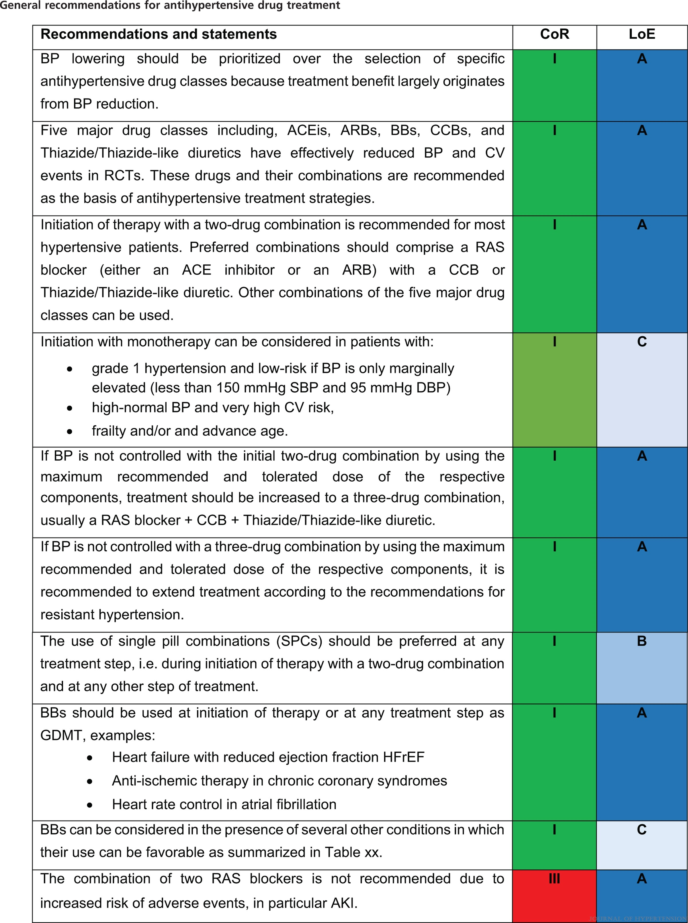
2023 ESH Guidelines for the management of arterial hypertension The Task Force for the management of arterial hypertension of the European Society of Hypertension Endorsed by the European Renal Association (ERA) and the International Society of Hypertension (ISH)
Mancia(Chairperson), Giuseppe; Kreutz(Co-Chair), Reinhold; Brunström, Mattias; Burnier, Michel; Grassi, Guido; Januszewicz, Andrzej; Muiesan, Maria Lorenza; Tsioufis, Konstantinos; Agabiti-Rosei, Enrico; Algharably, Engi Abd Elhady; Azizi, Michel; Benetos, Athanase; Borghi, Claudio; Hitij, Jana Brguljan; Cifkova, Renata; Coca, Antonio; Cornelissen, Veronique; Cruickshank, Kennedy; Cunha, Pedro G.; Danser, A.H. Jan; de Pinho, Rosa Maria; Delles, Christian; Dominiczak, Anna F.; Dorobantu, Maria; Doumas, Michalis; Fernández-Alfonso, María S.; Halimi, Jean-Michel; Járai, Zoltán; Jelaković, Bojan; Jordan, Jens; Kuznetsova, Tatiana; Laurent, Stephane; Lovic, Dragan; Lurbe, Empar; Mahfoud, Felix; Manolis, Athanasios; Miglinas, Marius; Narkiewicz, Krzystof; Niiranen, Teemu; Palatini, Paolo; Parati, Gianfranco; Pathak, Atul; Persu, Alexandre; Polonia, Jorge; Redon, Josep; Sarafidis, Pantelis; Schmieder, Roland; Spronck, Bart; Stabouli, Stella; Stergiou, George; Taddei, Stefano; Thomopoulos, Costas; Tomaszewski, Maciej; Van de Borne, Philippe; Wanner, Christoph; Weber, Thomas; Williams, Bryan; Zhang, Zhen-Yu; Kjeldsen, Sverre E.
Journal of Hypertension : June 21, 2023
doi: 10.1097/HJH.0000000000003480

Slide 28
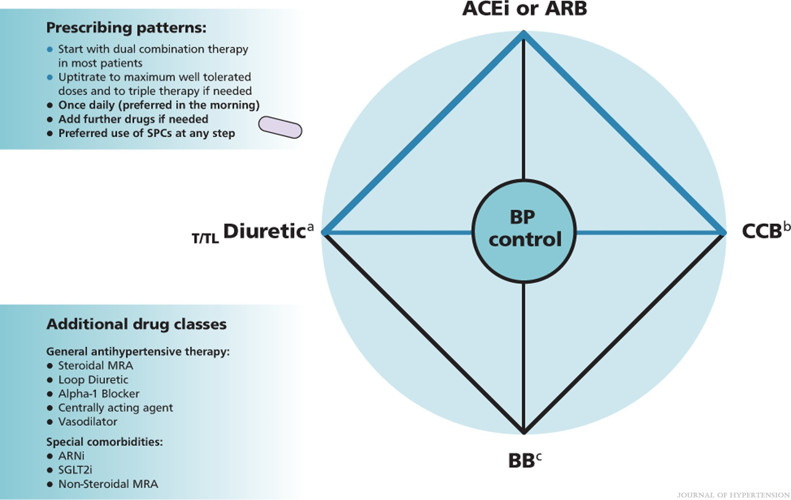
FIGURE 11
2023 ESH Guidelines for the management of arterial hypertension The Task Force for the management of arterial hypertension of the European Society of Hypertension Endorsed by the European Renal Association (ERA) and the International Society of Hypertension (ISH)
Mancia(Chairperson), Giuseppe; Kreutz(Co-Chair), Reinhold; Brunström, Mattias; Burnier, Michel; Grassi, Guido; Januszewicz, Andrzej; Muiesan, Maria Lorenza; Tsioufis, Konstantinos; Agabiti-Rosei, Enrico; Algharably, Engi Abd Elhady; Azizi, Michel; Benetos, Athanase; Borghi, Claudio; Hitij, Jana Brguljan; Cifkova, Renata; Coca, Antonio; Cornelissen, Veronique; Cruickshank, Kennedy; Cunha, Pedro G.; Danser, A.H. Jan; de Pinho, Rosa Maria; Delles, Christian; Dominiczak, Anna F.; Dorobantu, Maria; Doumas, Michalis; Fernández-Alfonso, María S.; Halimi, Jean-Michel; Járai, Zoltán; Jelaković, Bojan; Jordan, Jens; Kuznetsova, Tatiana; Laurent, Stephane; Lovic, Dragan; Lurbe, Empar; Mahfoud, Felix; Manolis, Athanasios; Miglinas, Marius; Narkiewicz, Krzystof; Niiranen, Teemu; Palatini, Paolo; Parati, Gianfranco; Pathak, Atul; Persu, Alexandre; Polonia, Jorge; Redon, Josep; Sarafidis, Pantelis; Schmieder, Roland; Spronck, Bart; Stabouli, Stella; Stergiou, George; Taddei, Stefano; Thomopoulos, Costas; Tomaszewski, Maciej; Van de Borne, Philippe; Wanner, Christoph; Weber, Thomas; Williams, Bryan; Zhang, Zhen-Yu; Kjeldsen, Sverre E.
Journal of Hypertension : June 21, 2023
doi: 10.1097/HJH.0000000000003480
Drug classes for BP-lowering therapy.(a) Use of Diuretics: Consider transition to Loop Diuretic if eGFR is between 30 to 45 ml/min/1.73 m2. If eGFR <30 ml/min/1.73 m2 use Loop Diuretic. (b) Non-DHP CCB should not be combined with BB. (c) BB should be used as guideline directed medical therapy in respective indications or considered in several other conditions (Table 16).

Slide 29
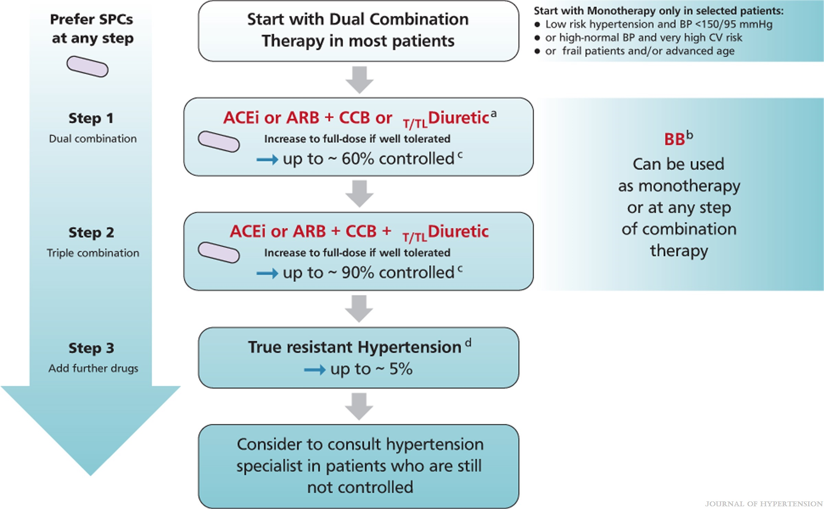
FIGURE 12
2023 ESH Guidelines for the management of arterial hypertension The Task Force for the management of arterial hypertension of the European Society of Hypertension Endorsed by the European Renal Association (ERA) and the International Society of Hypertension (ISH)
Mancia(Chairperson), Giuseppe; Kreutz(Co-Chair), Reinhold; Brunström, Mattias; Burnier, Michel; Grassi, Guido; Januszewicz, Andrzej; Muiesan, Maria Lorenza; Tsioufis, Konstantinos; Agabiti-Rosei, Enrico; Algharably, Engi Abd Elhady; Azizi, Michel; Benetos, Athanase; Borghi, Claudio; Hitij, Jana Brguljan; Cifkova, Renata; Coca, Antonio; Cornelissen, Veronique; Cruickshank, Kennedy; Cunha, Pedro G.; Danser, A.H. Jan; de Pinho, Rosa Maria; Delles, Christian; Dominiczak, Anna F.; Dorobantu, Maria; Doumas, Michalis; Fernández-Alfonso, María S.; Halimi, Jean-Michel; Járai, Zoltán; Jelaković, Bojan; Jordan, Jens; Kuznetsova, Tatiana; Laurent, Stephane; Lovic, Dragan; Lurbe, Empar; Mahfoud, Felix; Manolis, Athanasios; Miglinas, Marius; Narkiewicz, Krzystof; Niiranen, Teemu; Palatini, Paolo; Parati, Gianfranco; Pathak, Atul; Persu, Alexandre; Polonia, Jorge; Redon, Josep; Sarafidis, Pantelis; Schmieder, Roland; Spronck, Bart; Stabouli, Stella; Stergiou, George; Taddei, Stefano; Thomopoulos, Costas; Tomaszewski, Maciej; Van de Borne, Philippe; Wanner, Christoph; Weber, Thomas; Williams, Bryan; Zhang, Zhen-Yu; Kjeldsen, Sverre E.
Journal of Hypertension : June 21, 2023
doi: 10.1097/HJH.0000000000003480
General BP lowering strategy in patients with Hypertension.aUse of Diuretics:–Consider transition to Loop Diuretic if eGFR is between 30 to 45 ml/min/1.73 m2–If eGFR <30 ml/min/1.73 m2 use Loop DiureticbBB should be used als guideline directed medical therapy in respective indications or considered in several other conditions (Table 16)cControlled below 140/90 mmHgd When SBP is ≥140mmHg or DBP is ≥90 mmHg provided that:–maximum recommended and tolerated doses of a three-drug combination comprising a RAS blocker (either an ACEi or an ARB), a CCB and a Thiazide/Thiazide-like diuretic were used–adequate BP control has been confirmed by ABPM or by HBPM if ABPM is not feasible–various causes of pseudo-resistant hypertension (especially poor medication adherence) and secondary hypertension have been excluded (Section 12).

Slide 30
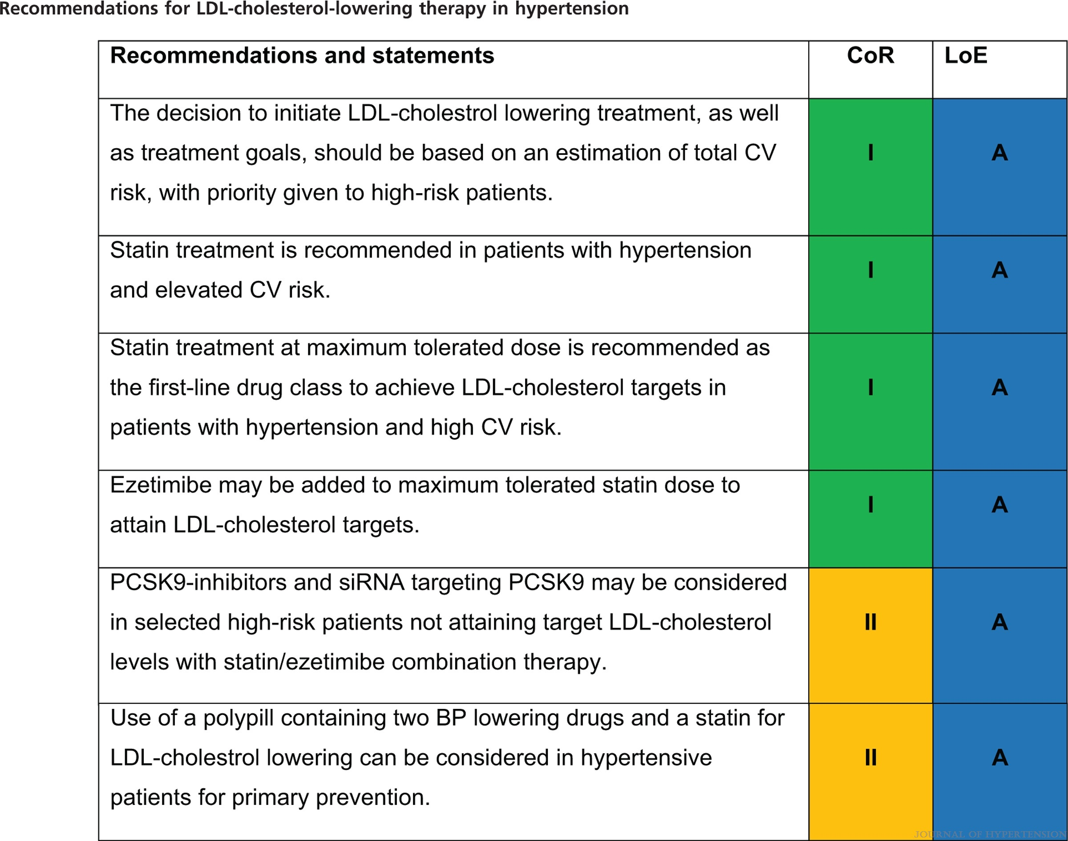
2023 ESH Guidelines for the management of arterial hypertension The Task Force for the management of arterial hypertension of the European Society of Hypertension Endorsed by the European Renal Association (ERA) and the International Society of Hypertension (ISH)
Mancia(Chairperson), Giuseppe; Kreutz(Co-Chair), Reinhold; Brunström, Mattias; Burnier, Michel; Grassi, Guido; Januszewicz, Andrzej; Muiesan, Maria Lorenza; Tsioufis, Konstantinos; Agabiti-Rosei, Enrico; Algharably, Engi Abd Elhady; Azizi, Michel; Benetos, Athanase; Borghi, Claudio; Hitij, Jana Brguljan; Cifkova, Renata; Coca, Antonio; Cornelissen, Veronique; Cruickshank, Kennedy; Cunha, Pedro G.; Danser, A.H. Jan; de Pinho, Rosa Maria; Delles, Christian; Dominiczak, Anna F.; Dorobantu, Maria; Doumas, Michalis; Fernández-Alfonso, María S.; Halimi, Jean-Michel; Járai, Zoltán; Jelaković, Bojan; Jordan, Jens; Kuznetsova, Tatiana; Laurent, Stephane; Lovic, Dragan; Lurbe, Empar; Mahfoud, Felix; Manolis, Athanasios; Miglinas, Marius; Narkiewicz, Krzystof; Niiranen, Teemu; Palatini, Paolo; Parati, Gianfranco; Pathak, Atul; Persu, Alexandre; Polonia, Jorge; Redon, Josep; Sarafidis, Pantelis; Schmieder, Roland; Spronck, Bart; Stabouli, Stella; Stergiou, George; Taddei, Stefano; Thomopoulos, Costas; Tomaszewski, Maciej; Van de Borne, Philippe; Wanner, Christoph; Weber, Thomas; Williams, Bryan; Zhang, Zhen-Yu; Kjeldsen, Sverre E.
Journal of Hypertension : June 21, 2023
doi: 10.1097/HJH.0000000000003480

Slide 31
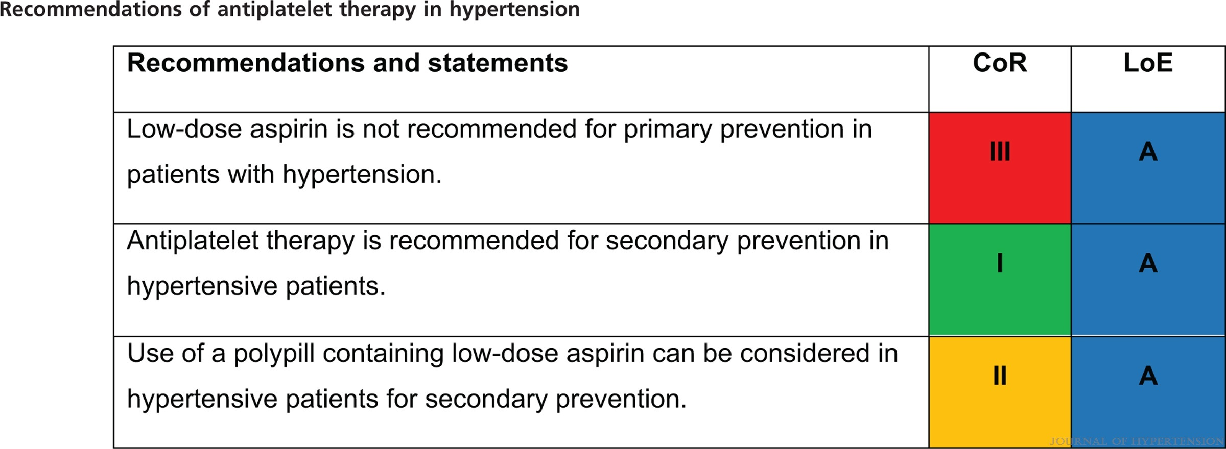
2023 ESH Guidelines for the management of arterial hypertension The Task Force for the management of arterial hypertension of the European Society of Hypertension Endorsed by the European Renal Association (ERA) and the International Society of Hypertension (ISH)
Mancia(Chairperson), Giuseppe; Kreutz(Co-Chair), Reinhold; Brunström, Mattias; Burnier, Michel; Grassi, Guido; Januszewicz, Andrzej; Muiesan, Maria Lorenza; Tsioufis, Konstantinos; Agabiti-Rosei, Enrico; Algharably, Engi Abd Elhady; Azizi, Michel; Benetos, Athanase; Borghi, Claudio; Hitij, Jana Brguljan; Cifkova, Renata; Coca, Antonio; Cornelissen, Veronique; Cruickshank, Kennedy; Cunha, Pedro G.; Danser, A.H. Jan; de Pinho, Rosa Maria; Delles, Christian; Dominiczak, Anna F.; Dorobantu, Maria; Doumas, Michalis; Fernández-Alfonso, María S.; Halimi, Jean-Michel; Járai, Zoltán; Jelaković, Bojan; Jordan, Jens; Kuznetsova, Tatiana; Laurent, Stephane; Lovic, Dragan; Lurbe, Empar; Mahfoud, Felix; Manolis, Athanasios; Miglinas, Marius; Narkiewicz, Krzystof; Niiranen, Teemu; Palatini, Paolo; Parati, Gianfranco; Pathak, Atul; Persu, Alexandre; Polonia, Jorge; Redon, Josep; Sarafidis, Pantelis; Schmieder, Roland; Spronck, Bart; Stabouli, Stella; Stergiou, George; Taddei, Stefano; Thomopoulos, Costas; Tomaszewski, Maciej; Van de Borne, Philippe; Wanner, Christoph; Weber, Thomas; Williams, Bryan; Zhang, Zhen-Yu; Kjeldsen, Sverre E.
Journal of Hypertension : June 21, 2023
doi: 10.1097/HJH.0000000000003480

Slide 32
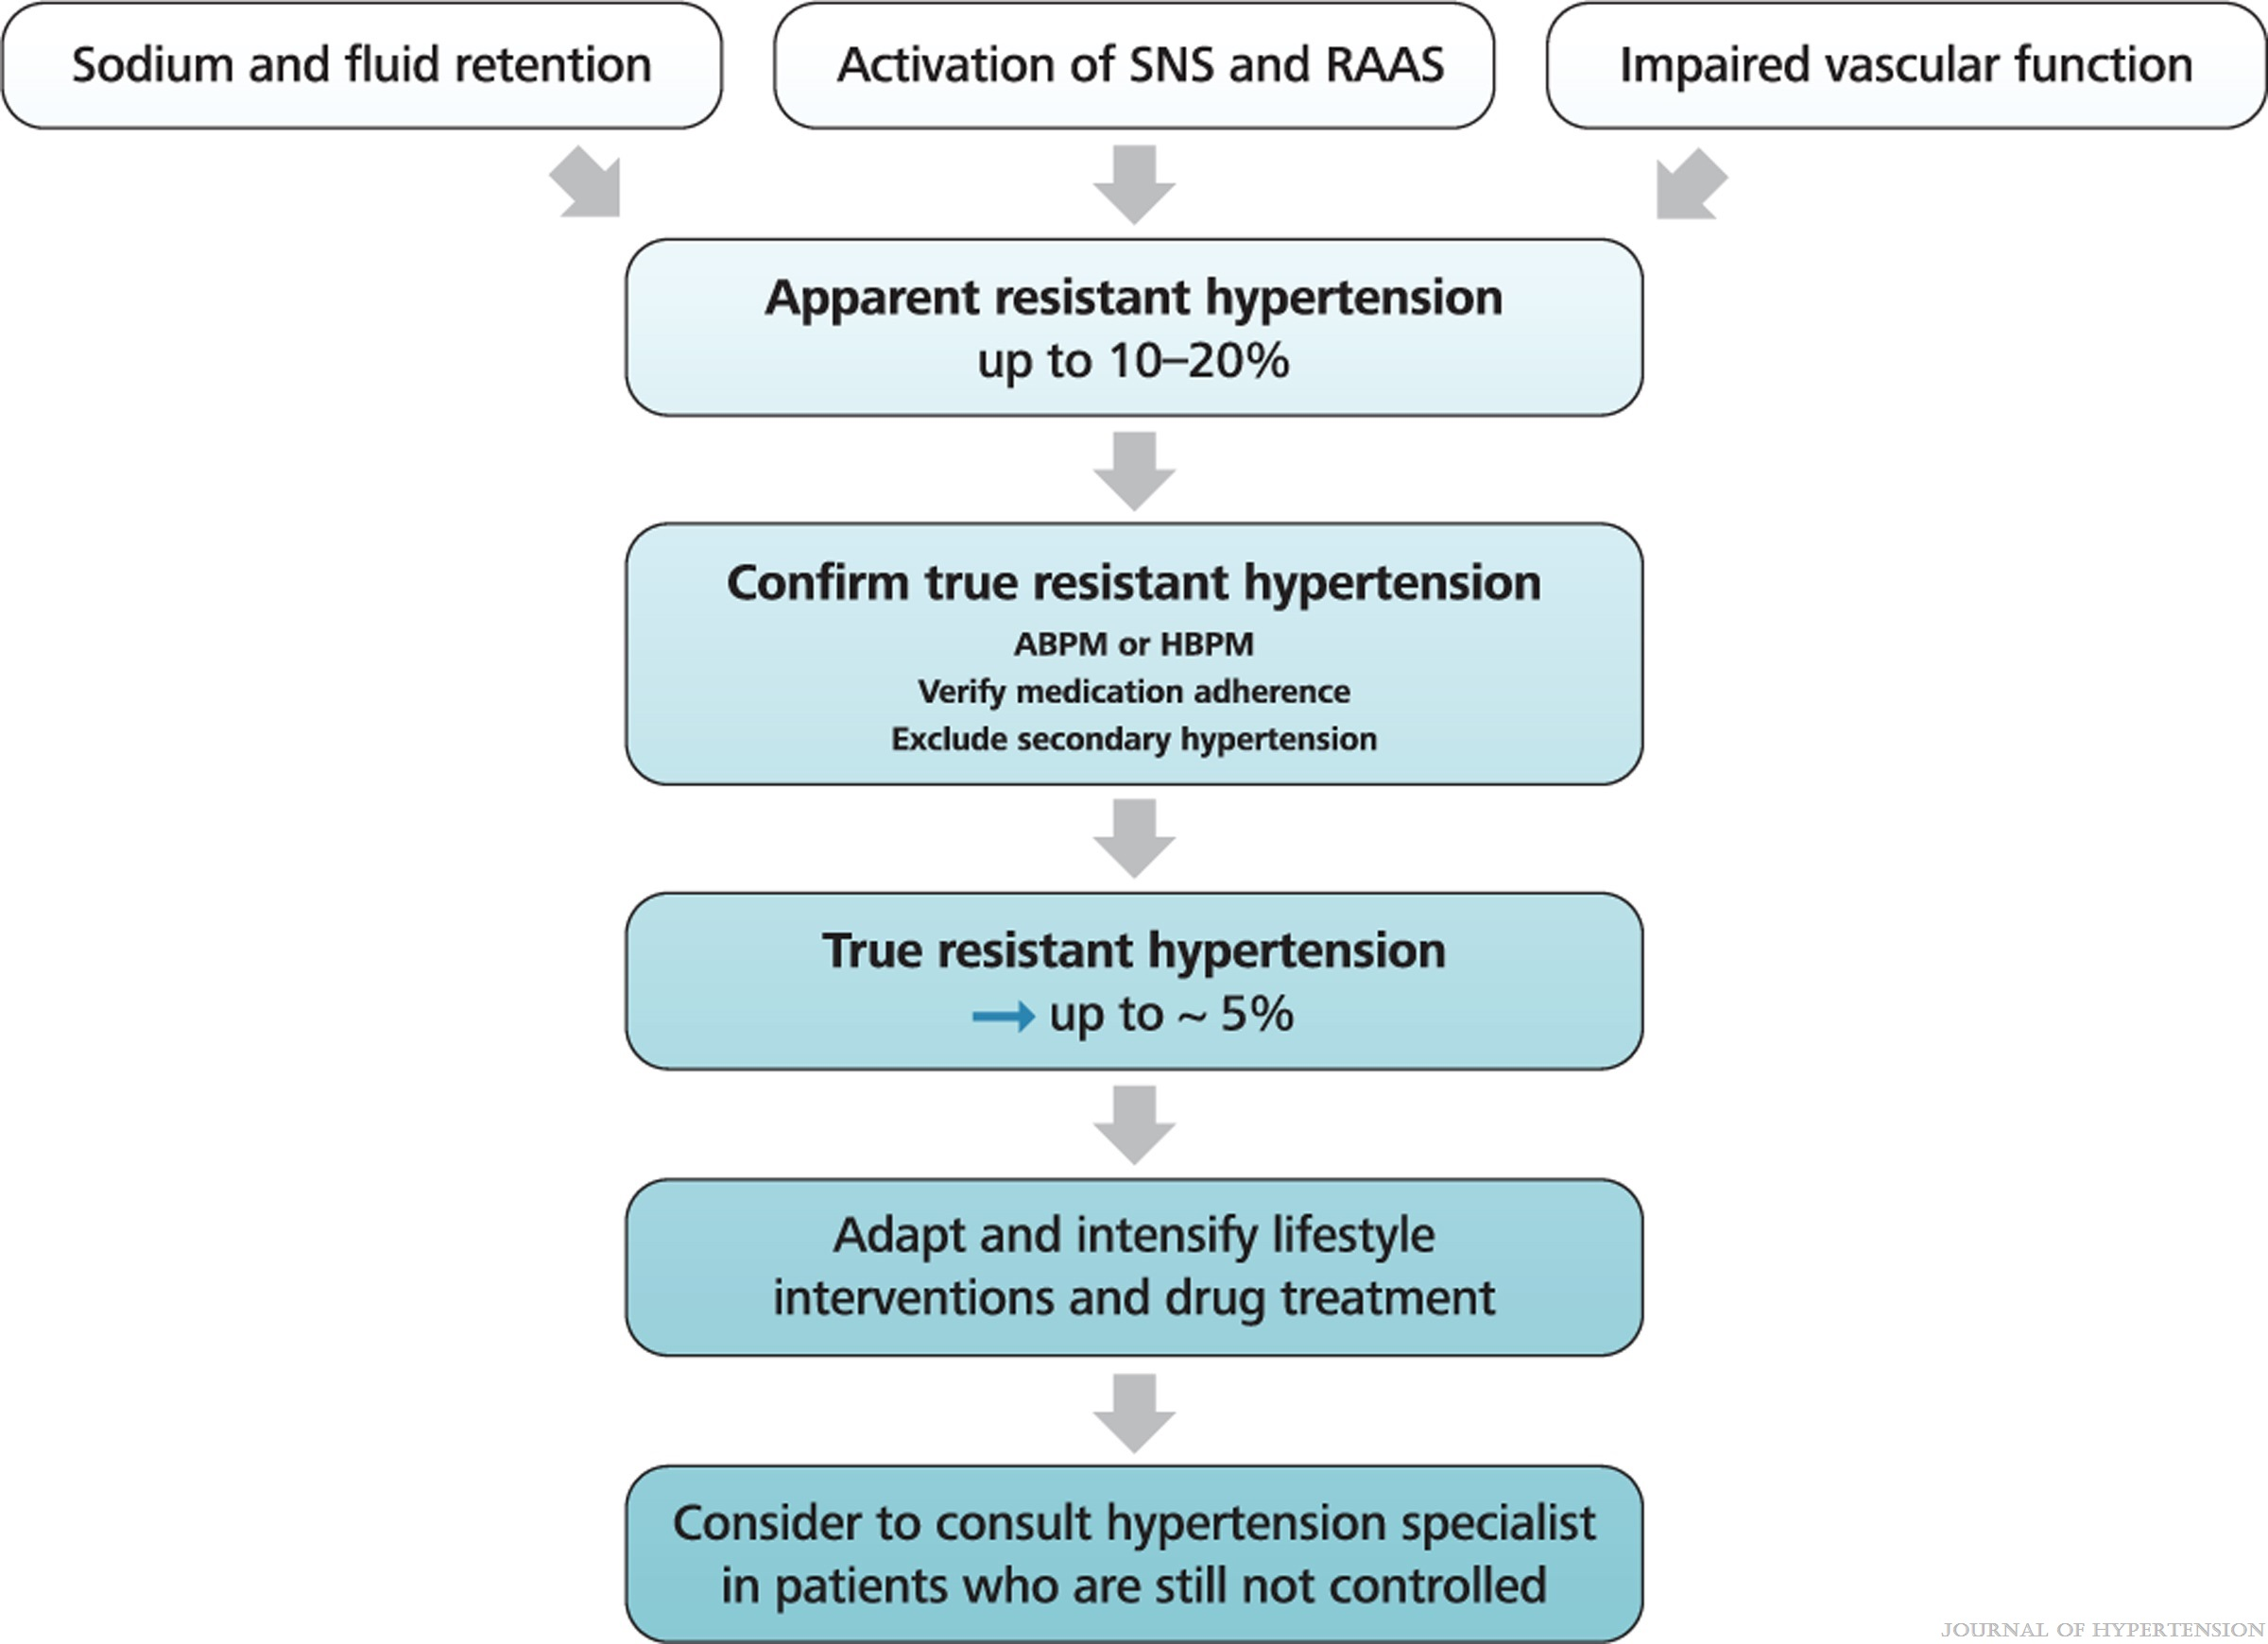
FIGURE 13
2023 ESH Guidelines for the management of arterial hypertension The Task Force for the management of arterial hypertension of the European Society of Hypertension Endorsed by the European Renal Association (ERA) and the International Society of Hypertension (ISH)
Mancia(Chairperson), Giuseppe; Kreutz(Co-Chair), Reinhold; Brunström, Mattias; Burnier, Michel; Grassi, Guido; Januszewicz, Andrzej; Muiesan, Maria Lorenza; Tsioufis, Konstantinos; Agabiti-Rosei, Enrico; Algharably, Engi Abd Elhady; Azizi, Michel; Benetos, Athanase; Borghi, Claudio; Hitij, Jana Brguljan; Cifkova, Renata; Coca, Antonio; Cornelissen, Veronique; Cruickshank, Kennedy; Cunha, Pedro G.; Danser, A.H. Jan; de Pinho, Rosa Maria; Delles, Christian; Dominiczak, Anna F.; Dorobantu, Maria; Doumas, Michalis; Fernández-Alfonso, María S.; Halimi, Jean-Michel; Járai, Zoltán; Jelaković, Bojan; Jordan, Jens; Kuznetsova, Tatiana; Laurent, Stephane; Lovic, Dragan; Lurbe, Empar; Mahfoud, Felix; Manolis, Athanasios; Miglinas, Marius; Narkiewicz, Krzystof; Niiranen, Teemu; Palatini, Paolo; Parati, Gianfranco; Pathak, Atul; Persu, Alexandre; Polonia, Jorge; Redon, Josep; Sarafidis, Pantelis; Schmieder, Roland; Spronck, Bart; Stabouli, Stella; Stergiou, George; Taddei, Stefano; Thomopoulos, Costas; Tomaszewski, Maciej; Van de Borne, Philippe; Wanner, Christoph; Weber, Thomas; Williams, Bryan; Zhang, Zhen-Yu; Kjeldsen, Sverre E.
Journal of Hypertension : June 21, 2023
doi: 10.1097/HJH.0000000000003480
Characteristics of true resistant hypertension. RAAS, renin – angiotensin aldosterone system.

Slide 33
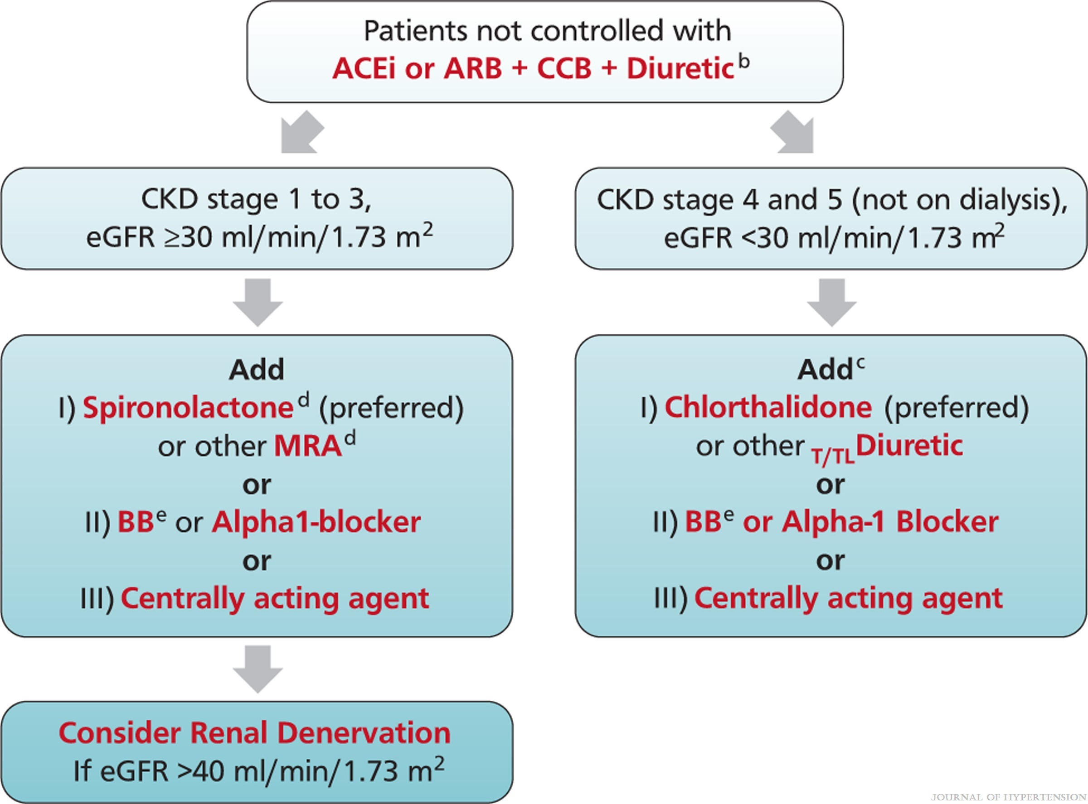
FIGURE 14
2023 ESH Guidelines for the management of arterial hypertension The Task Force for the management of arterial hypertension of the European Society of Hypertension Endorsed by the European Renal Association (ERA) and the International Society of Hypertension (ISH)
Mancia(Chairperson), Giuseppe; Kreutz(Co-Chair), Reinhold; Brunström, Mattias; Burnier, Michel; Grassi, Guido; Januszewicz, Andrzej; Muiesan, Maria Lorenza; Tsioufis, Konstantinos; Agabiti-Rosei, Enrico; Algharably, Engi Abd Elhady; Azizi, Michel; Benetos, Athanase; Borghi, Claudio; Hitij, Jana Brguljan; Cifkova, Renata; Coca, Antonio; Cornelissen, Veronique; Cruickshank, Kennedy; Cunha, Pedro G.; Danser, A.H. Jan; de Pinho, Rosa Maria; Delles, Christian; Dominiczak, Anna F.; Dorobantu, Maria; Doumas, Michalis; Fernández-Alfonso, María S.; Halimi, Jean-Michel; Járai, Zoltán; Jelaković, Bojan; Jordan, Jens; Kuznetsova, Tatiana; Laurent, Stephane; Lovic, Dragan; Lurbe, Empar; Mahfoud, Felix; Manolis, Athanasios; Miglinas, Marius; Narkiewicz, Krzystof; Niiranen, Teemu; Palatini, Paolo; Parati, Gianfranco; Pathak, Atul; Persu, Alexandre; Polonia, Jorge; Redon, Josep; Sarafidis, Pantelis; Schmieder, Roland; Spronck, Bart; Stabouli, Stella; Stergiou, George; Taddei, Stefano; Thomopoulos, Costas; Tomaszewski, Maciej; Van de Borne, Philippe; Wanner, Christoph; Weber, Thomas; Williams, Bryan; Zhang, Zhen-Yu; Kjeldsen, Sverre E.
Journal of Hypertension : June 21, 2023
doi: 10.1097/HJH.0000000000003480
BP-lowering strategy in true resistant hypertension. (a) When SBP is ≥140mmHg or DBP is ≥90 mmHg provided that: maximum recommended and tolerated doses of a three-drug combination comprising a RAS blocker (either an ACEi or an ARB), a CCB and a T/TLDiuretic were used. adequate BP control has been confirmed by ABPM or by HBPM if ABPM is not feasible. various causes of pseudo-resistant hypertension (especially poor medication adherence) and secondary hypertension have been excluded (Section 12). (b) Use of Diuretics: Use T/TLDiuretic if eGFR >45 ml/min/1.73 m2. Consider transition to Loop Diuretic if eGFR is between 30 to 45 ml/min/1.73 m2. Use loop Diuretic if eGFR <30 ml/min/1.73 m2. (c) MRA contraindicated. (d) Caution if eGFR <45 ml/min/1.73 m2 or serum potassium >4.5 mmol/l. (e) Should be used earlier at any step as guideline directed medical therapy in respective indications or considered in several other conditions (Table 16).

Slide 34
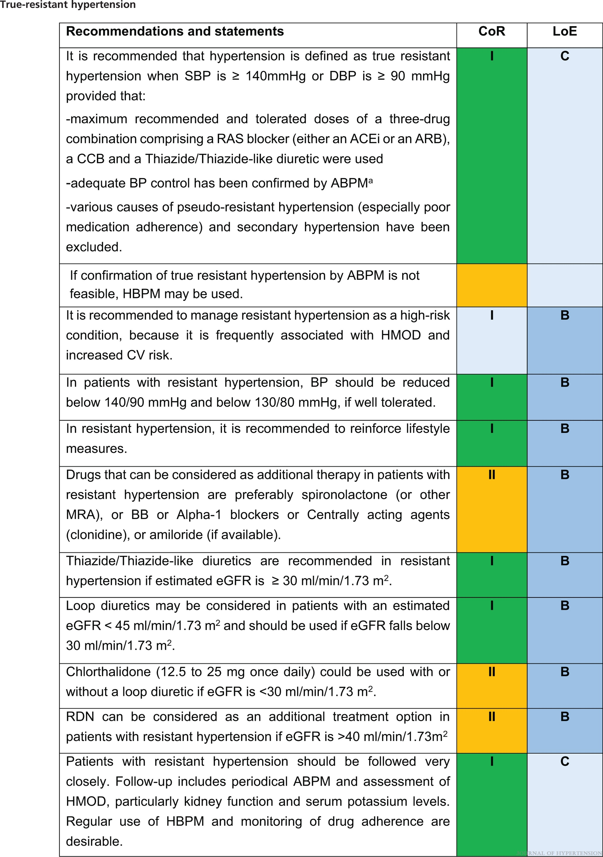
2023 ESH Guidelines for the management of arterial hypertension The Task Force for the management of arterial hypertension of the European Society of Hypertension Endorsed by the European Renal Association (ERA) and the International Society of Hypertension (ISH)
Mancia(Chairperson), Giuseppe; Kreutz(Co-Chair), Reinhold; Brunström, Mattias; Burnier, Michel; Grassi, Guido; Januszewicz, Andrzej; Muiesan, Maria Lorenza; Tsioufis, Konstantinos; Agabiti-Rosei, Enrico; Algharably, Engi Abd Elhady; Azizi, Michel; Benetos, Athanase; Borghi, Claudio; Hitij, Jana Brguljan; Cifkova, Renata; Coca, Antonio; Cornelissen, Veronique; Cruickshank, Kennedy; Cunha, Pedro G.; Danser, A.H. Jan; de Pinho, Rosa Maria; Delles, Christian; Dominiczak, Anna F.; Dorobantu, Maria; Doumas, Michalis; Fernández-Alfonso, María S.; Halimi, Jean-Michel; Járai, Zoltán; Jelaković, Bojan; Jordan, Jens; Kuznetsova, Tatiana; Laurent, Stephane; Lovic, Dragan; Lurbe, Empar; Mahfoud, Felix; Manolis, Athanasios; Miglinas, Marius; Narkiewicz, Krzystof; Niiranen, Teemu; Palatini, Paolo; Parati, Gianfranco; Pathak, Atul; Persu, Alexandre; Polonia, Jorge; Redon, Josep; Sarafidis, Pantelis; Schmieder, Roland; Spronck, Bart; Stabouli, Stella; Stergiou, George; Taddei, Stefano; Thomopoulos, Costas; Tomaszewski, Maciej; Van de Borne, Philippe; Wanner, Christoph; Weber, Thomas; Williams, Bryan; Zhang, Zhen-Yu; Kjeldsen, Sverre E.
Journal of Hypertension : June 21, 2023
doi: 10.1097/HJH.0000000000003480

Slide 35
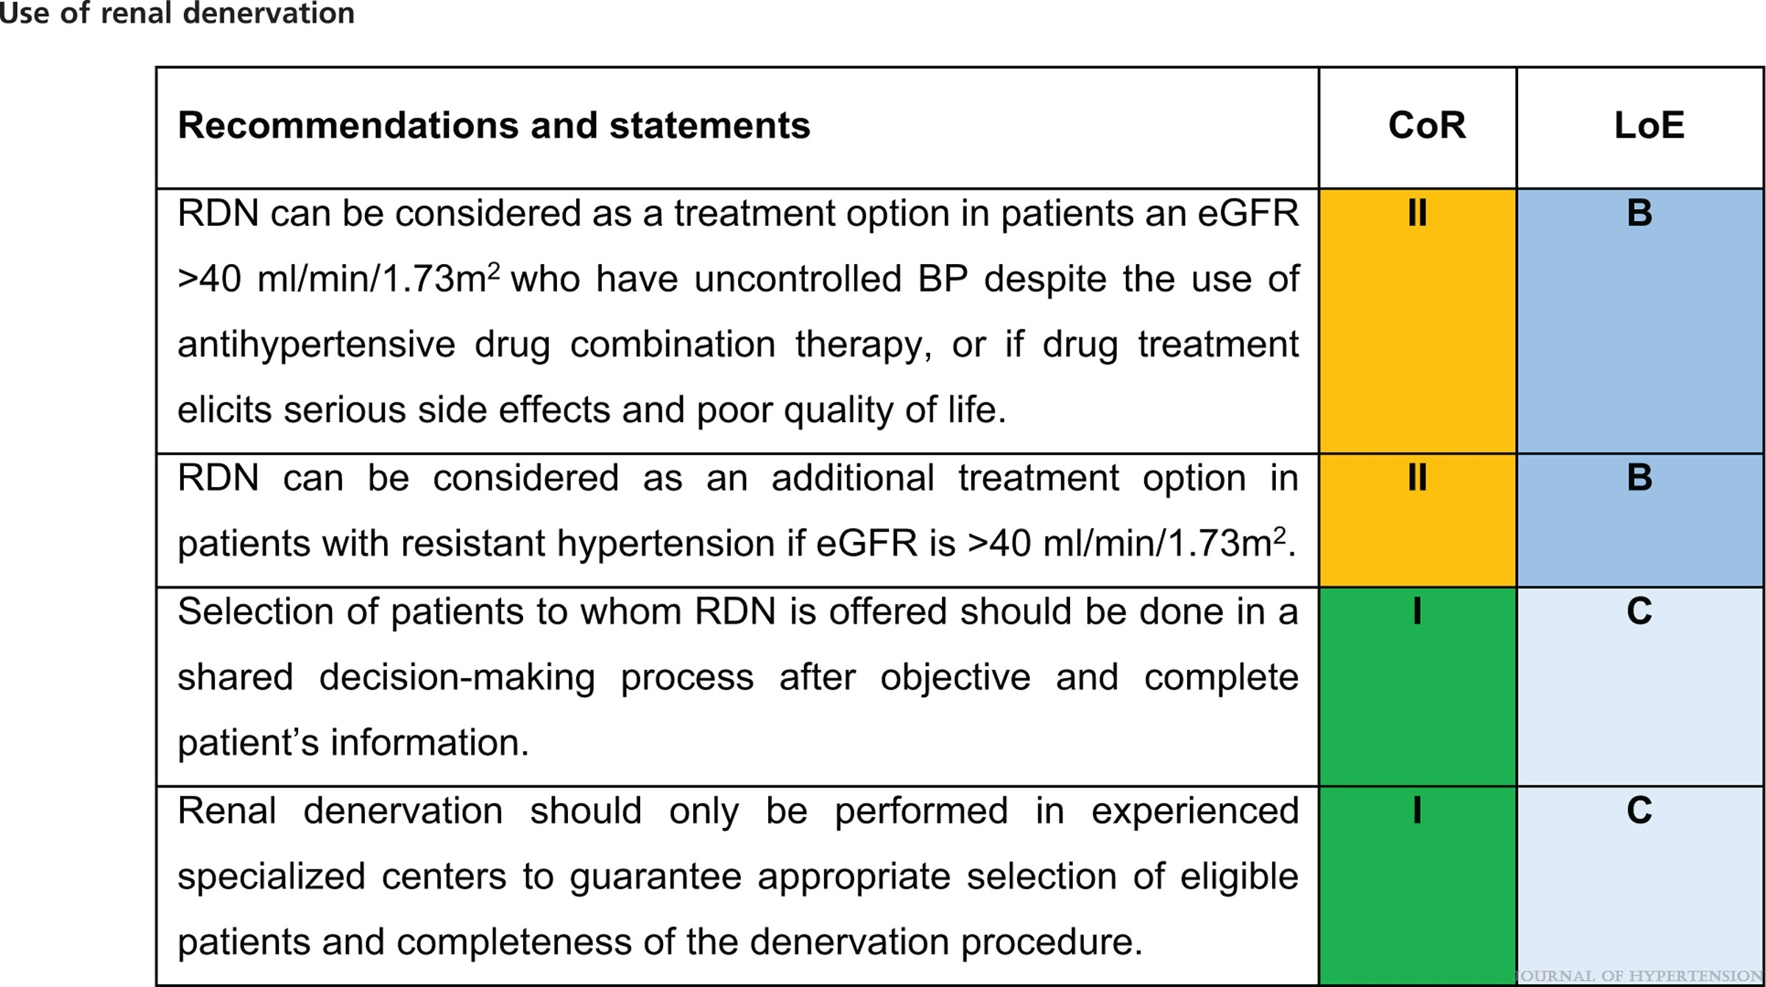
2023 ESH Guidelines for the management of arterial hypertension The Task Force for the management of arterial hypertension of the European Society of Hypertension Endorsed by the European Renal Association (ERA) and the International Society of Hypertension (ISH)
Mancia(Chairperson), Giuseppe; Kreutz(Co-Chair), Reinhold; Brunström, Mattias; Burnier, Michel; Grassi, Guido; Januszewicz, Andrzej; Muiesan, Maria Lorenza; Tsioufis, Konstantinos; Agabiti-Rosei, Enrico; Algharably, Engi Abd Elhady; Azizi, Michel; Benetos, Athanase; Borghi, Claudio; Hitij, Jana Brguljan; Cifkova, Renata; Coca, Antonio; Cornelissen, Veronique; Cruickshank, Kennedy; Cunha, Pedro G.; Danser, A.H. Jan; de Pinho, Rosa Maria; Delles, Christian; Dominiczak, Anna F.; Dorobantu, Maria; Doumas, Michalis; Fernández-Alfonso, María S.; Halimi, Jean-Michel; Járai, Zoltán; Jelaković, Bojan; Jordan, Jens; Kuznetsova, Tatiana; Laurent, Stephane; Lovic, Dragan; Lurbe, Empar; Mahfoud, Felix; Manolis, Athanasios; Miglinas, Marius; Narkiewicz, Krzystof; Niiranen, Teemu; Palatini, Paolo; Parati, Gianfranco; Pathak, Atul; Persu, Alexandre; Polonia, Jorge; Redon, Josep; Sarafidis, Pantelis; Schmieder, Roland; Spronck, Bart; Stabouli, Stella; Stergiou, George; Taddei, Stefano; Thomopoulos, Costas; Tomaszewski, Maciej; Van de Borne, Philippe; Wanner, Christoph; Weber, Thomas; Williams, Bryan; Zhang, Zhen-Yu; Kjeldsen, Sverre E.
Journal of Hypertension : June 21, 2023
doi: 10.1097/HJH.0000000000003480

Slide 36
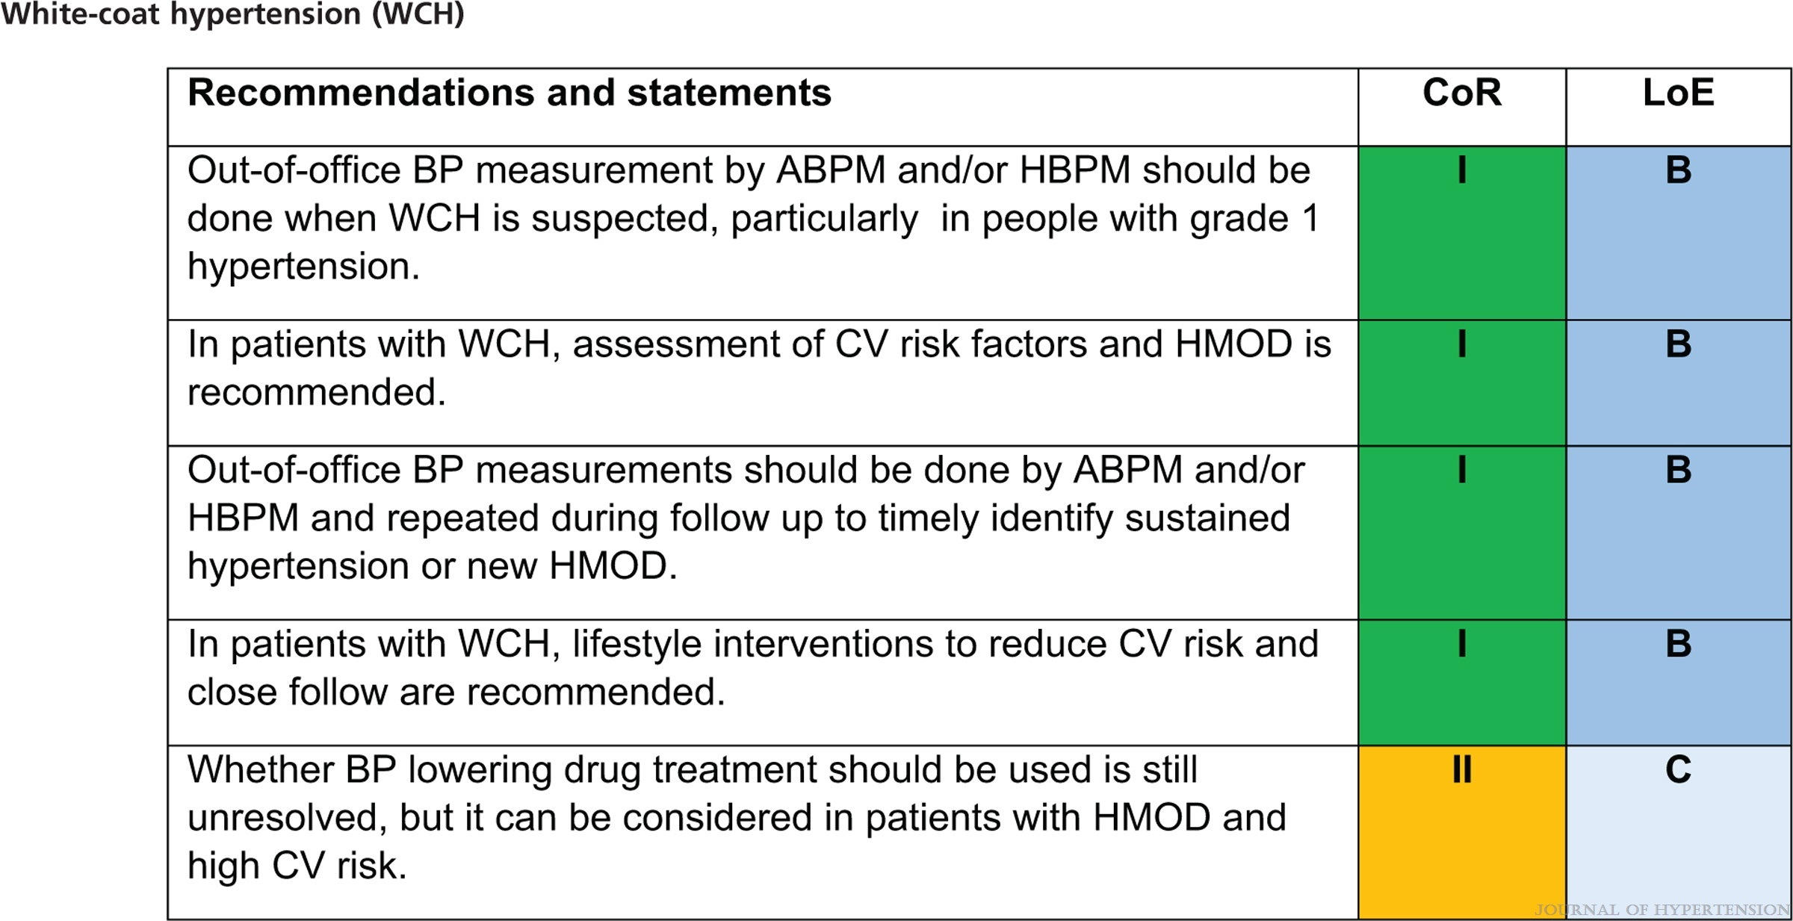
2023 ESH Guidelines for the management of arterial hypertension The Task Force for the management of arterial hypertension of the European Society of Hypertension Endorsed by the European Renal Association (ERA) and the International Society of Hypertension (ISH)
Mancia(Chairperson), Giuseppe; Kreutz(Co-Chair), Reinhold; Brunström, Mattias; Burnier, Michel; Grassi, Guido; Januszewicz, Andrzej; Muiesan, Maria Lorenza; Tsioufis, Konstantinos; Agabiti-Rosei, Enrico; Algharably, Engi Abd Elhady; Azizi, Michel; Benetos, Athanase; Borghi, Claudio; Hitij, Jana Brguljan; Cifkova, Renata; Coca, Antonio; Cornelissen, Veronique; Cruickshank, Kennedy; Cunha, Pedro G.; Danser, A.H. Jan; de Pinho, Rosa Maria; Delles, Christian; Dominiczak, Anna F.; Dorobantu, Maria; Doumas, Michalis; Fernández-Alfonso, María S.; Halimi, Jean-Michel; Járai, Zoltán; Jelaković, Bojan; Jordan, Jens; Kuznetsova, Tatiana; Laurent, Stephane; Lovic, Dragan; Lurbe, Empar; Mahfoud, Felix; Manolis, Athanasios; Miglinas, Marius; Narkiewicz, Krzystof; Niiranen, Teemu; Palatini, Paolo; Parati, Gianfranco; Pathak, Atul; Persu, Alexandre; Polonia, Jorge; Redon, Josep; Sarafidis, Pantelis; Schmieder, Roland; Spronck, Bart; Stabouli, Stella; Stergiou, George; Taddei, Stefano; Thomopoulos, Costas; Tomaszewski, Maciej; Van de Borne, Philippe; Wanner, Christoph; Weber, Thomas; Williams, Bryan; Zhang, Zhen-Yu; Kjeldsen, Sverre E.
Journal of Hypertension : June 21, 2023
doi: 10.1097/HJH.0000000000003480

Slide 37
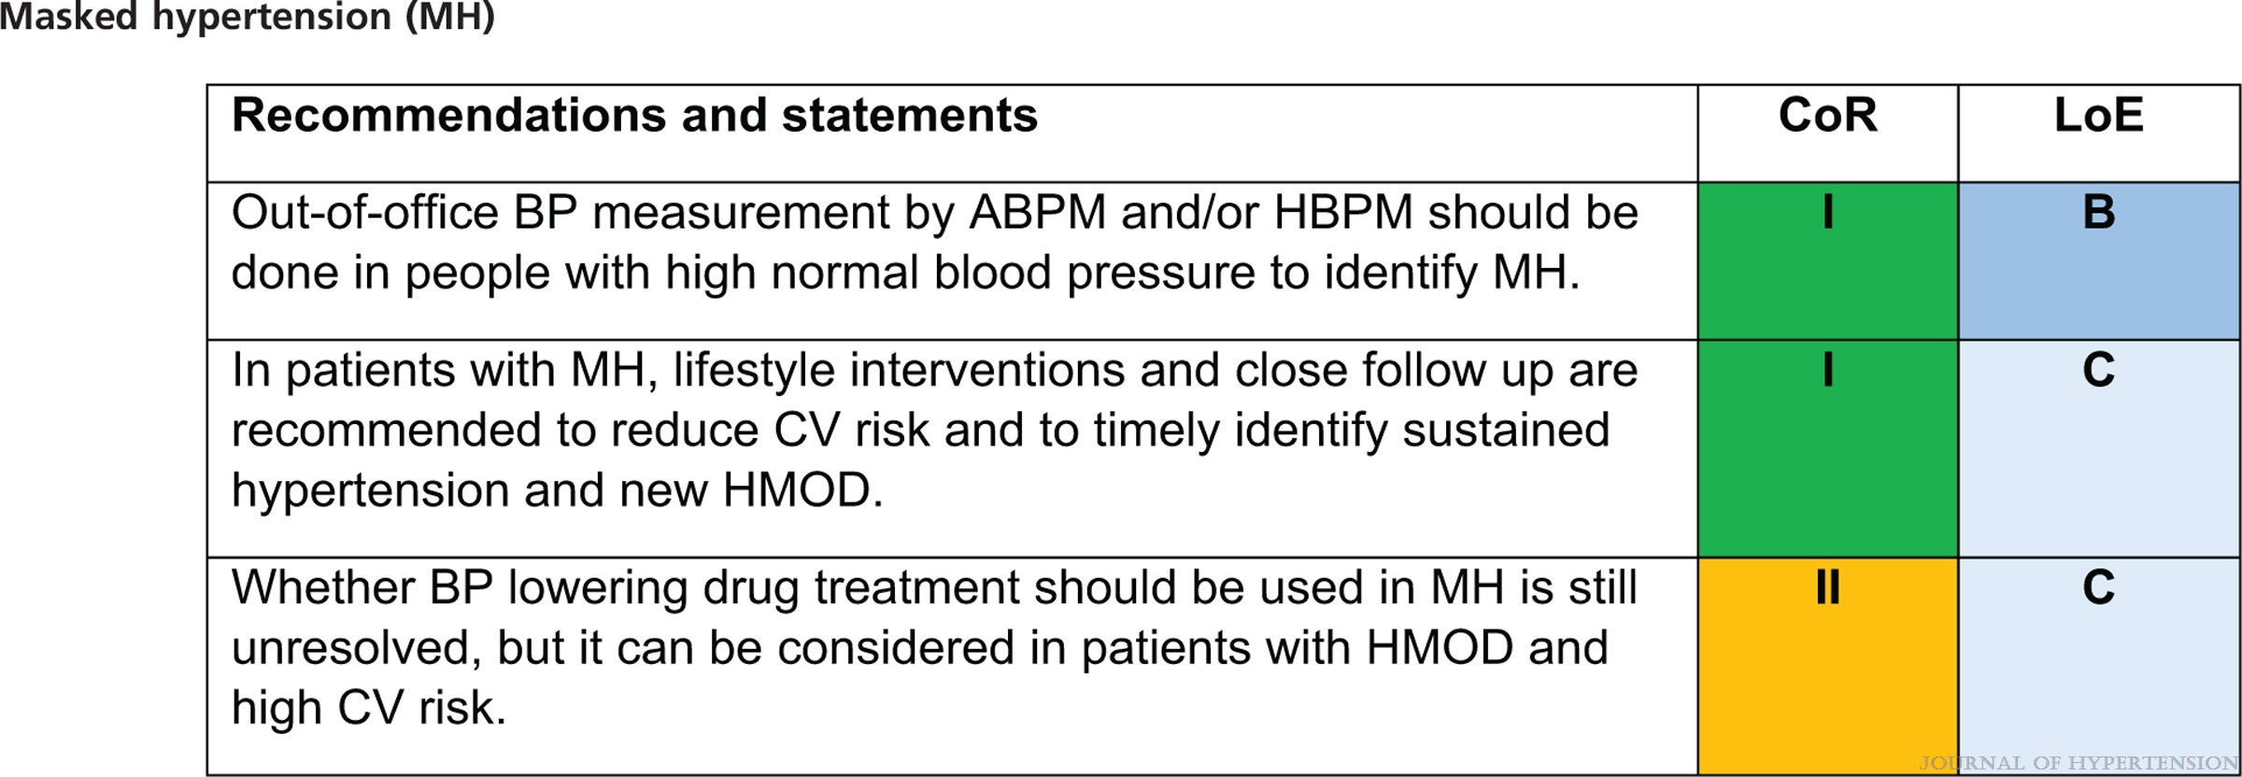
2023 ESH Guidelines for the management of arterial hypertension The Task Force for the management of arterial hypertension of the European Society of Hypertension Endorsed by the European Renal Association (ERA) and the International Society of Hypertension (ISH)
Mancia(Chairperson), Giuseppe; Kreutz(Co-Chair), Reinhold; Brunström, Mattias; Burnier, Michel; Grassi, Guido; Januszewicz, Andrzej; Muiesan, Maria Lorenza; Tsioufis, Konstantinos; Agabiti-Rosei, Enrico; Algharably, Engi Abd Elhady; Azizi, Michel; Benetos, Athanase; Borghi, Claudio; Hitij, Jana Brguljan; Cifkova, Renata; Coca, Antonio; Cornelissen, Veronique; Cruickshank, Kennedy; Cunha, Pedro G.; Danser, A.H. Jan; de Pinho, Rosa Maria; Delles, Christian; Dominiczak, Anna F.; Dorobantu, Maria; Doumas, Michalis; Fernández-Alfonso, María S.; Halimi, Jean-Michel; Járai, Zoltán; Jelaković, Bojan; Jordan, Jens; Kuznetsova, Tatiana; Laurent, Stephane; Lovic, Dragan; Lurbe, Empar; Mahfoud, Felix; Manolis, Athanasios; Miglinas, Marius; Narkiewicz, Krzystof; Niiranen, Teemu; Palatini, Paolo; Parati, Gianfranco; Pathak, Atul; Persu, Alexandre; Polonia, Jorge; Redon, Josep; Sarafidis, Pantelis; Schmieder, Roland; Spronck, Bart; Stabouli, Stella; Stergiou, George; Taddei, Stefano; Thomopoulos, Costas; Tomaszewski, Maciej; Van de Borne, Philippe; Wanner, Christoph; Weber, Thomas; Williams, Bryan; Zhang, Zhen-Yu; Kjeldsen, Sverre E.
Journal of Hypertension : June 21, 2023
doi: 10.1097/HJH.0000000000003480

Slide 38
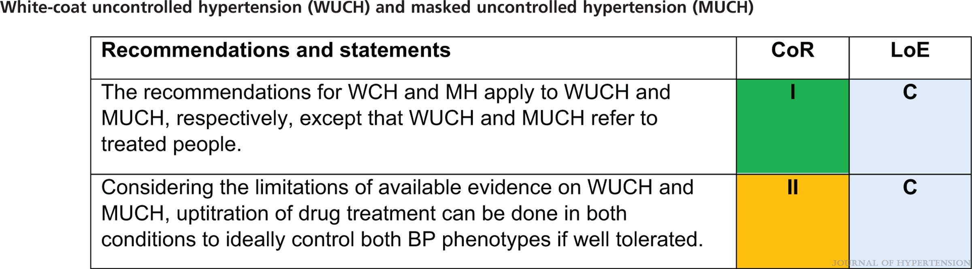
2023 ESH Guidelines for the management of arterial hypertension The Task Force for the management of arterial hypertension of the European Society of Hypertension Endorsed by the European Renal Association (ERA) and the International Society of Hypertension (ISH)
Mancia(Chairperson), Giuseppe; Kreutz(Co-Chair), Reinhold; Brunström, Mattias; Burnier, Michel; Grassi, Guido; Januszewicz, Andrzej; Muiesan, Maria Lorenza; Tsioufis, Konstantinos; Agabiti-Rosei, Enrico; Algharably, Engi Abd Elhady; Azizi, Michel; Benetos, Athanase; Borghi, Claudio; Hitij, Jana Brguljan; Cifkova, Renata; Coca, Antonio; Cornelissen, Veronique; Cruickshank, Kennedy; Cunha, Pedro G.; Danser, A.H. Jan; de Pinho, Rosa Maria; Delles, Christian; Dominiczak, Anna F.; Dorobantu, Maria; Doumas, Michalis; Fernández-Alfonso, María S.; Halimi, Jean-Michel; Járai, Zoltán; Jelaković, Bojan; Jordan, Jens; Kuznetsova, Tatiana; Laurent, Stephane; Lovic, Dragan; Lurbe, Empar; Mahfoud, Felix; Manolis, Athanasios; Miglinas, Marius; Narkiewicz, Krzystof; Niiranen, Teemu; Palatini, Paolo; Parati, Gianfranco; Pathak, Atul; Persu, Alexandre; Polonia, Jorge; Redon, Josep; Sarafidis, Pantelis; Schmieder, Roland; Spronck, Bart; Stabouli, Stella; Stergiou, George; Taddei, Stefano; Thomopoulos, Costas; Tomaszewski, Maciej; Van de Borne, Philippe; Wanner, Christoph; Weber, Thomas; Williams, Bryan; Zhang, Zhen-Yu; Kjeldsen, Sverre E.
Journal of Hypertension : June 21, 2023
doi: 10.1097/HJH.0000000000003480

Slide 39
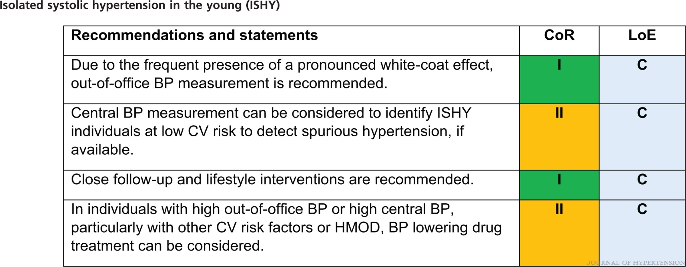
2023 ESH Guidelines for the management of arterial hypertension The Task Force for the management of arterial hypertension of the European Society of Hypertension Endorsed by the European Renal Association (ERA) and the International Society of Hypertension (ISH)
Mancia(Chairperson), Giuseppe; Kreutz(Co-Chair), Reinhold; Brunström, Mattias; Burnier, Michel; Grassi, Guido; Januszewicz, Andrzej; Muiesan, Maria Lorenza; Tsioufis, Konstantinos; Agabiti-Rosei, Enrico; Algharably, Engi Abd Elhady; Azizi, Michel; Benetos, Athanase; Borghi, Claudio; Hitij, Jana Brguljan; Cifkova, Renata; Coca, Antonio; Cornelissen, Veronique; Cruickshank, Kennedy; Cunha, Pedro G.; Danser, A.H. Jan; de Pinho, Rosa Maria; Delles, Christian; Dominiczak, Anna F.; Dorobantu, Maria; Doumas, Michalis; Fernández-Alfonso, María S.; Halimi, Jean-Michel; Járai, Zoltán; Jelaković, Bojan; Jordan, Jens; Kuznetsova, Tatiana; Laurent, Stephane; Lovic, Dragan; Lurbe, Empar; Mahfoud, Felix; Manolis, Athanasios; Miglinas, Marius; Narkiewicz, Krzystof; Niiranen, Teemu; Palatini, Paolo; Parati, Gianfranco; Pathak, Atul; Persu, Alexandre; Polonia, Jorge; Redon, Josep; Sarafidis, Pantelis; Schmieder, Roland; Spronck, Bart; Stabouli, Stella; Stergiou, George; Taddei, Stefano; Thomopoulos, Costas; Tomaszewski, Maciej; Van de Borne, Philippe; Wanner, Christoph; Weber, Thomas; Williams, Bryan; Zhang, Zhen-Yu; Kjeldsen, Sverre E.
Journal of Hypertension : June 21, 2023
doi: 10.1097/HJH.0000000000003480

Slide 40
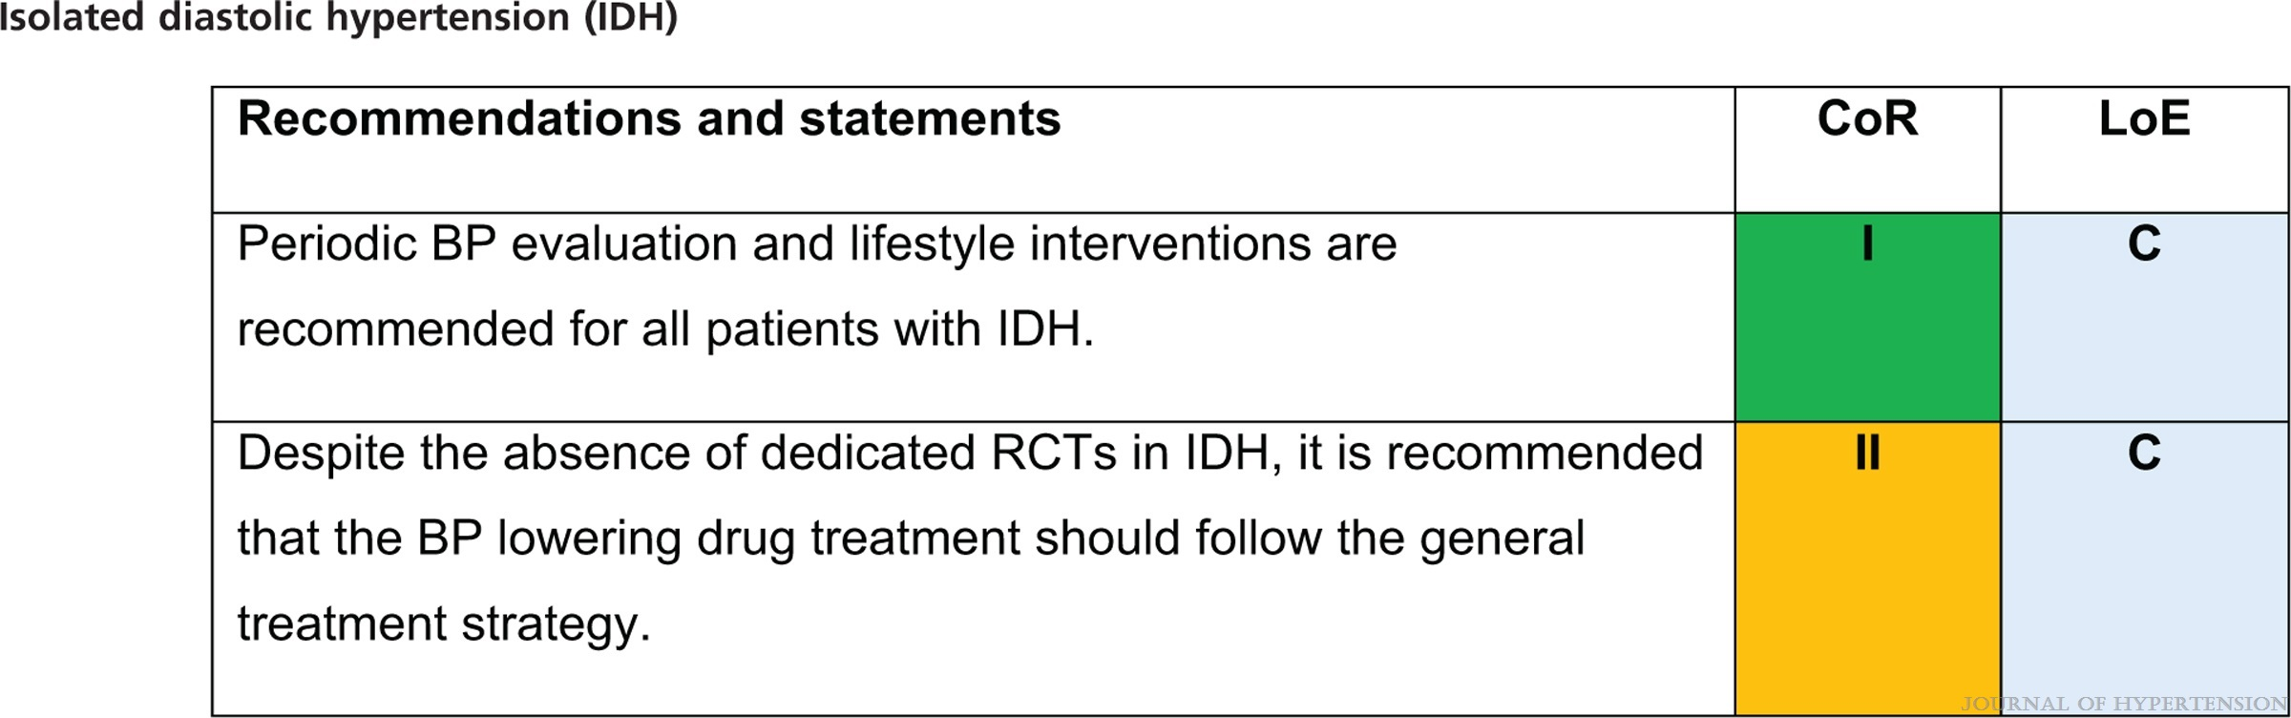
2023 ESH Guidelines for the management of arterial hypertension The Task Force for the management of arterial hypertension of the European Society of Hypertension Endorsed by the European Renal Association (ERA) and the International Society of Hypertension (ISH)
Mancia(Chairperson), Giuseppe; Kreutz(Co-Chair), Reinhold; Brunström, Mattias; Burnier, Michel; Grassi, Guido; Januszewicz, Andrzej; Muiesan, Maria Lorenza; Tsioufis, Konstantinos; Agabiti-Rosei, Enrico; Algharably, Engi Abd Elhady; Azizi, Michel; Benetos, Athanase; Borghi, Claudio; Hitij, Jana Brguljan; Cifkova, Renata; Coca, Antonio; Cornelissen, Veronique; Cruickshank, Kennedy; Cunha, Pedro G.; Danser, A.H. Jan; de Pinho, Rosa Maria; Delles, Christian; Dominiczak, Anna F.; Dorobantu, Maria; Doumas, Michalis; Fernández-Alfonso, María S.; Halimi, Jean-Michel; Járai, Zoltán; Jelaković, Bojan; Jordan, Jens; Kuznetsova, Tatiana; Laurent, Stephane; Lovic, Dragan; Lurbe, Empar; Mahfoud, Felix; Manolis, Athanasios; Miglinas, Marius; Narkiewicz, Krzystof; Niiranen, Teemu; Palatini, Paolo; Parati, Gianfranco; Pathak, Atul; Persu, Alexandre; Polonia, Jorge; Redon, Josep; Sarafidis, Pantelis; Schmieder, Roland; Spronck, Bart; Stabouli, Stella; Stergiou, George; Taddei, Stefano; Thomopoulos, Costas; Tomaszewski, Maciej; Van de Borne, Philippe; Wanner, Christoph; Weber, Thomas; Williams, Bryan; Zhang, Zhen-Yu; Kjeldsen, Sverre E.
Journal of Hypertension : June 21, 2023
doi: 10.1097/HJH.0000000000003480

Slide 41
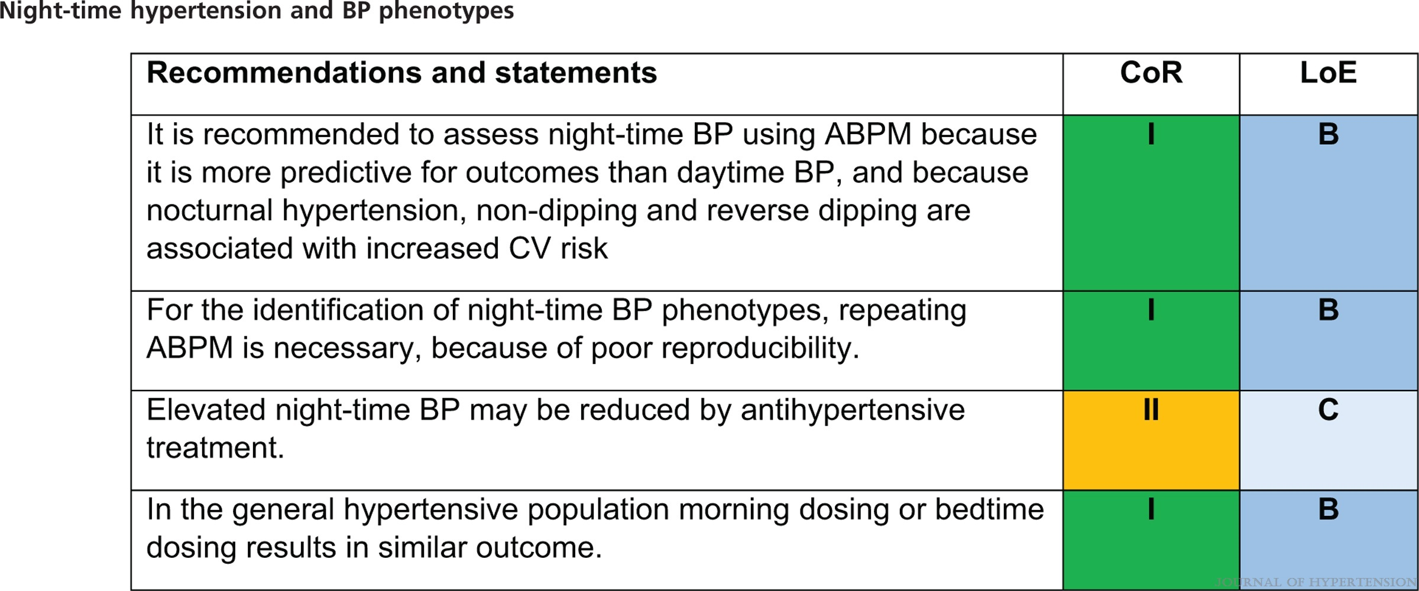
2023 ESH Guidelines for the management of arterial hypertension The Task Force for the management of arterial hypertension of the European Society of Hypertension Endorsed by the European Renal Association (ERA) and the International Society of Hypertension (ISH)
Mancia(Chairperson), Giuseppe; Kreutz(Co-Chair), Reinhold; Brunström, Mattias; Burnier, Michel; Grassi, Guido; Januszewicz, Andrzej; Muiesan, Maria Lorenza; Tsioufis, Konstantinos; Agabiti-Rosei, Enrico; Algharably, Engi Abd Elhady; Azizi, Michel; Benetos, Athanase; Borghi, Claudio; Hitij, Jana Brguljan; Cifkova, Renata; Coca, Antonio; Cornelissen, Veronique; Cruickshank, Kennedy; Cunha, Pedro G.; Danser, A.H. Jan; de Pinho, Rosa Maria; Delles, Christian; Dominiczak, Anna F.; Dorobantu, Maria; Doumas, Michalis; Fernández-Alfonso, María S.; Halimi, Jean-Michel; Járai, Zoltán; Jelaković, Bojan; Jordan, Jens; Kuznetsova, Tatiana; Laurent, Stephane; Lovic, Dragan; Lurbe, Empar; Mahfoud, Felix; Manolis, Athanasios; Miglinas, Marius; Narkiewicz, Krzystof; Niiranen, Teemu; Palatini, Paolo; Parati, Gianfranco; Pathak, Atul; Persu, Alexandre; Polonia, Jorge; Redon, Josep; Sarafidis, Pantelis; Schmieder, Roland; Spronck, Bart; Stabouli, Stella; Stergiou, George; Taddei, Stefano; Thomopoulos, Costas; Tomaszewski, Maciej; Van de Borne, Philippe; Wanner, Christoph; Weber, Thomas; Williams, Bryan; Zhang, Zhen-Yu; Kjeldsen, Sverre E.
Journal of Hypertension : June 21, 2023
doi: 10.1097/HJH.0000000000003480

Slide 42
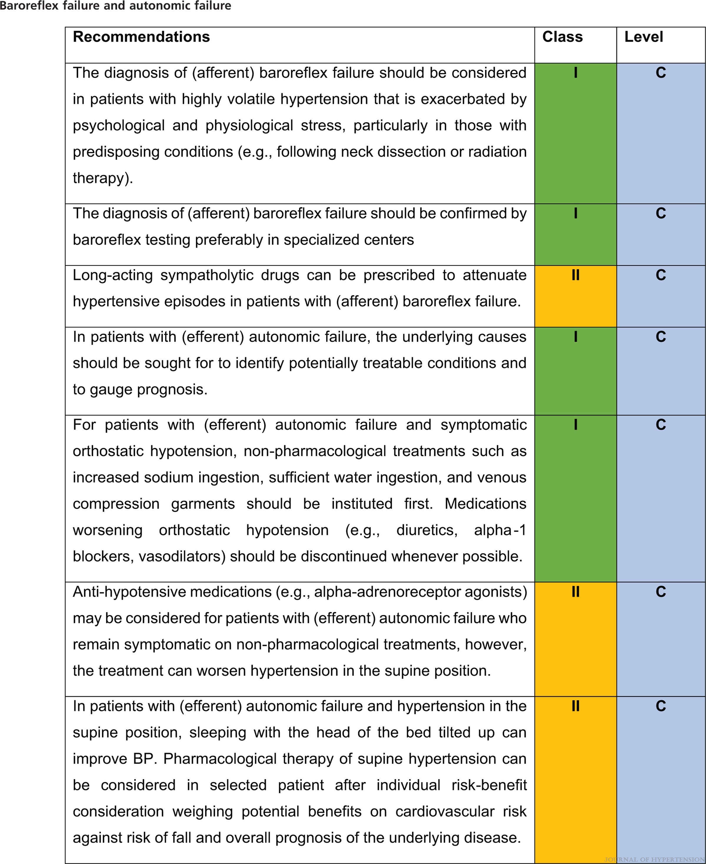
2023 ESH Guidelines for the management of arterial hypertension The Task Force for the management of arterial hypertension of the European Society of Hypertension Endorsed by the European Renal Association (ERA) and the International Society of Hypertension (ISH)
Mancia(Chairperson), Giuseppe; Kreutz(Co-Chair), Reinhold; Brunström, Mattias; Burnier, Michel; Grassi, Guido; Januszewicz, Andrzej; Muiesan, Maria Lorenza; Tsioufis, Konstantinos; Agabiti-Rosei, Enrico; Algharably, Engi Abd Elhady; Azizi, Michel; Benetos, Athanase; Borghi, Claudio; Hitij, Jana Brguljan; Cifkova, Renata; Coca, Antonio; Cornelissen, Veronique; Cruickshank, Kennedy; Cunha, Pedro G.; Danser, A.H. Jan; de Pinho, Rosa Maria; Delles, Christian; Dominiczak, Anna F.; Dorobantu, Maria; Doumas, Michalis; Fernández-Alfonso, María S.; Halimi, Jean-Michel; Járai, Zoltán; Jelaković, Bojan; Jordan, Jens; Kuznetsova, Tatiana; Laurent, Stephane; Lovic, Dragan; Lurbe, Empar; Mahfoud, Felix; Manolis, Athanasios; Miglinas, Marius; Narkiewicz, Krzystof; Niiranen, Teemu; Palatini, Paolo; Parati, Gianfranco; Pathak, Atul; Persu, Alexandre; Polonia, Jorge; Redon, Josep; Sarafidis, Pantelis; Schmieder, Roland; Spronck, Bart; Stabouli, Stella; Stergiou, George; Taddei, Stefano; Thomopoulos, Costas; Tomaszewski, Maciej; Van de Borne, Philippe; Wanner, Christoph; Weber, Thomas; Williams, Bryan; Zhang, Zhen-Yu; Kjeldsen, Sverre E.
Journal of Hypertension : June 21, 2023
doi: 10.1097/HJH.0000000000003480

Slide 43
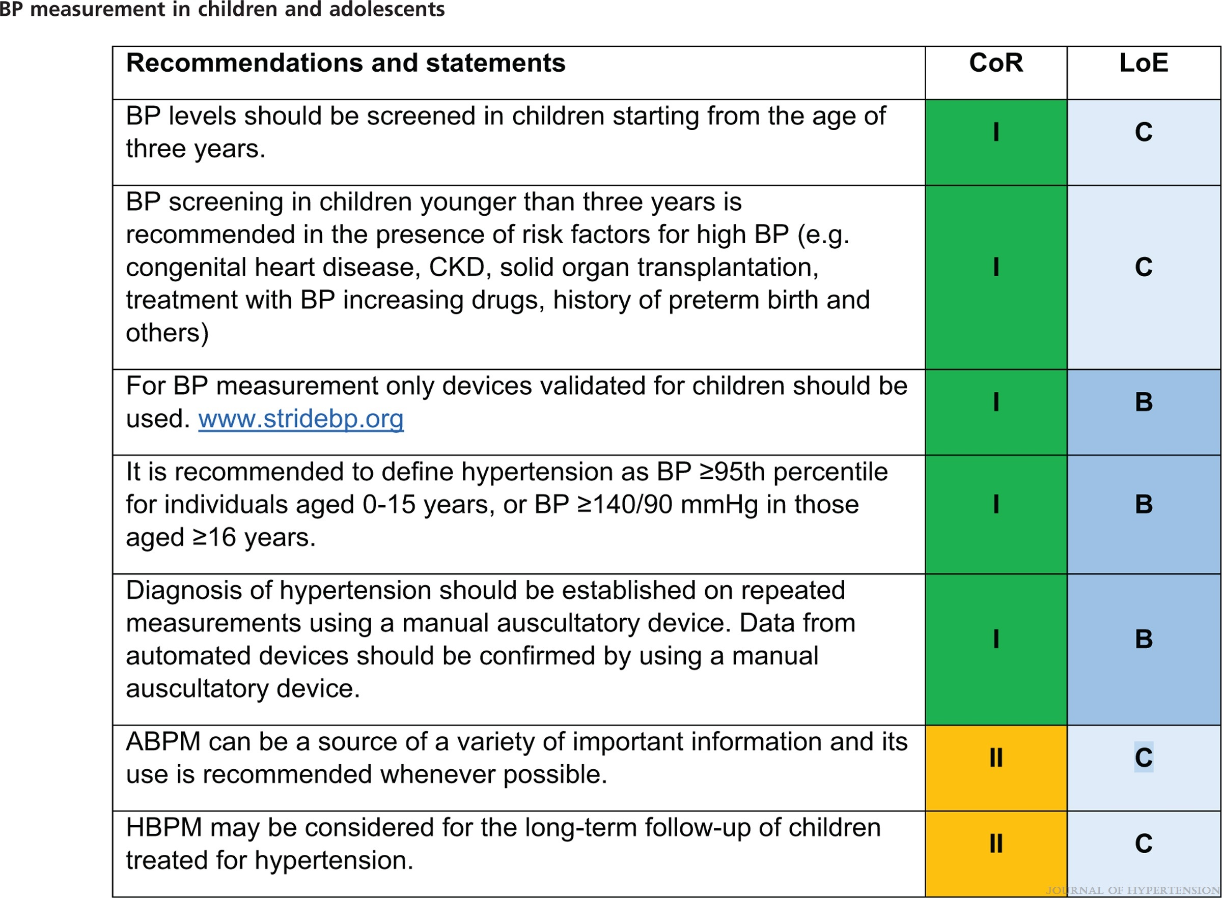
2023 ESH Guidelines for the management of arterial hypertension The Task Force for the management of arterial hypertension of the European Society of Hypertension Endorsed by the European Renal Association (ERA) and the International Society of Hypertension (ISH)
Mancia(Chairperson), Giuseppe; Kreutz(Co-Chair), Reinhold; Brunström, Mattias; Burnier, Michel; Grassi, Guido; Januszewicz, Andrzej; Muiesan, Maria Lorenza; Tsioufis, Konstantinos; Agabiti-Rosei, Enrico; Algharably, Engi Abd Elhady; Azizi, Michel; Benetos, Athanase; Borghi, Claudio; Hitij, Jana Brguljan; Cifkova, Renata; Coca, Antonio; Cornelissen, Veronique; Cruickshank, Kennedy; Cunha, Pedro G.; Danser, A.H. Jan; de Pinho, Rosa Maria; Delles, Christian; Dominiczak, Anna F.; Dorobantu, Maria; Doumas, Michalis; Fernández-Alfonso, María S.; Halimi, Jean-Michel; Járai, Zoltán; Jelaković, Bojan; Jordan, Jens; Kuznetsova, Tatiana; Laurent, Stephane; Lovic, Dragan; Lurbe, Empar; Mahfoud, Felix; Manolis, Athanasios; Miglinas, Marius; Narkiewicz, Krzystof; Niiranen, Teemu; Palatini, Paolo; Parati, Gianfranco; Pathak, Atul; Persu, Alexandre; Polonia, Jorge; Redon, Josep; Sarafidis, Pantelis; Schmieder, Roland; Spronck, Bart; Stabouli, Stella; Stergiou, George; Taddei, Stefano; Thomopoulos, Costas; Tomaszewski, Maciej; Van de Borne, Philippe; Wanner, Christoph; Weber, Thomas; Williams, Bryan; Zhang, Zhen-Yu; Kjeldsen, Sverre E.
Journal of Hypertension : June 21, 2023
doi: 10.1097/HJH.0000000000003480

Slide 44
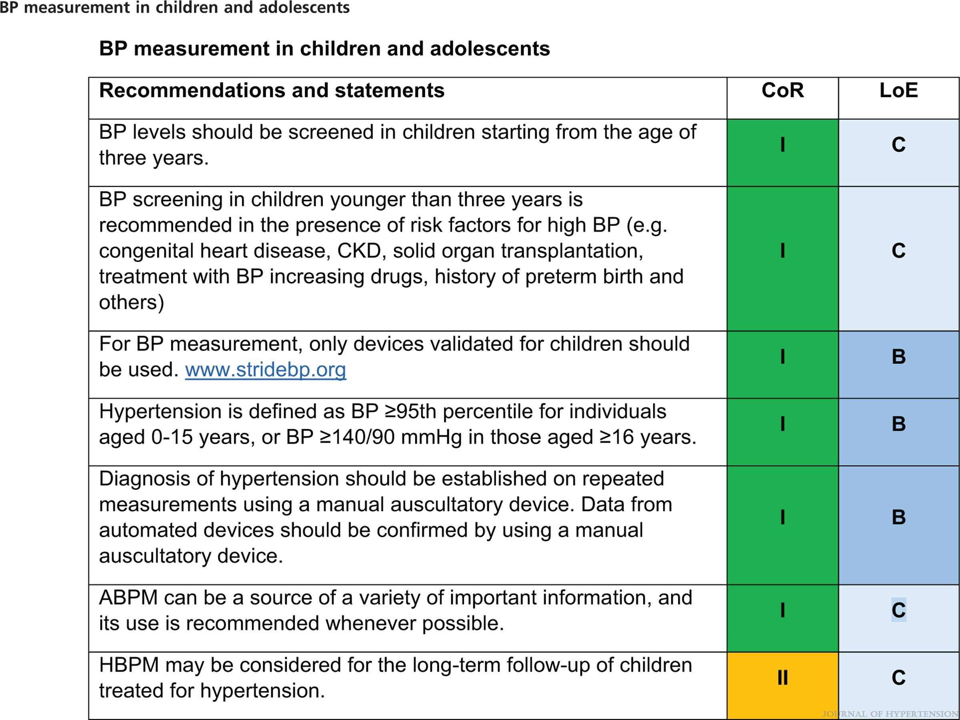
2023 ESH Guidelines for the management of arterial hypertension The Task Force for the management of arterial hypertension of the European Society of Hypertension Endorsed by the European Renal Association (ERA) and the International Society of Hypertension (ISH)
Mancia(Chairperson), Giuseppe; Kreutz(Co-Chair), Reinhold; Brunström, Mattias; Burnier, Michel; Grassi, Guido; Januszewicz, Andrzej; Muiesan, Maria Lorenza; Tsioufis, Konstantinos; Agabiti-Rosei, Enrico; Algharably, Engi Abd Elhady; Azizi, Michel; Benetos, Athanase; Borghi, Claudio; Hitij, Jana Brguljan; Cifkova, Renata; Coca, Antonio; Cornelissen, Veronique; Cruickshank, Kennedy; Cunha, Pedro G.; Danser, A.H. Jan; de Pinho, Rosa Maria; Delles, Christian; Dominiczak, Anna F.; Dorobantu, Maria; Doumas, Michalis; Fernández-Alfonso, María S.; Halimi, Jean-Michel; Járai, Zoltán; Jelaković, Bojan; Jordan, Jens; Kuznetsova, Tatiana; Laurent, Stephane; Lovic, Dragan; Lurbe, Empar; Mahfoud, Felix; Manolis, Athanasios; Miglinas, Marius; Narkiewicz, Krzystof; Niiranen, Teemu; Palatini, Paolo; Parati, Gianfranco; Pathak, Atul; Persu, Alexandre; Polonia, Jorge; Redon, Josep; Sarafidis, Pantelis; Schmieder, Roland; Spronck, Bart; Stabouli, Stella; Stergiou, George; Taddei, Stefano; Thomopoulos, Costas; Tomaszewski, Maciej; Van de Borne, Philippe; Wanner, Christoph; Weber, Thomas; Williams, Bryan; Zhang, Zhen-Yu; Kjeldsen, Sverre E.
Journal of Hypertension : June 21, 2023
doi: 10.1097/HJH.0000000000003480

Slide 45
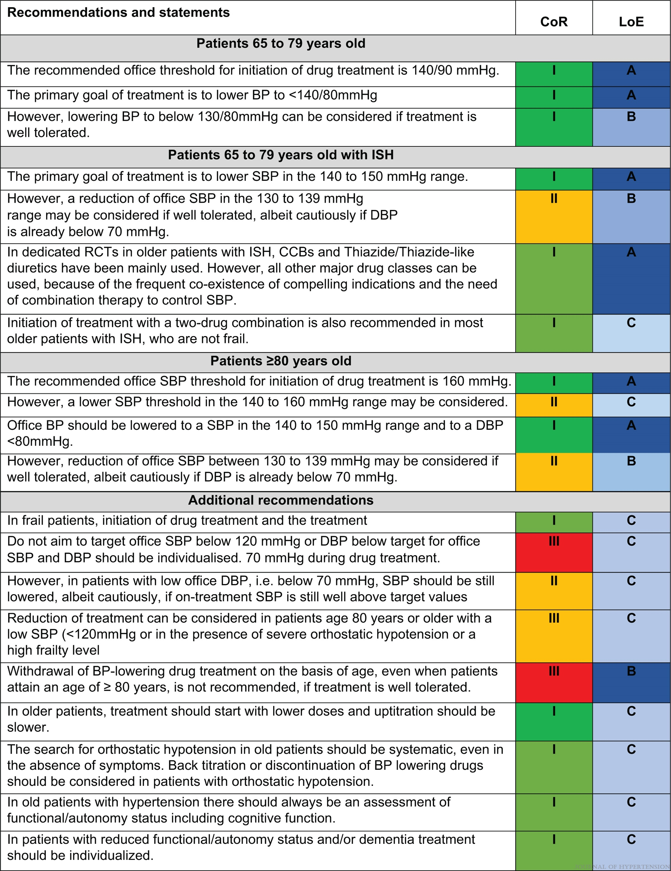
2023 ESH Guidelines for the management of arterial hypertension The Task Force for the management of arterial hypertension of the European Society of Hypertension Endorsed by the European Renal Association (ERA) and the International Society of Hypertension (ISH)
Mancia(Chairperson), Giuseppe; Kreutz(Co-Chair), Reinhold; Brunström, Mattias; Burnier, Michel; Grassi, Guido; Januszewicz, Andrzej; Muiesan, Maria Lorenza; Tsioufis, Konstantinos; Agabiti-Rosei, Enrico; Algharably, Engi Abd Elhady; Azizi, Michel; Benetos, Athanase; Borghi, Claudio; Hitij, Jana Brguljan; Cifkova, Renata; Coca, Antonio; Cornelissen, Veronique; Cruickshank, Kennedy; Cunha, Pedro G.; Danser, A.H. Jan; de Pinho, Rosa Maria; Delles, Christian; Dominiczak, Anna F.; Dorobantu, Maria; Doumas, Michalis; Fernández-Alfonso, María S.; Halimi, Jean-Michel; Járai, Zoltán; Jelaković, Bojan; Jordan, Jens; Kuznetsova, Tatiana; Laurent, Stephane; Lovic, Dragan; Lurbe, Empar; Mahfoud, Felix; Manolis, Athanasios; Miglinas, Marius; Narkiewicz, Krzystof; Niiranen, Teemu; Palatini, Paolo; Parati, Gianfranco; Pathak, Atul; Persu, Alexandre; Polonia, Jorge; Redon, Josep; Sarafidis, Pantelis; Schmieder, Roland; Spronck, Bart; Stabouli, Stella; Stergiou, George; Taddei, Stefano; Thomopoulos, Costas; Tomaszewski, Maciej; Van de Borne, Philippe; Wanner, Christoph; Weber, Thomas; Williams, Bryan; Zhang, Zhen-Yu; Kjeldsen, Sverre E.
Journal of Hypertension : June 21, 2023
doi: 10.1097/HJH.0000000000003480

Slide 46
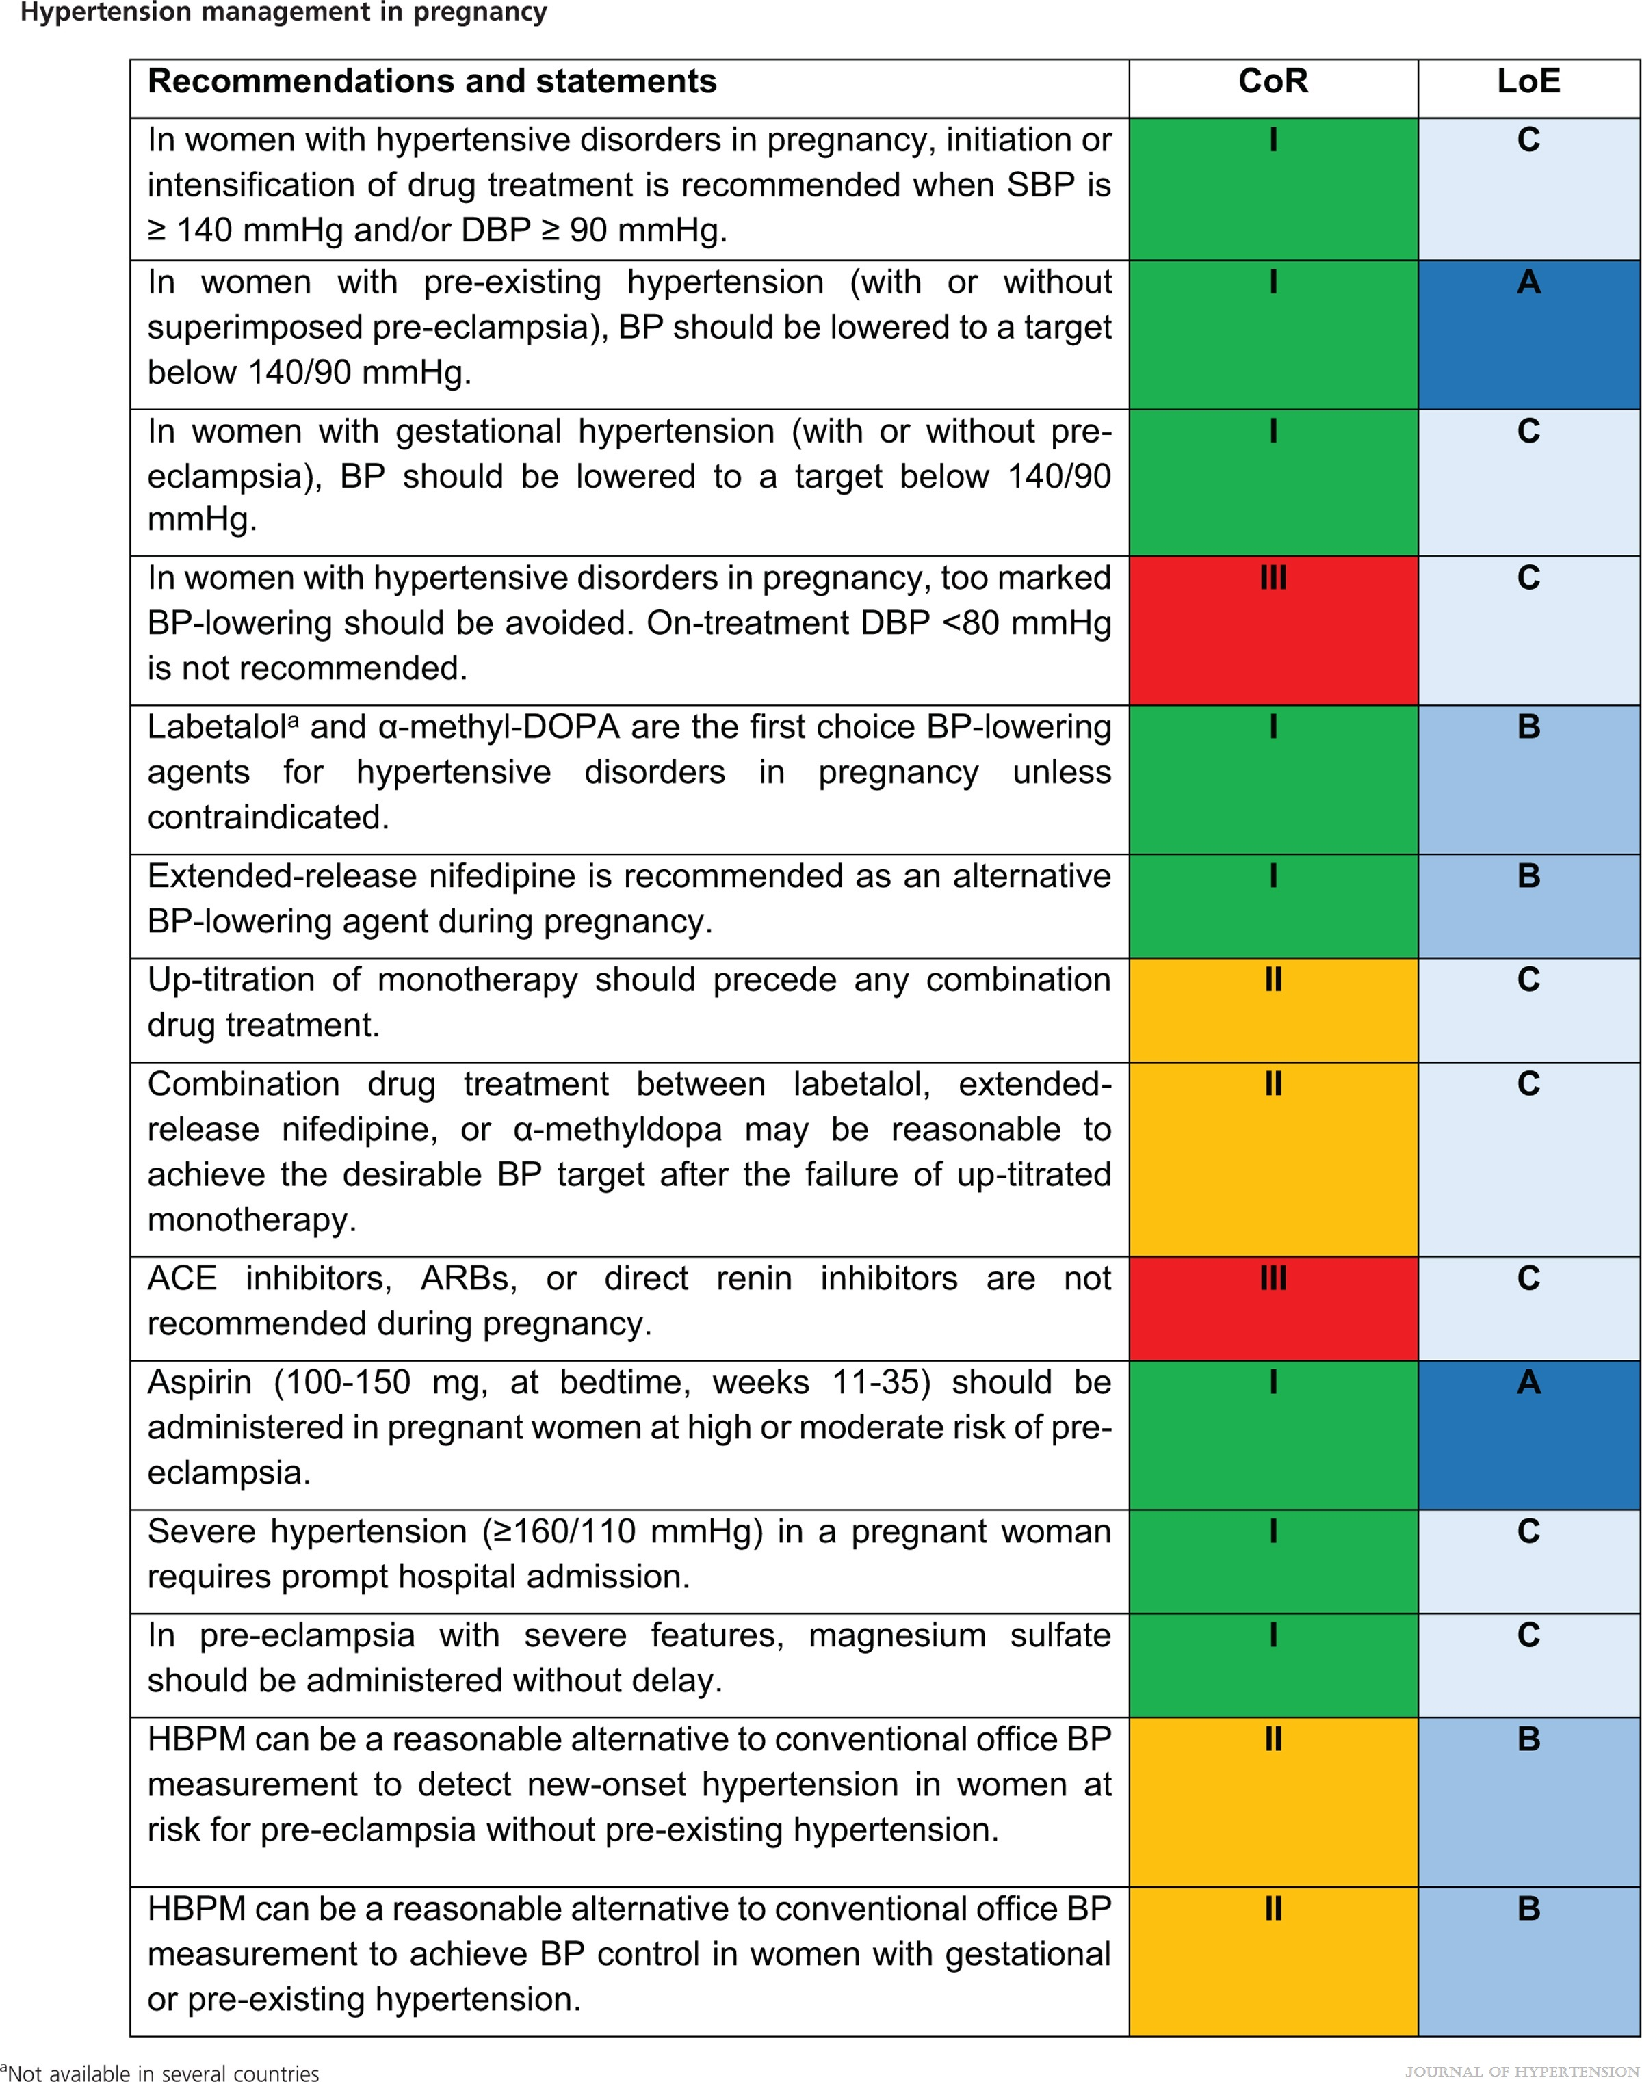
2023 ESH Guidelines for the management of arterial hypertension The Task Force for the management of arterial hypertension of the European Society of Hypertension Endorsed by the European Renal Association (ERA) and the International Society of Hypertension (ISH)
Mancia(Chairperson), Giuseppe; Kreutz(Co-Chair), Reinhold; Brunström, Mattias; Burnier, Michel; Grassi, Guido; Januszewicz, Andrzej; Muiesan, Maria Lorenza; Tsioufis, Konstantinos; Agabiti-Rosei, Enrico; Algharably, Engi Abd Elhady; Azizi, Michel; Benetos, Athanase; Borghi, Claudio; Hitij, Jana Brguljan; Cifkova, Renata; Coca, Antonio; Cornelissen, Veronique; Cruickshank, Kennedy; Cunha, Pedro G.; Danser, A.H. Jan; de Pinho, Rosa Maria; Delles, Christian; Dominiczak, Anna F.; Dorobantu, Maria; Doumas, Michalis; Fernández-Alfonso, María S.; Halimi, Jean-Michel; Járai, Zoltán; Jelaković, Bojan; Jordan, Jens; Kuznetsova, Tatiana; Laurent, Stephane; Lovic, Dragan; Lurbe, Empar; Mahfoud, Felix; Manolis, Athanasios; Miglinas, Marius; Narkiewicz, Krzystof; Niiranen, Teemu; Palatini, Paolo; Parati, Gianfranco; Pathak, Atul; Persu, Alexandre; Polonia, Jorge; Redon, Josep; Sarafidis, Pantelis; Schmieder, Roland; Spronck, Bart; Stabouli, Stella; Stergiou, George; Taddei, Stefano; Thomopoulos, Costas; Tomaszewski, Maciej; Van de Borne, Philippe; Wanner, Christoph; Weber, Thomas; Williams, Bryan; Zhang, Zhen-Yu; Kjeldsen, Sverre E.
Journal of Hypertension : June 21, 2023
doi: 10.1097/HJH.0000000000003480

Slide 47
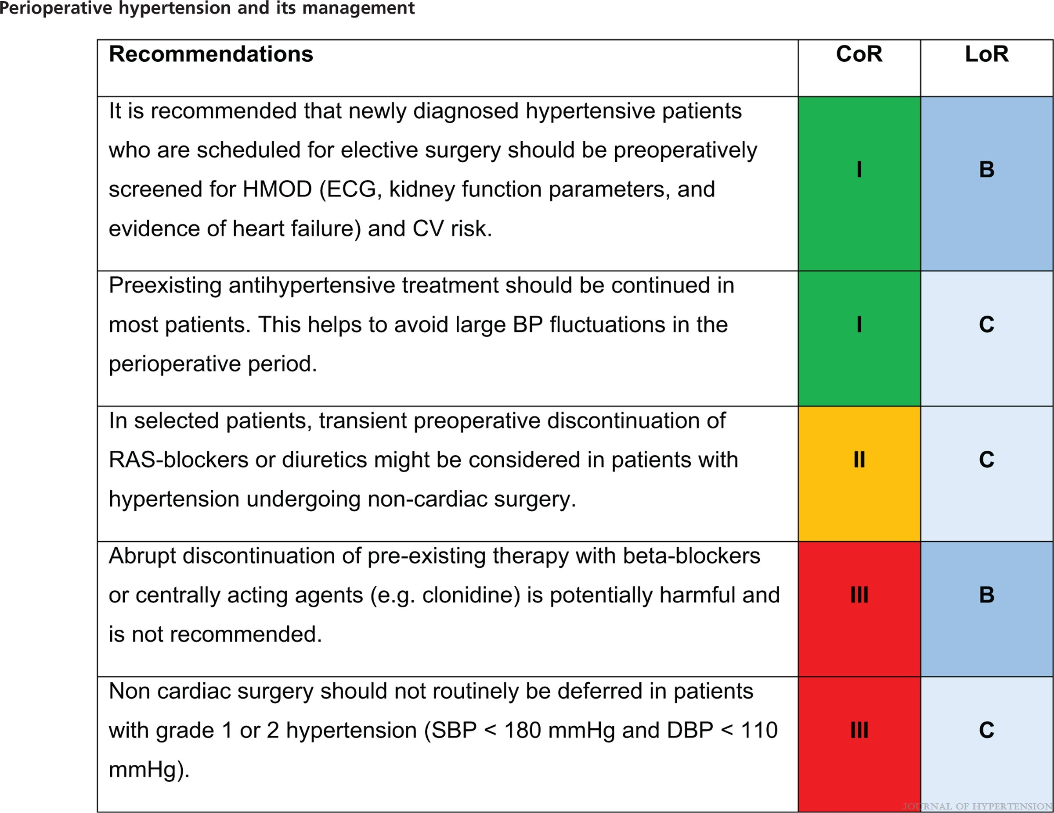
2023 ESH Guidelines for the management of arterial hypertension The Task Force for the management of arterial hypertension of the European Society of Hypertension Endorsed by the European Renal Association (ERA) and the International Society of Hypertension (ISH)
Mancia(Chairperson), Giuseppe; Kreutz(Co-Chair), Reinhold; Brunström, Mattias; Burnier, Michel; Grassi, Guido; Januszewicz, Andrzej; Muiesan, Maria Lorenza; Tsioufis, Konstantinos; Agabiti-Rosei, Enrico; Algharably, Engi Abd Elhady; Azizi, Michel; Benetos, Athanase; Borghi, Claudio; Hitij, Jana Brguljan; Cifkova, Renata; Coca, Antonio; Cornelissen, Veronique; Cruickshank, Kennedy; Cunha, Pedro G.; Danser, A.H. Jan; de Pinho, Rosa Maria; Delles, Christian; Dominiczak, Anna F.; Dorobantu, Maria; Doumas, Michalis; Fernández-Alfonso, María S.; Halimi, Jean-Michel; Járai, Zoltán; Jelaković, Bojan; Jordan, Jens; Kuznetsova, Tatiana; Laurent, Stephane; Lovic, Dragan; Lurbe, Empar; Mahfoud, Felix; Manolis, Athanasios; Miglinas, Marius; Narkiewicz, Krzystof; Niiranen, Teemu; Palatini, Paolo; Parati, Gianfranco; Pathak, Atul; Persu, Alexandre; Polonia, Jorge; Redon, Josep; Sarafidis, Pantelis; Schmieder, Roland; Spronck, Bart; Stabouli, Stella; Stergiou, George; Taddei, Stefano; Thomopoulos, Costas; Tomaszewski, Maciej; Van de Borne, Philippe; Wanner, Christoph; Weber, Thomas; Williams, Bryan; Zhang, Zhen-Yu; Kjeldsen, Sverre E.
Journal of Hypertension : June 21, 2023
doi: 10.1097/HJH.0000000000003480

Slide 48
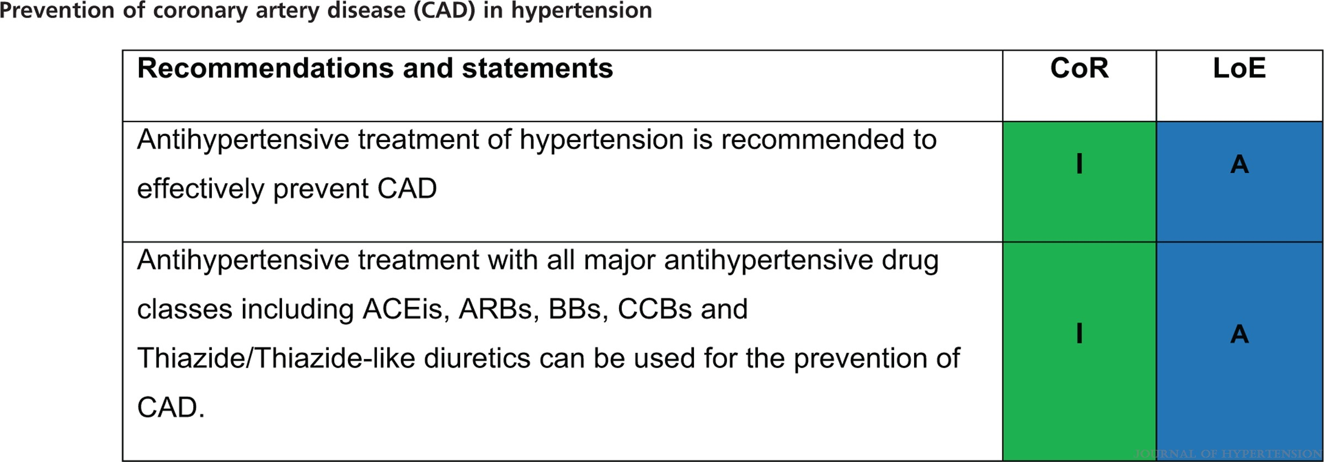
2023 ESH Guidelines for the management of arterial hypertension The Task Force for the management of arterial hypertension of the European Society of Hypertension Endorsed by the European Renal Association (ERA) and the International Society of Hypertension (ISH)
Mancia(Chairperson), Giuseppe; Kreutz(Co-Chair), Reinhold; Brunström, Mattias; Burnier, Michel; Grassi, Guido; Januszewicz, Andrzej; Muiesan, Maria Lorenza; Tsioufis, Konstantinos; Agabiti-Rosei, Enrico; Algharably, Engi Abd Elhady; Azizi, Michel; Benetos, Athanase; Borghi, Claudio; Hitij, Jana Brguljan; Cifkova, Renata; Coca, Antonio; Cornelissen, Veronique; Cruickshank, Kennedy; Cunha, Pedro G.; Danser, A.H. Jan; de Pinho, Rosa Maria; Delles, Christian; Dominiczak, Anna F.; Dorobantu, Maria; Doumas, Michalis; Fernández-Alfonso, María S.; Halimi, Jean-Michel; Járai, Zoltán; Jelaković, Bojan; Jordan, Jens; Kuznetsova, Tatiana; Laurent, Stephane; Lovic, Dragan; Lurbe, Empar; Mahfoud, Felix; Manolis, Athanasios; Miglinas, Marius; Narkiewicz, Krzystof; Niiranen, Teemu; Palatini, Paolo; Parati, Gianfranco; Pathak, Atul; Persu, Alexandre; Polonia, Jorge; Redon, Josep; Sarafidis, Pantelis; Schmieder, Roland; Spronck, Bart; Stabouli, Stella; Stergiou, George; Taddei, Stefano; Thomopoulos, Costas; Tomaszewski, Maciej; Van de Borne, Philippe; Wanner, Christoph; Weber, Thomas; Williams, Bryan; Zhang, Zhen-Yu; Kjeldsen, Sverre E.
Journal of Hypertension : June 21, 2023
doi: 10.1097/HJH.0000000000003480

Slide 49
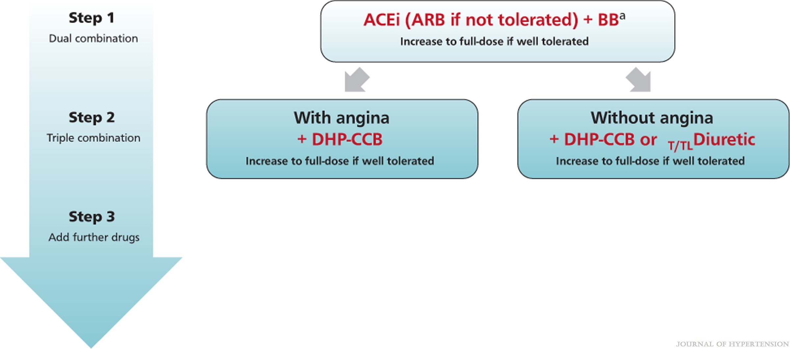
FIGURE 15
2023 ESH Guidelines for the management of arterial hypertension The Task Force for the management of arterial hypertension of the European Society of Hypertension Endorsed by the European Renal Association (ERA) and the International Society of Hypertension (ISH)
Mancia(Chairperson), Giuseppe; Kreutz(Co-Chair), Reinhold; Brunström, Mattias; Burnier, Michel; Grassi, Guido; Januszewicz, Andrzej; Muiesan, Maria Lorenza; Tsioufis, Konstantinos; Agabiti-Rosei, Enrico; Algharably, Engi Abd Elhady; Azizi, Michel; Benetos, Athanase; Borghi, Claudio; Hitij, Jana Brguljan; Cifkova, Renata; Coca, Antonio; Cornelissen, Veronique; Cruickshank, Kennedy; Cunha, Pedro G.; Danser, A.H. Jan; de Pinho, Rosa Maria; Delles, Christian; Dominiczak, Anna F.; Dorobantu, Maria; Doumas, Michalis; Fernández-Alfonso, María S.; Halimi, Jean-Michel; Járai, Zoltán; Jelaković, Bojan; Jordan, Jens; Kuznetsova, Tatiana; Laurent, Stephane; Lovic, Dragan; Lurbe, Empar; Mahfoud, Felix; Manolis, Athanasios; Miglinas, Marius; Narkiewicz, Krzystof; Niiranen, Teemu; Palatini, Paolo; Parati, Gianfranco; Pathak, Atul; Persu, Alexandre; Polonia, Jorge; Redon, Josep; Sarafidis, Pantelis; Schmieder, Roland; Spronck, Bart; Stabouli, Stella; Stergiou, George; Taddei, Stefano; Thomopoulos, Costas; Tomaszewski, Maciej; Van de Borne, Philippe; Wanner, Christoph; Weber, Thomas; Williams, Bryan; Zhang, Zhen-Yu; Kjeldsen, Sverre E.
Journal of Hypertension : June 21, 2023
doi: 10.1097/HJH.0000000000003480
BP lowering therapy in patients with Hypertension and Coronary Artery Disease.aTarget heart rate below 80 beats per minute, if BBs are contraindicated or not tolerated consider use of non-DHP CCB at any step instead of DHP-CCB.

Slide 50
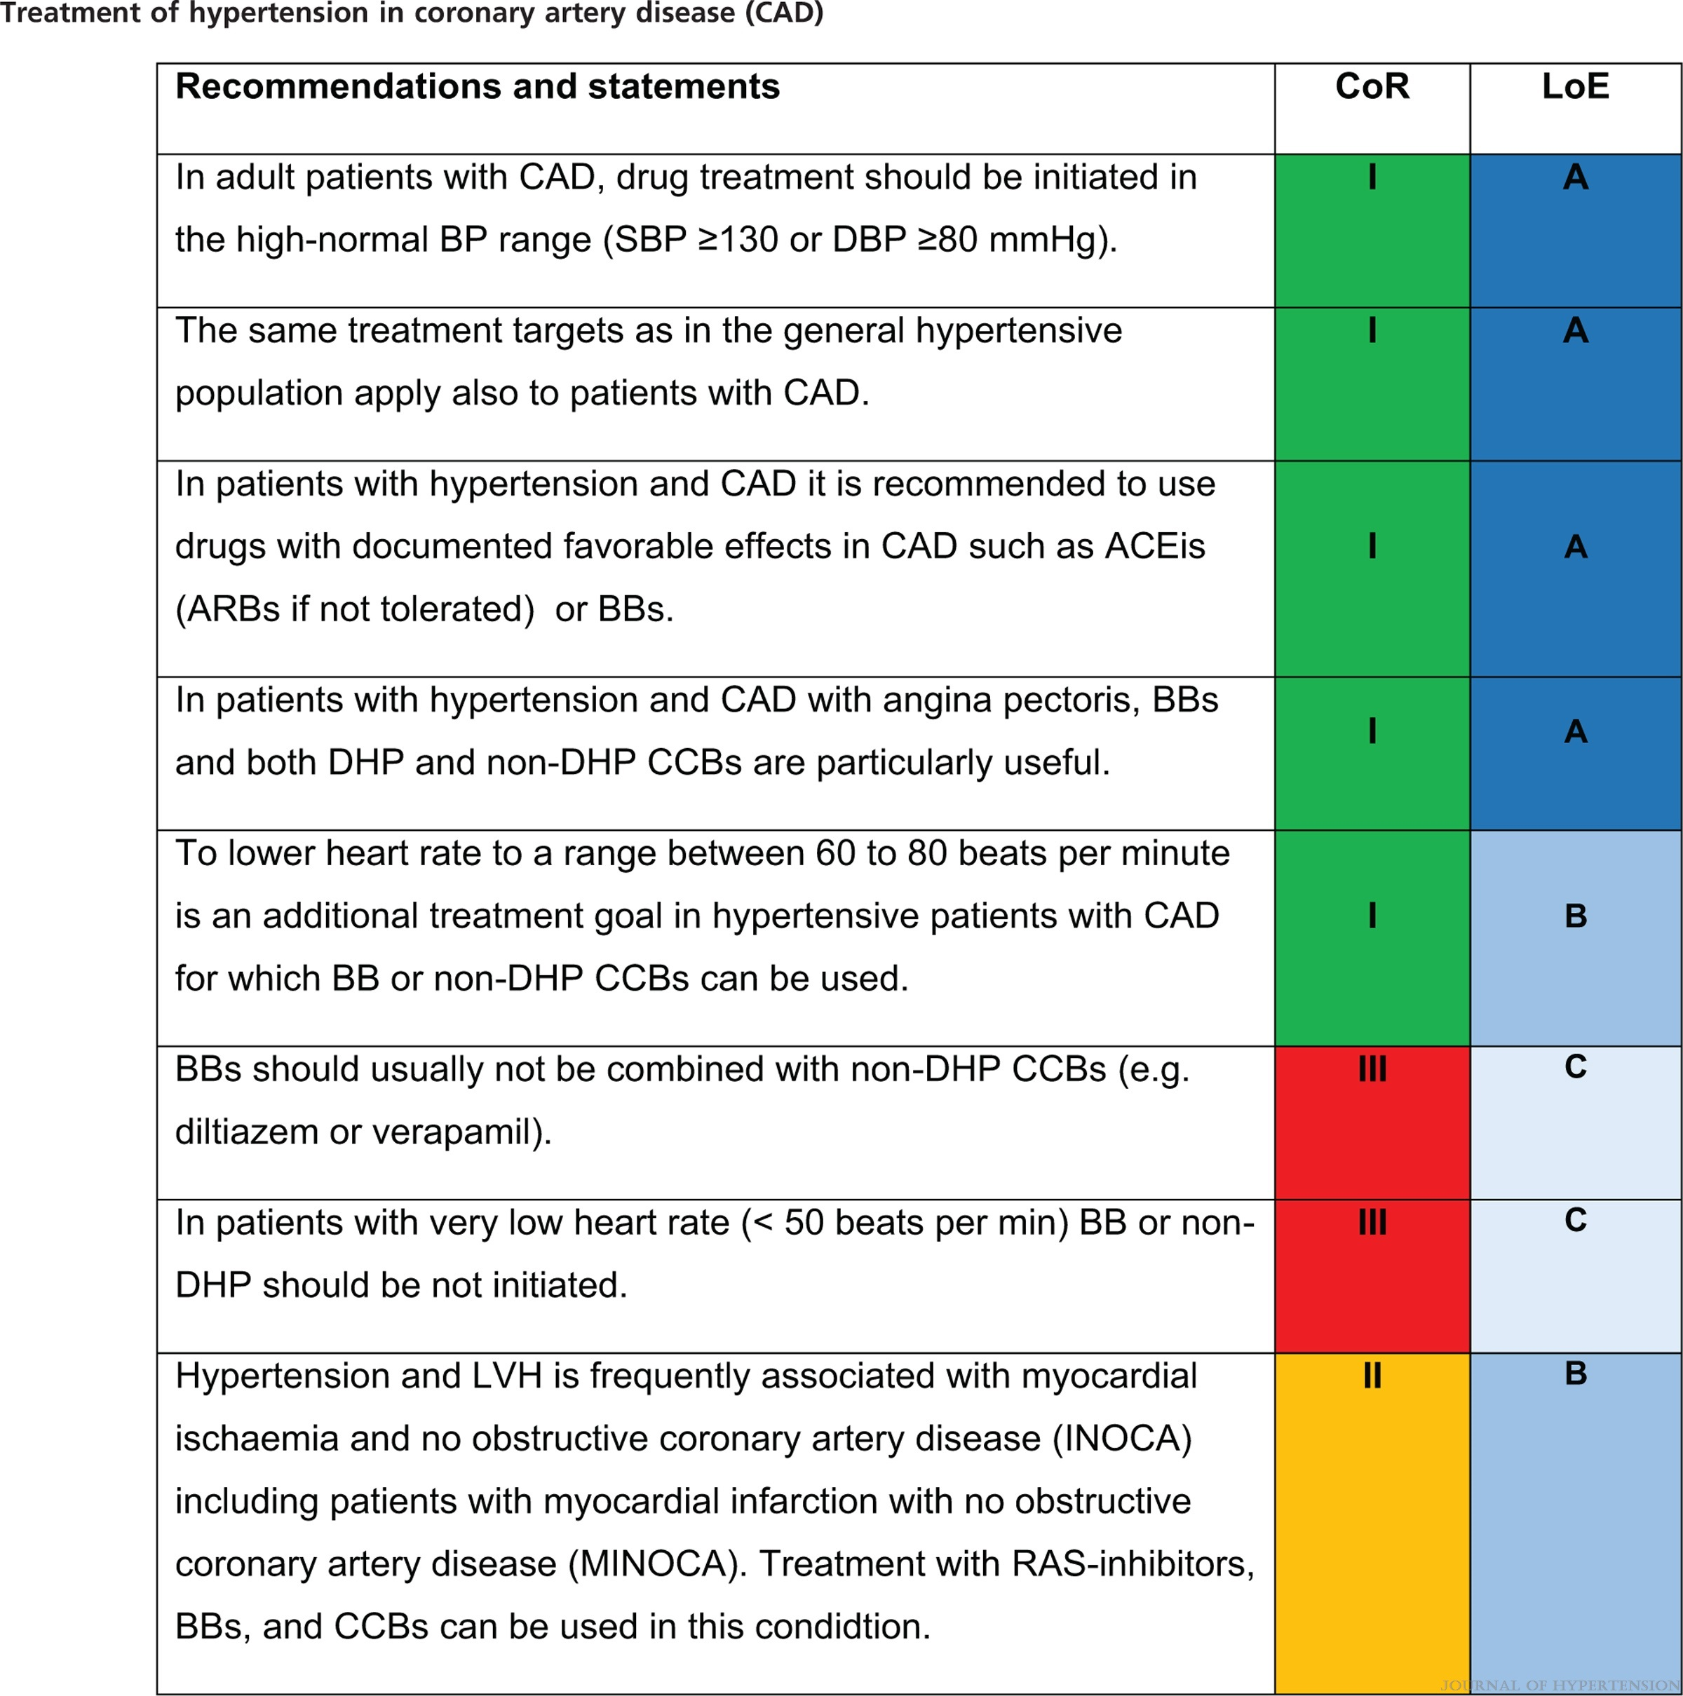
2023 ESH Guidelines for the management of arterial hypertension The Task Force for the management of arterial hypertension of the European Society of Hypertension Endorsed by the European Renal Association (ERA) and the International Society of Hypertension (ISH)
Mancia(Chairperson), Giuseppe; Kreutz(Co-Chair), Reinhold; Brunström, Mattias; Burnier, Michel; Grassi, Guido; Januszewicz, Andrzej; Muiesan, Maria Lorenza; Tsioufis, Konstantinos; Agabiti-Rosei, Enrico; Algharably, Engi Abd Elhady; Azizi, Michel; Benetos, Athanase; Borghi, Claudio; Hitij, Jana Brguljan; Cifkova, Renata; Coca, Antonio; Cornelissen, Veronique; Cruickshank, Kennedy; Cunha, Pedro G.; Danser, A.H. Jan; de Pinho, Rosa Maria; Delles, Christian; Dominiczak, Anna F.; Dorobantu, Maria; Doumas, Michalis; Fernández-Alfonso, María S.; Halimi, Jean-Michel; Járai, Zoltán; Jelaković, Bojan; Jordan, Jens; Kuznetsova, Tatiana; Laurent, Stephane; Lovic, Dragan; Lurbe, Empar; Mahfoud, Felix; Manolis, Athanasios; Miglinas, Marius; Narkiewicz, Krzystof; Niiranen, Teemu; Palatini, Paolo; Parati, Gianfranco; Pathak, Atul; Persu, Alexandre; Polonia, Jorge; Redon, Josep; Sarafidis, Pantelis; Schmieder, Roland; Spronck, Bart; Stabouli, Stella; Stergiou, George; Taddei, Stefano; Thomopoulos, Costas; Tomaszewski, Maciej; Van de Borne, Philippe; Wanner, Christoph; Weber, Thomas; Williams, Bryan; Zhang, Zhen-Yu; Kjeldsen, Sverre E.
Journal of Hypertension : June 21, 2023
doi: 10.1097/HJH.0000000000003480

Slide 51
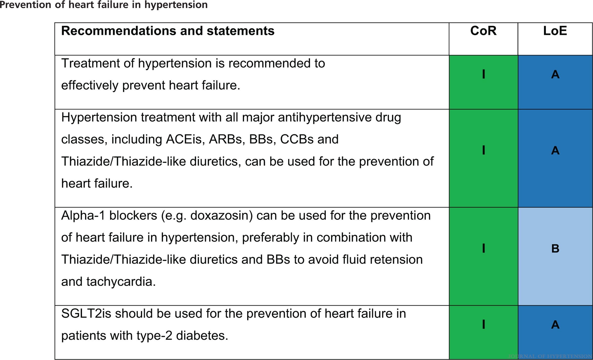
2023 ESH Guidelines for the management of arterial hypertension The Task Force for the management of arterial hypertension of the European Society of Hypertension Endorsed by the European Renal Association (ERA) and the International Society of Hypertension (ISH)
Mancia(Chairperson), Giuseppe; Kreutz(Co-Chair), Reinhold; Brunström, Mattias; Burnier, Michel; Grassi, Guido; Januszewicz, Andrzej; Muiesan, Maria Lorenza; Tsioufis, Konstantinos; Agabiti-Rosei, Enrico; Algharably, Engi Abd Elhady; Azizi, Michel; Benetos, Athanase; Borghi, Claudio; Hitij, Jana Brguljan; Cifkova, Renata; Coca, Antonio; Cornelissen, Veronique; Cruickshank, Kennedy; Cunha, Pedro G.; Danser, A.H. Jan; de Pinho, Rosa Maria; Delles, Christian; Dominiczak, Anna F.; Dorobantu, Maria; Doumas, Michalis; Fernández-Alfonso, María S.; Halimi, Jean-Michel; Járai, Zoltán; Jelaković, Bojan; Jordan, Jens; Kuznetsova, Tatiana; Laurent, Stephane; Lovic, Dragan; Lurbe, Empar; Mahfoud, Felix; Manolis, Athanasios; Miglinas, Marius; Narkiewicz, Krzystof; Niiranen, Teemu; Palatini, Paolo; Parati, Gianfranco; Pathak, Atul; Persu, Alexandre; Polonia, Jorge; Redon, Josep; Sarafidis, Pantelis; Schmieder, Roland; Spronck, Bart; Stabouli, Stella; Stergiou, George; Taddei, Stefano; Thomopoulos, Costas; Tomaszewski, Maciej; Van de Borne, Philippe; Wanner, Christoph; Weber, Thomas; Williams, Bryan; Zhang, Zhen-Yu; Kjeldsen, Sverre E.
Journal of Hypertension : June 21, 2023
doi: 10.1097/HJH.0000000000003480

Slide 52

FIGURE 16
2023 ESH Guidelines for the management of arterial hypertension The Task Force for the management of arterial hypertension of the European Society of Hypertension Endorsed by the European Renal Association (ERA) and the International Society of Hypertension (ISH)
Mancia(Chairperson), Giuseppe; Kreutz(Co-Chair), Reinhold; Brunström, Mattias; Burnier, Michel; Grassi, Guido; Januszewicz, Andrzej; Muiesan, Maria Lorenza; Tsioufis, Konstantinos; Agabiti-Rosei, Enrico; Algharably, Engi Abd Elhady; Azizi, Michel; Benetos, Athanase; Borghi, Claudio; Hitij, Jana Brguljan; Cifkova, Renata; Coca, Antonio; Cornelissen, Veronique; Cruickshank, Kennedy; Cunha, Pedro G.; Danser, A.H. Jan; de Pinho, Rosa Maria; Delles, Christian; Dominiczak, Anna F.; Dorobantu, Maria; Doumas, Michalis; Fernández-Alfonso, María S.; Halimi, Jean-Michel; Járai, Zoltán; Jelaković, Bojan; Jordan, Jens; Kuznetsova, Tatiana; Laurent, Stephane; Lovic, Dragan; Lurbe, Empar; Mahfoud, Felix; Manolis, Athanasios; Miglinas, Marius; Narkiewicz, Krzystof; Niiranen, Teemu; Palatini, Paolo; Parati, Gianfranco; Pathak, Atul; Persu, Alexandre; Polonia, Jorge; Redon, Josep; Sarafidis, Pantelis; Schmieder, Roland; Spronck, Bart; Stabouli, Stella; Stergiou, George; Taddei, Stefano; Thomopoulos, Costas; Tomaszewski, Maciej; Van de Borne, Philippe; Wanner, Christoph; Weber, Thomas; Williams, Bryan; Zhang, Zhen-Yu; Kjeldsen, Sverre E.
Journal of Hypertension : June 21, 2023
doi: 10.1097/HJH.0000000000003480
BP-lowering drugs in hypertension and heart failure. (a) Non-DHP CCB are not recommended in HFrEF and should not be combined with BB. (b) Use of Diuretics: Use T/TLDiuretic if eGFR >45 ml/min/1.73 m2. Consider transition to Loop Diuretic if eGFR is between 30 to 45 ml/min/1.73 m2. Use loop Diuretic if eGFR <30 ml/min/1.73 m2 or in patients with fluid retention/oedema.

Slide 53

2023 ESH Guidelines for the management of arterial hypertension The Task Force for the management of arterial hypertension of the European Society of Hypertension Endorsed by the European Renal Association (ERA) and the International Society of Hypertension (ISH)
Mancia(Chairperson), Giuseppe; Kreutz(Co-Chair), Reinhold; Brunström, Mattias; Burnier, Michel; Grassi, Guido; Januszewicz, Andrzej; Muiesan, Maria Lorenza; Tsioufis, Konstantinos; Agabiti-Rosei, Enrico; Algharably, Engi Abd Elhady; Azizi, Michel; Benetos, Athanase; Borghi, Claudio; Hitij, Jana Brguljan; Cifkova, Renata; Coca, Antonio; Cornelissen, Veronique; Cruickshank, Kennedy; Cunha, Pedro G.; Danser, A.H. Jan; de Pinho, Rosa Maria; Delles, Christian; Dominiczak, Anna F.; Dorobantu, Maria; Doumas, Michalis; Fernández-Alfonso, María S.; Halimi, Jean-Michel; Járai, Zoltán; Jelaković, Bojan; Jordan, Jens; Kuznetsova, Tatiana; Laurent, Stephane; Lovic, Dragan; Lurbe, Empar; Mahfoud, Felix; Manolis, Athanasios; Miglinas, Marius; Narkiewicz, Krzystof; Niiranen, Teemu; Palatini, Paolo; Parati, Gianfranco; Pathak, Atul; Persu, Alexandre; Polonia, Jorge; Redon, Josep; Sarafidis, Pantelis; Schmieder, Roland; Spronck, Bart; Stabouli, Stella; Stergiou, George; Taddei, Stefano; Thomopoulos, Costas; Tomaszewski, Maciej; Van de Borne, Philippe; Wanner, Christoph; Weber, Thomas; Williams, Bryan; Zhang, Zhen-Yu; Kjeldsen, Sverre E.
Journal of Hypertension : June 21, 2023
doi: 10.1097/HJH.0000000000003480

Slide 54

FIGURE 17
2023 ESH Guidelines for the management of arterial hypertension The Task Force for the management of arterial hypertension of the European Society of Hypertension Endorsed by the European Renal Association (ERA) and the International Society of Hypertension (ISH)
Mancia(Chairperson), Giuseppe; Kreutz(Co-Chair), Reinhold; Brunström, Mattias; Burnier, Michel; Grassi, Guido; Januszewicz, Andrzej; Muiesan, Maria Lorenza; Tsioufis, Konstantinos; Agabiti-Rosei, Enrico; Algharably, Engi Abd Elhady; Azizi, Michel; Benetos, Athanase; Borghi, Claudio; Hitij, Jana Brguljan; Cifkova, Renata; Coca, Antonio; Cornelissen, Veronique; Cruickshank, Kennedy; Cunha, Pedro G.; Danser, A.H. Jan; de Pinho, Rosa Maria; Delles, Christian; Dominiczak, Anna F.; Dorobantu, Maria; Doumas, Michalis; Fernández-Alfonso, María S.; Halimi, Jean-Michel; Járai, Zoltán; Jelaković, Bojan; Jordan, Jens; Kuznetsova, Tatiana; Laurent, Stephane; Lovic, Dragan; Lurbe, Empar; Mahfoud, Felix; Manolis, Athanasios; Miglinas, Marius; Narkiewicz, Krzystof; Niiranen, Teemu; Palatini, Paolo; Parati, Gianfranco; Pathak, Atul; Persu, Alexandre; Polonia, Jorge; Redon, Josep; Sarafidis, Pantelis; Schmieder, Roland; Spronck, Bart; Stabouli, Stella; Stergiou, George; Taddei, Stefano; Thomopoulos, Costas; Tomaszewski, Maciej; Van de Borne, Philippe; Wanner, Christoph; Weber, Thomas; Williams, Bryan; Zhang, Zhen-Yu; Kjeldsen, Sverre E.
Journal of Hypertension : June 21, 2023
doi: 10.1097/HJH.0000000000003480
BP-lowering therapy in hypertension and HFpEF. (a) Use of Diuretics: Use T/TLDiuretic if eGFR >45 ml/min/1.73 m2. Consider transition to Loop Diuretic if eGFR is between 30 to 45 ml/min/1.73 m2. Use loop Diuretic if eGFR <30 ml/min/1.73 m2 or in patients with fluid retention/oedema. (b) BB should be used as guideline directed medical therapy in respective indications or considered in several other conditions (Table 16).

Slide 55

2023 ESH Guidelines for the management of arterial hypertension The Task Force for the management of arterial hypertension of the European Society of Hypertension Endorsed by the European Renal Association (ERA) and the International Society of Hypertension (ISH)
Mancia(Chairperson), Giuseppe; Kreutz(Co-Chair), Reinhold; Brunström, Mattias; Burnier, Michel; Grassi, Guido; Januszewicz, Andrzej; Muiesan, Maria Lorenza; Tsioufis, Konstantinos; Agabiti-Rosei, Enrico; Algharably, Engi Abd Elhady; Azizi, Michel; Benetos, Athanase; Borghi, Claudio; Hitij, Jana Brguljan; Cifkova, Renata; Coca, Antonio; Cornelissen, Veronique; Cruickshank, Kennedy; Cunha, Pedro G.; Danser, A.H. Jan; de Pinho, Rosa Maria; Delles, Christian; Dominiczak, Anna F.; Dorobantu, Maria; Doumas, Michalis; Fernández-Alfonso, María S.; Halimi, Jean-Michel; Járai, Zoltán; Jelaković, Bojan; Jordan, Jens; Kuznetsova, Tatiana; Laurent, Stephane; Lovic, Dragan; Lurbe, Empar; Mahfoud, Felix; Manolis, Athanasios; Miglinas, Marius; Narkiewicz, Krzystof; Niiranen, Teemu; Palatini, Paolo; Parati, Gianfranco; Pathak, Atul; Persu, Alexandre; Polonia, Jorge; Redon, Josep; Sarafidis, Pantelis; Schmieder, Roland; Spronck, Bart; Stabouli, Stella; Stergiou, George; Taddei, Stefano; Thomopoulos, Costas; Tomaszewski, Maciej; Van de Borne, Philippe; Wanner, Christoph; Weber, Thomas; Williams, Bryan; Zhang, Zhen-Yu; Kjeldsen, Sverre E.
Journal of Hypertension : June 21, 2023
doi: 10.1097/HJH.0000000000003480

Slide 56

2023 ESH Guidelines for the management of arterial hypertension The Task Force for the management of arterial hypertension of the European Society of Hypertension Endorsed by the European Renal Association (ERA) and the International Society of Hypertension (ISH)
Mancia(Chairperson), Giuseppe; Kreutz(Co-Chair), Reinhold; Brunström, Mattias; Burnier, Michel; Grassi, Guido; Januszewicz, Andrzej; Muiesan, Maria Lorenza; Tsioufis, Konstantinos; Agabiti-Rosei, Enrico; Algharably, Engi Abd Elhady; Azizi, Michel; Benetos, Athanase; Borghi, Claudio; Hitij, Jana Brguljan; Cifkova, Renata; Coca, Antonio; Cornelissen, Veronique; Cruickshank, Kennedy; Cunha, Pedro G.; Danser, A.H. Jan; de Pinho, Rosa Maria; Delles, Christian; Dominiczak, Anna F.; Dorobantu, Maria; Doumas, Michalis; Fernández-Alfonso, María S.; Halimi, Jean-Michel; Járai, Zoltán; Jelaković, Bojan; Jordan, Jens; Kuznetsova, Tatiana; Laurent, Stephane; Lovic, Dragan; Lurbe, Empar; Mahfoud, Felix; Manolis, Athanasios; Miglinas, Marius; Narkiewicz, Krzystof; Niiranen, Teemu; Palatini, Paolo; Parati, Gianfranco; Pathak, Atul; Persu, Alexandre; Polonia, Jorge; Redon, Josep; Sarafidis, Pantelis; Schmieder, Roland; Spronck, Bart; Stabouli, Stella; Stergiou, George; Taddei, Stefano; Thomopoulos, Costas; Tomaszewski, Maciej; Van de Borne, Philippe; Wanner, Christoph; Weber, Thomas; Williams, Bryan; Zhang, Zhen-Yu; Kjeldsen, Sverre E.
Journal of Hypertension : June 21, 2023
doi: 10.1097/HJH.0000000000003480

Slide 57

2023 ESH Guidelines for the management of arterial hypertension The Task Force for the management of arterial hypertension of the European Society of Hypertension Endorsed by the European Renal Association (ERA) and the International Society of Hypertension (ISH)
Mancia(Chairperson), Giuseppe; Kreutz(Co-Chair), Reinhold; Brunström, Mattias; Burnier, Michel; Grassi, Guido; Januszewicz, Andrzej; Muiesan, Maria Lorenza; Tsioufis, Konstantinos; Agabiti-Rosei, Enrico; Algharably, Engi Abd Elhady; Azizi, Michel; Benetos, Athanase; Borghi, Claudio; Hitij, Jana Brguljan; Cifkova, Renata; Coca, Antonio; Cornelissen, Veronique; Cruickshank, Kennedy; Cunha, Pedro G.; Danser, A.H. Jan; de Pinho, Rosa Maria; Delles, Christian; Dominiczak, Anna F.; Dorobantu, Maria; Doumas, Michalis; Fernández-Alfonso, María S.; Halimi, Jean-Michel; Járai, Zoltán; Jelaković, Bojan; Jordan, Jens; Kuznetsova, Tatiana; Laurent, Stephane; Lovic, Dragan; Lurbe, Empar; Mahfoud, Felix; Manolis, Athanasios; Miglinas, Marius; Narkiewicz, Krzystof; Niiranen, Teemu; Palatini, Paolo; Parati, Gianfranco; Pathak, Atul; Persu, Alexandre; Polonia, Jorge; Redon, Josep; Sarafidis, Pantelis; Schmieder, Roland; Spronck, Bart; Stabouli, Stella; Stergiou, George; Taddei, Stefano; Thomopoulos, Costas; Tomaszewski, Maciej; Van de Borne, Philippe; Wanner, Christoph; Weber, Thomas; Williams, Bryan; Zhang, Zhen-Yu; Kjeldsen, Sverre E.
Journal of Hypertension : June 21, 2023
doi: 10.1097/HJH.0000000000003480

Slide 58

FIGURE 18
2023 ESH Guidelines for the management of arterial hypertension The Task Force for the management of arterial hypertension of the European Society of Hypertension Endorsed by the European Renal Association (ERA) and the International Society of Hypertension (ISH)
Mancia(Chairperson), Giuseppe; Kreutz(Co-Chair), Reinhold; Brunström, Mattias; Burnier, Michel; Grassi, Guido; Januszewicz, Andrzej; Muiesan, Maria Lorenza; Tsioufis, Konstantinos; Agabiti-Rosei, Enrico; Algharably, Engi Abd Elhady; Azizi, Michel; Benetos, Athanase; Borghi, Claudio; Hitij, Jana Brguljan; Cifkova, Renata; Coca, Antonio; Cornelissen, Veronique; Cruickshank, Kennedy; Cunha, Pedro G.; Danser, A.H. Jan; de Pinho, Rosa Maria; Delles, Christian; Dominiczak, Anna F.; Dorobantu, Maria; Doumas, Michalis; Fernández-Alfonso, María S.; Halimi, Jean-Michel; Járai, Zoltán; Jelaković, Bojan; Jordan, Jens; Kuznetsova, Tatiana; Laurent, Stephane; Lovic, Dragan; Lurbe, Empar; Mahfoud, Felix; Manolis, Athanasios; Miglinas, Marius; Narkiewicz, Krzystof; Niiranen, Teemu; Palatini, Paolo; Parati, Gianfranco; Pathak, Atul; Persu, Alexandre; Polonia, Jorge; Redon, Josep; Sarafidis, Pantelis; Schmieder, Roland; Spronck, Bart; Stabouli, Stella; Stergiou, George; Taddei, Stefano; Thomopoulos, Costas; Tomaszewski, Maciej; Van de Borne, Philippe; Wanner, Christoph; Weber, Thomas; Williams, Bryan; Zhang, Zhen-Yu; Kjeldsen, Sverre E.
Journal of Hypertension : June 21, 2023
doi: 10.1097/HJH.0000000000003480
BP-lowering therapy in hypertension and atrial fibrillation. (a) Target heart rate below 80 beats per minute, if BBs are contraindicated or not tolerated consider use of non-DHP CCB at any step instead of DHP-CCB.

Slide 59

2023 ESH Guidelines for the management of arterial hypertension The Task Force for the management of arterial hypertension of the European Society of Hypertension Endorsed by the European Renal Association (ERA) and the International Society of Hypertension (ISH)
Mancia(Chairperson), Giuseppe; Kreutz(Co-Chair), Reinhold; Brunström, Mattias; Burnier, Michel; Grassi, Guido; Januszewicz, Andrzej; Muiesan, Maria Lorenza; Tsioufis, Konstantinos; Agabiti-Rosei, Enrico; Algharably, Engi Abd Elhady; Azizi, Michel; Benetos, Athanase; Borghi, Claudio; Hitij, Jana Brguljan; Cifkova, Renata; Coca, Antonio; Cornelissen, Veronique; Cruickshank, Kennedy; Cunha, Pedro G.; Danser, A.H. Jan; de Pinho, Rosa Maria; Delles, Christian; Dominiczak, Anna F.; Dorobantu, Maria; Doumas, Michalis; Fernández-Alfonso, María S.; Halimi, Jean-Michel; Járai, Zoltán; Jelaković, Bojan; Jordan, Jens; Kuznetsova, Tatiana; Laurent, Stephane; Lovic, Dragan; Lurbe, Empar; Mahfoud, Felix; Manolis, Athanasios; Miglinas, Marius; Narkiewicz, Krzystof; Niiranen, Teemu; Palatini, Paolo; Parati, Gianfranco; Pathak, Atul; Persu, Alexandre; Polonia, Jorge; Redon, Josep; Sarafidis, Pantelis; Schmieder, Roland; Spronck, Bart; Stabouli, Stella; Stergiou, George; Taddei, Stefano; Thomopoulos, Costas; Tomaszewski, Maciej; Van de Borne, Philippe; Wanner, Christoph; Weber, Thomas; Williams, Bryan; Zhang, Zhen-Yu; Kjeldsen, Sverre E.
Journal of Hypertension : June 21, 2023
doi: 10.1097/HJH.0000000000003480

Slide 60

2023 ESH Guidelines for the management of arterial hypertension The Task Force for the management of arterial hypertension of the European Society of Hypertension Endorsed by the European Renal Association (ERA) and the International Society of Hypertension (ISH)
Mancia(Chairperson), Giuseppe; Kreutz(Co-Chair), Reinhold; Brunström, Mattias; Burnier, Michel; Grassi, Guido; Januszewicz, Andrzej; Muiesan, Maria Lorenza; Tsioufis, Konstantinos; Agabiti-Rosei, Enrico; Algharably, Engi Abd Elhady; Azizi, Michel; Benetos, Athanase; Borghi, Claudio; Hitij, Jana Brguljan; Cifkova, Renata; Coca, Antonio; Cornelissen, Veronique; Cruickshank, Kennedy; Cunha, Pedro G.; Danser, A.H. Jan; de Pinho, Rosa Maria; Delles, Christian; Dominiczak, Anna F.; Dorobantu, Maria; Doumas, Michalis; Fernández-Alfonso, María S.; Halimi, Jean-Michel; Járai, Zoltán; Jelaković, Bojan; Jordan, Jens; Kuznetsova, Tatiana; Laurent, Stephane; Lovic, Dragan; Lurbe, Empar; Mahfoud, Felix; Manolis, Athanasios; Miglinas, Marius; Narkiewicz, Krzystof; Niiranen, Teemu; Palatini, Paolo; Parati, Gianfranco; Pathak, Atul; Persu, Alexandre; Polonia, Jorge; Redon, Josep; Sarafidis, Pantelis; Schmieder, Roland; Spronck, Bart; Stabouli, Stella; Stergiou, George; Taddei, Stefano; Thomopoulos, Costas; Tomaszewski, Maciej; Van de Borne, Philippe; Wanner, Christoph; Weber, Thomas; Williams, Bryan; Zhang, Zhen-Yu; Kjeldsen, Sverre E.
Journal of Hypertension : June 21, 2023
doi: 10.1097/HJH.0000000000003480

Slide 61

FIGURE 19
2023 ESH Guidelines for the management of arterial hypertension The Task Force for the management of arterial hypertension of the European Society of Hypertension Endorsed by the European Renal Association (ERA) and the International Society of Hypertension (ISH)
Mancia(Chairperson), Giuseppe; Kreutz(Co-Chair), Reinhold; Brunström, Mattias; Burnier, Michel; Grassi, Guido; Januszewicz, Andrzej; Muiesan, Maria Lorenza; Tsioufis, Konstantinos; Agabiti-Rosei, Enrico; Algharably, Engi Abd Elhady; Azizi, Michel; Benetos, Athanase; Borghi, Claudio; Hitij, Jana Brguljan; Cifkova, Renata; Coca, Antonio; Cornelissen, Veronique; Cruickshank, Kennedy; Cunha, Pedro G.; Danser, A.H. Jan; de Pinho, Rosa Maria; Delles, Christian; Dominiczak, Anna F.; Dorobantu, Maria; Doumas, Michalis; Fernández-Alfonso, María S.; Halimi, Jean-Michel; Járai, Zoltán; Jelaković, Bojan; Jordan, Jens; Kuznetsova, Tatiana; Laurent, Stephane; Lovic, Dragan; Lurbe, Empar; Mahfoud, Felix; Manolis, Athanasios; Miglinas, Marius; Narkiewicz, Krzystof; Niiranen, Teemu; Palatini, Paolo; Parati, Gianfranco; Pathak, Atul; Persu, Alexandre; Polonia, Jorge; Redon, Josep; Sarafidis, Pantelis; Schmieder, Roland; Spronck, Bart; Stabouli, Stella; Stergiou, George; Taddei, Stefano; Thomopoulos, Costas; Tomaszewski, Maciej; Van de Borne, Philippe; Wanner, Christoph; Weber, Thomas; Williams, Bryan; Zhang, Zhen-Yu; Kjeldsen, Sverre E.
Journal of Hypertension : June 21, 2023
doi: 10.1097/HJH.0000000000003480
BP management in acute stroke. (a) Avoid absolute reductions of SBP >60 mmHg from initial SBP.

Slide 62

2023 ESH Guidelines for the management of arterial hypertension The Task Force for the management of arterial hypertension of the European Society of Hypertension Endorsed by the European Renal Association (ERA) and the International Society of Hypertension (ISH)
Mancia(Chairperson), Giuseppe; Kreutz(Co-Chair), Reinhold; Brunström, Mattias; Burnier, Michel; Grassi, Guido; Januszewicz, Andrzej; Muiesan, Maria Lorenza; Tsioufis, Konstantinos; Agabiti-Rosei, Enrico; Algharably, Engi Abd Elhady; Azizi, Michel; Benetos, Athanase; Borghi, Claudio; Hitij, Jana Brguljan; Cifkova, Renata; Coca, Antonio; Cornelissen, Veronique; Cruickshank, Kennedy; Cunha, Pedro G.; Danser, A.H. Jan; de Pinho, Rosa Maria; Delles, Christian; Dominiczak, Anna F.; Dorobantu, Maria; Doumas, Michalis; Fernández-Alfonso, María S.; Halimi, Jean-Michel; Járai, Zoltán; Jelaković, Bojan; Jordan, Jens; Kuznetsova, Tatiana; Laurent, Stephane; Lovic, Dragan; Lurbe, Empar; Mahfoud, Felix; Manolis, Athanasios; Miglinas, Marius; Narkiewicz, Krzystof; Niiranen, Teemu; Palatini, Paolo; Parati, Gianfranco; Pathak, Atul; Persu, Alexandre; Polonia, Jorge; Redon, Josep; Sarafidis, Pantelis; Schmieder, Roland; Spronck, Bart; Stabouli, Stella; Stergiou, George; Taddei, Stefano; Thomopoulos, Costas; Tomaszewski, Maciej; Van de Borne, Philippe; Wanner, Christoph; Weber, Thomas; Williams, Bryan; Zhang, Zhen-Yu; Kjeldsen, Sverre E.
Journal of Hypertension : June 21, 2023
doi: 10.1097/HJH.0000000000003480

Slide 63

2023 ESH Guidelines for the management of arterial hypertension The Task Force for the management of arterial hypertension of the European Society of Hypertension Endorsed by the European Renal Association (ERA) and the International Society of Hypertension (ISH)
Mancia(Chairperson), Giuseppe; Kreutz(Co-Chair), Reinhold; Brunström, Mattias; Burnier, Michel; Grassi, Guido; Januszewicz, Andrzej; Muiesan, Maria Lorenza; Tsioufis, Konstantinos; Agabiti-Rosei, Enrico; Algharably, Engi Abd Elhady; Azizi, Michel; Benetos, Athanase; Borghi, Claudio; Hitij, Jana Brguljan; Cifkova, Renata; Coca, Antonio; Cornelissen, Veronique; Cruickshank, Kennedy; Cunha, Pedro G.; Danser, A.H. Jan; de Pinho, Rosa Maria; Delles, Christian; Dominiczak, Anna F.; Dorobantu, Maria; Doumas, Michalis; Fernández-Alfonso, María S.; Halimi, Jean-Michel; Járai, Zoltán; Jelaković, Bojan; Jordan, Jens; Kuznetsova, Tatiana; Laurent, Stephane; Lovic, Dragan; Lurbe, Empar; Mahfoud, Felix; Manolis, Athanasios; Miglinas, Marius; Narkiewicz, Krzystof; Niiranen, Teemu; Palatini, Paolo; Parati, Gianfranco; Pathak, Atul; Persu, Alexandre; Polonia, Jorge; Redon, Josep; Sarafidis, Pantelis; Schmieder, Roland; Spronck, Bart; Stabouli, Stella; Stergiou, George; Taddei, Stefano; Thomopoulos, Costas; Tomaszewski, Maciej; Van de Borne, Philippe; Wanner, Christoph; Weber, Thomas; Williams, Bryan; Zhang, Zhen-Yu; Kjeldsen, Sverre E.
Journal of Hypertension : June 21, 2023
doi: 10.1097/HJH.0000000000003480

Slide 64

FIGURE 20
2023 ESH Guidelines for the management of arterial hypertension The Task Force for the management of arterial hypertension of the European Society of Hypertension Endorsed by the European Renal Association (ERA) and the International Society of Hypertension (ISH)
Mancia(Chairperson), Giuseppe; Kreutz(Co-Chair), Reinhold; Brunström, Mattias; Burnier, Michel; Grassi, Guido; Januszewicz, Andrzej; Muiesan, Maria Lorenza; Tsioufis, Konstantinos; Agabiti-Rosei, Enrico; Algharably, Engi Abd Elhady; Azizi, Michel; Benetos, Athanase; Borghi, Claudio; Hitij, Jana Brguljan; Cifkova, Renata; Coca, Antonio; Cornelissen, Veronique; Cruickshank, Kennedy; Cunha, Pedro G.; Danser, A.H. Jan; de Pinho, Rosa Maria; Delles, Christian; Dominiczak, Anna F.; Dorobantu, Maria; Doumas, Michalis; Fernández-Alfonso, María S.; Halimi, Jean-Michel; Járai, Zoltán; Jelaković, Bojan; Jordan, Jens; Kuznetsova, Tatiana; Laurent, Stephane; Lovic, Dragan; Lurbe, Empar; Mahfoud, Felix; Manolis, Athanasios; Miglinas, Marius; Narkiewicz, Krzystof; Niiranen, Teemu; Palatini, Paolo; Parati, Gianfranco; Pathak, Atul; Persu, Alexandre; Polonia, Jorge; Redon, Josep; Sarafidis, Pantelis; Schmieder, Roland; Spronck, Bart; Stabouli, Stella; Stergiou, George; Taddei, Stefano; Thomopoulos, Costas; Tomaszewski, Maciej; Van de Borne, Philippe; Wanner, Christoph; Weber, Thomas; Williams, Bryan; Zhang, Zhen-Yu; Kjeldsen, Sverre E.
Journal of Hypertension : June 21, 2023
doi: 10.1097/HJH.0000000000003480
BP-lowering in patients with hypertension and chronic kidney disease. (a) Transition from T/TLDiuretic to Loop Diuretic should be individualized, in patients with eGFR < 45 ml/min/1.73 m2. (b) Cautious start with low-dose. (c) Check for dose adjustment according to renal impairment for drugs with relevant renal excretion rate. (d) When SBP is ≥140mmHg or DBP is ≥90 mmHg provided that: maximum recommended and tolerated doses of a three-drug combination comprising a RAS blocker (either an ACEi or an ARB), a CCB and a T/TLDiuretic were used. adequate BP control has been confirmed by ABPM or by HBPM if ABPM is not feasible, various causes of pseudo-resistant hypertension (especially poor medication adherence) and secondary hypertension have been excluded (Section 12). (e) Caution if eGFR <45 ml/min/1.73 m2 or serum potassium >4.5 mmol/l. (f) Should be used at any step as guideline directed medical therapy in respective indications or considered in several other conditions (Table 16). (g) SGLT2is and Finerenone should be used according to their approval for CKD treatment.

Slide 65

2023 ESH Guidelines for the management of arterial hypertension The Task Force for the management of arterial hypertension of the European Society of Hypertension Endorsed by the European Renal Association (ERA) and the International Society of Hypertension (ISH)
Mancia(Chairperson), Giuseppe; Kreutz(Co-Chair), Reinhold; Brunström, Mattias; Burnier, Michel; Grassi, Guido; Januszewicz, Andrzej; Muiesan, Maria Lorenza; Tsioufis, Konstantinos; Agabiti-Rosei, Enrico; Algharably, Engi Abd Elhady; Azizi, Michel; Benetos, Athanase; Borghi, Claudio; Hitij, Jana Brguljan; Cifkova, Renata; Coca, Antonio; Cornelissen, Veronique; Cruickshank, Kennedy; Cunha, Pedro G.; Danser, A.H. Jan; de Pinho, Rosa Maria; Delles, Christian; Dominiczak, Anna F.; Dorobantu, Maria; Doumas, Michalis; Fernández-Alfonso, María S.; Halimi, Jean-Michel; Járai, Zoltán; Jelaković, Bojan; Jordan, Jens; Kuznetsova, Tatiana; Laurent, Stephane; Lovic, Dragan; Lurbe, Empar; Mahfoud, Felix; Manolis, Athanasios; Miglinas, Marius; Narkiewicz, Krzystof; Niiranen, Teemu; Palatini, Paolo; Parati, Gianfranco; Pathak, Atul; Persu, Alexandre; Polonia, Jorge; Redon, Josep; Sarafidis, Pantelis; Schmieder, Roland; Spronck, Bart; Stabouli, Stella; Stergiou, George; Taddei, Stefano; Thomopoulos, Costas; Tomaszewski, Maciej; Van de Borne, Philippe; Wanner, Christoph; Weber, Thomas; Williams, Bryan; Zhang, Zhen-Yu; Kjeldsen, Sverre E.
Journal of Hypertension : June 21, 2023
doi: 10.1097/HJH.0000000000003480

Slide 66

2023 ESH Guidelines for the management of arterial hypertension The Task Force for the management of arterial hypertension of the European Society of Hypertension Endorsed by the European Renal Association (ERA) and the International Society of Hypertension (ISH)
Mancia(Chairperson), Giuseppe; Kreutz(Co-Chair), Reinhold; Brunström, Mattias; Burnier, Michel; Grassi, Guido; Januszewicz, Andrzej; Muiesan, Maria Lorenza; Tsioufis, Konstantinos; Agabiti-Rosei, Enrico; Algharably, Engi Abd Elhady; Azizi, Michel; Benetos, Athanase; Borghi, Claudio; Hitij, Jana Brguljan; Cifkova, Renata; Coca, Antonio; Cornelissen, Veronique; Cruickshank, Kennedy; Cunha, Pedro G.; Danser, A.H. Jan; de Pinho, Rosa Maria; Delles, Christian; Dominiczak, Anna F.; Dorobantu, Maria; Doumas, Michalis; Fernández-Alfonso, María S.; Halimi, Jean-Michel; Járai, Zoltán; Jelaković, Bojan; Jordan, Jens; Kuznetsova, Tatiana; Laurent, Stephane; Lovic, Dragan; Lurbe, Empar; Mahfoud, Felix; Manolis, Athanasios; Miglinas, Marius; Narkiewicz, Krzystof; Niiranen, Teemu; Palatini, Paolo; Parati, Gianfranco; Pathak, Atul; Persu, Alexandre; Polonia, Jorge; Redon, Josep; Sarafidis, Pantelis; Schmieder, Roland; Spronck, Bart; Stabouli, Stella; Stergiou, George; Taddei, Stefano; Thomopoulos, Costas; Tomaszewski, Maciej; Van de Borne, Philippe; Wanner, Christoph; Weber, Thomas; Williams, Bryan; Zhang, Zhen-Yu; Kjeldsen, Sverre E.
Journal of Hypertension : June 21, 2023
doi: 10.1097/HJH.0000000000003480

Slide 67

2023 ESH Guidelines for the management of arterial hypertension The Task Force for the management of arterial hypertension of the European Society of Hypertension Endorsed by the European Renal Association (ERA) and the International Society of Hypertension (ISH)
Mancia(Chairperson), Giuseppe; Kreutz(Co-Chair), Reinhold; Brunström, Mattias; Burnier, Michel; Grassi, Guido; Januszewicz, Andrzej; Muiesan, Maria Lorenza; Tsioufis, Konstantinos; Agabiti-Rosei, Enrico; Algharably, Engi Abd Elhady; Azizi, Michel; Benetos, Athanase; Borghi, Claudio; Hitij, Jana Brguljan; Cifkova, Renata; Coca, Antonio; Cornelissen, Veronique; Cruickshank, Kennedy; Cunha, Pedro G.; Danser, A.H. Jan; de Pinho, Rosa Maria; Delles, Christian; Dominiczak, Anna F.; Dorobantu, Maria; Doumas, Michalis; Fernández-Alfonso, María S.; Halimi, Jean-Michel; Járai, Zoltán; Jelaković, Bojan; Jordan, Jens; Kuznetsova, Tatiana; Laurent, Stephane; Lovic, Dragan; Lurbe, Empar; Mahfoud, Felix; Manolis, Athanasios; Miglinas, Marius; Narkiewicz, Krzystof; Niiranen, Teemu; Palatini, Paolo; Parati, Gianfranco; Pathak, Atul; Persu, Alexandre; Polonia, Jorge; Redon, Josep; Sarafidis, Pantelis; Schmieder, Roland; Spronck, Bart; Stabouli, Stella; Stergiou, George; Taddei, Stefano; Thomopoulos, Costas; Tomaszewski, Maciej; Van de Borne, Philippe; Wanner, Christoph; Weber, Thomas; Williams, Bryan; Zhang, Zhen-Yu; Kjeldsen, Sverre E.
Journal of Hypertension : June 21, 2023
doi: 10.1097/HJH.0000000000003480

Slide 68

2023 ESH Guidelines for the management of arterial hypertension The Task Force for the management of arterial hypertension of the European Society of Hypertension Endorsed by the European Renal Association (ERA) and the International Society of Hypertension (ISH)
Mancia(Chairperson), Giuseppe; Kreutz(Co-Chair), Reinhold; Brunström, Mattias; Burnier, Michel; Grassi, Guido; Januszewicz, Andrzej; Muiesan, Maria Lorenza; Tsioufis, Konstantinos; Agabiti-Rosei, Enrico; Algharably, Engi Abd Elhady; Azizi, Michel; Benetos, Athanase; Borghi, Claudio; Hitij, Jana Brguljan; Cifkova, Renata; Coca, Antonio; Cornelissen, Veronique; Cruickshank, Kennedy; Cunha, Pedro G.; Danser, A.H. Jan; de Pinho, Rosa Maria; Delles, Christian; Dominiczak, Anna F.; Dorobantu, Maria; Doumas, Michalis; Fernández-Alfonso, María S.; Halimi, Jean-Michel; Járai, Zoltán; Jelaković, Bojan; Jordan, Jens; Kuznetsova, Tatiana; Laurent, Stephane; Lovic, Dragan; Lurbe, Empar; Mahfoud, Felix; Manolis, Athanasios; Miglinas, Marius; Narkiewicz, Krzystof; Niiranen, Teemu; Palatini, Paolo; Parati, Gianfranco; Pathak, Atul; Persu, Alexandre; Polonia, Jorge; Redon, Josep; Sarafidis, Pantelis; Schmieder, Roland; Spronck, Bart; Stabouli, Stella; Stergiou, George; Taddei, Stefano; Thomopoulos, Costas; Tomaszewski, Maciej; Van de Borne, Philippe; Wanner, Christoph; Weber, Thomas; Williams, Bryan; Zhang, Zhen-Yu; Kjeldsen, Sverre E.
Journal of Hypertension : June 21, 2023
doi: 10.1097/HJH.0000000000003480

Slide 69

TABLE 26
2023 ESH Guidelines for the management of arterial hypertension The Task Force for the management of arterial hypertension of the European Society of Hypertension Endorsed by the European Renal Association (ERA) and the International Society of Hypertension (ISH)
Mancia(Chairperson), Giuseppe; Kreutz(Co-Chair), Reinhold; Brunström, Mattias; Burnier, Michel; Grassi, Guido; Januszewicz, Andrzej; Muiesan, Maria Lorenza; Tsioufis, Konstantinos; Agabiti-Rosei, Enrico; Algharably, Engi Abd Elhady; Azizi, Michel; Benetos, Athanase; Borghi, Claudio; Hitij, Jana Brguljan; Cifkova, Renata; Coca, Antonio; Cornelissen, Veronique; Cruickshank, Kennedy; Cunha, Pedro G.; Danser, A.H. Jan; de Pinho, Rosa Maria; Delles, Christian; Dominiczak, Anna F.; Dorobantu, Maria; Doumas, Michalis; Fernández-Alfonso, María S.; Halimi, Jean-Michel; Járai, Zoltán; Jelaković, Bojan; Jordan, Jens; Kuznetsova, Tatiana; Laurent, Stephane; Lovic, Dragan; Lurbe, Empar; Mahfoud, Felix; Manolis, Athanasios; Miglinas, Marius; Narkiewicz, Krzystof; Niiranen, Teemu; Palatini, Paolo; Parati, Gianfranco; Pathak, Atul; Persu, Alexandre; Polonia, Jorge; Redon, Josep; Sarafidis, Pantelis; Schmieder, Roland; Spronck, Bart; Stabouli, Stella; Stergiou, George; Taddei, Stefano; Thomopoulos, Costas; Tomaszewski, Maciej; Van de Borne, Philippe; Wanner, Christoph; Weber, Thomas; Williams, Bryan; Zhang, Zhen-Yu; Kjeldsen, Sverre E.
Journal of Hypertension : June 21, 2023
doi: 10.1097/HJH.0000000000003480
Hypertension induced by selected anticancer treatments

Slide 70

2023 ESH Guidelines for the management of arterial hypertension The Task Force for the management of arterial hypertension of the European Society of Hypertension Endorsed by the European Renal Association (ERA) and the International Society of Hypertension (ISH)
Mancia(Chairperson), Giuseppe; Kreutz(Co-Chair), Reinhold; Brunström, Mattias; Burnier, Michel; Grassi, Guido; Januszewicz, Andrzej; Muiesan, Maria Lorenza; Tsioufis, Konstantinos; Agabiti-Rosei, Enrico; Algharably, Engi Abd Elhady; Azizi, Michel; Benetos, Athanase; Borghi, Claudio; Hitij, Jana Brguljan; Cifkova, Renata; Coca, Antonio; Cornelissen, Veronique; Cruickshank, Kennedy; Cunha, Pedro G.; Danser, A.H. Jan; de Pinho, Rosa Maria; Delles, Christian; Dominiczak, Anna F.; Dorobantu, Maria; Doumas, Michalis; Fernández-Alfonso, María S.; Halimi, Jean-Michel; Járai, Zoltán; Jelaković, Bojan; Jordan, Jens; Kuznetsova, Tatiana; Laurent, Stephane; Lovic, Dragan; Lurbe, Empar; Mahfoud, Felix; Manolis, Athanasios; Miglinas, Marius; Narkiewicz, Krzystof; Niiranen, Teemu; Palatini, Paolo; Parati, Gianfranco; Pathak, Atul; Persu, Alexandre; Polonia, Jorge; Redon, Josep; Sarafidis, Pantelis; Schmieder, Roland; Spronck, Bart; Stabouli, Stella; Stergiou, George; Taddei, Stefano; Thomopoulos, Costas; Tomaszewski, Maciej; Van de Borne, Philippe; Wanner, Christoph; Weber, Thomas; Williams, Bryan; Zhang, Zhen-Yu; Kjeldsen, Sverre E.
Journal of Hypertension : June 21, 2023
doi: 10.1097/HJH.0000000000003480

Slide 71

2023 ESH Guidelines for the management of arterial hypertension The Task Force for the management of arterial hypertension of the European Society of Hypertension Endorsed by the European Renal Association (ERA) and the International Society of Hypertension (ISH)
Mancia(Chairperson), Giuseppe; Kreutz(Co-Chair), Reinhold; Brunström, Mattias; Burnier, Michel; Grassi, Guido; Januszewicz, Andrzej; Muiesan, Maria Lorenza; Tsioufis, Konstantinos; Agabiti-Rosei, Enrico; Algharably, Engi Abd Elhady; Azizi, Michel; Benetos, Athanase; Borghi, Claudio; Hitij, Jana Brguljan; Cifkova, Renata; Coca, Antonio; Cornelissen, Veronique; Cruickshank, Kennedy; Cunha, Pedro G.; Danser, A.H. Jan; de Pinho, Rosa Maria; Delles, Christian; Dominiczak, Anna F.; Dorobantu, Maria; Doumas, Michalis; Fernández-Alfonso, María S.; Halimi, Jean-Michel; Járai, Zoltán; Jelaković, Bojan; Jordan, Jens; Kuznetsova, Tatiana; Laurent, Stephane; Lovic, Dragan; Lurbe, Empar; Mahfoud, Felix; Manolis, Athanasios; Miglinas, Marius; Narkiewicz, Krzystof; Niiranen, Teemu; Palatini, Paolo; Parati, Gianfranco; Pathak, Atul; Persu, Alexandre; Polonia, Jorge; Redon, Josep; Sarafidis, Pantelis; Schmieder, Roland; Spronck, Bart; Stabouli, Stella; Stergiou, George; Taddei, Stefano; Thomopoulos, Costas; Tomaszewski, Maciej; Van de Borne, Philippe; Wanner, Christoph; Weber, Thomas; Williams, Bryan; Zhang, Zhen-Yu; Kjeldsen, Sverre E.
Journal of Hypertension : June 21, 2023
doi: 10.1097/HJH.0000000000003480

Slide 72

FIGURE 21
2023 ESH Guidelines for the management of arterial hypertension The Task Force for the management of arterial hypertension of the European Society of Hypertension Endorsed by the European Renal Association (ERA) and the International Society of Hypertension (ISH)
Mancia(Chairperson), Giuseppe; Kreutz(Co-Chair), Reinhold; Brunström, Mattias; Burnier, Michel; Grassi, Guido; Januszewicz, Andrzej; Muiesan, Maria Lorenza; Tsioufis, Konstantinos; Agabiti-Rosei, Enrico; Algharably, Engi Abd Elhady; Azizi, Michel; Benetos, Athanase; Borghi, Claudio; Hitij, Jana Brguljan; Cifkova, Renata; Coca, Antonio; Cornelissen, Veronique; Cruickshank, Kennedy; Cunha, Pedro G.; Danser, A.H. Jan; de Pinho, Rosa Maria; Delles, Christian; Dominiczak, Anna F.; Dorobantu, Maria; Doumas, Michalis; Fernández-Alfonso, María S.; Halimi, Jean-Michel; Járai, Zoltán; Jelaković, Bojan; Jordan, Jens; Kuznetsova, Tatiana; Laurent, Stephane; Lovic, Dragan; Lurbe, Empar; Mahfoud, Felix; Manolis, Athanasios; Miglinas, Marius; Narkiewicz, Krzystof; Niiranen, Teemu; Palatini, Paolo; Parati, Gianfranco; Pathak, Atul; Persu, Alexandre; Polonia, Jorge; Redon, Josep; Sarafidis, Pantelis; Schmieder, Roland; Spronck, Bart; Stabouli, Stella; Stergiou, George; Taddei, Stefano; Thomopoulos, Costas; Tomaszewski, Maciej; Van de Borne, Philippe; Wanner, Christoph; Weber, Thomas; Williams, Bryan; Zhang, Zhen-Yu; Kjeldsen, Sverre E.
Journal of Hypertension : June 21, 2023
doi: 10.1097/HJH.0000000000003480
Suggested follow-up in patients with hypertension.

Slide 73

2023 ESH Guidelines for the management of arterial hypertension The Task Force for the management of arterial hypertension of the European Society of Hypertension Endorsed by the European Renal Association (ERA) and the International Society of Hypertension (ISH)
Mancia(Chairperson), Giuseppe; Kreutz(Co-Chair), Reinhold; Brunström, Mattias; Burnier, Michel; Grassi, Guido; Januszewicz, Andrzej; Muiesan, Maria Lorenza; Tsioufis, Konstantinos; Agabiti-Rosei, Enrico; Algharably, Engi Abd Elhady; Azizi, Michel; Benetos, Athanase; Borghi, Claudio; Hitij, Jana Brguljan; Cifkova, Renata; Coca, Antonio; Cornelissen, Veronique; Cruickshank, Kennedy; Cunha, Pedro G.; Danser, A.H. Jan; de Pinho, Rosa Maria; Delles, Christian; Dominiczak, Anna F.; Dorobantu, Maria; Doumas, Michalis; Fernández-Alfonso, María S.; Halimi, Jean-Michel; Járai, Zoltán; Jelaković, Bojan; Jordan, Jens; Kuznetsova, Tatiana; Laurent, Stephane; Lovic, Dragan; Lurbe, Empar; Mahfoud, Felix; Manolis, Athanasios; Miglinas, Marius; Narkiewicz, Krzystof; Niiranen, Teemu; Palatini, Paolo; Parati, Gianfranco; Pathak, Atul; Persu, Alexandre; Polonia, Jorge; Redon, Josep; Sarafidis, Pantelis; Schmieder, Roland; Spronck, Bart; Stabouli, Stella; Stergiou, George; Taddei, Stefano; Thomopoulos, Costas; Tomaszewski, Maciej; Van de Borne, Philippe; Wanner, Christoph; Weber, Thomas; Williams, Bryan; Zhang, Zhen-Yu; Kjeldsen, Sverre E.
Journal of Hypertension : June 21, 2023
doi: 10.1097/HJH.0000000000003480

Slide 74

2023 ESH Guidelines for the management of arterial hypertension The Task Force for the management of arterial hypertension of the European Society of Hypertension Endorsed by the European Renal Association (ERA) and the International Society of Hypertension (ISH)
Mancia(Chairperson), Giuseppe; Kreutz(Co-Chair), Reinhold; Brunström, Mattias; Burnier, Michel; Grassi, Guido; Januszewicz, Andrzej; Muiesan, Maria Lorenza; Tsioufis, Konstantinos; Agabiti-Rosei, Enrico; Algharably, Engi Abd Elhady; Azizi, Michel; Benetos, Athanase; Borghi, Claudio; Hitij, Jana Brguljan; Cifkova, Renata; Coca, Antonio; Cornelissen, Veronique; Cruickshank, Kennedy; Cunha, Pedro G.; Danser, A.H. Jan; de Pinho, Rosa Maria; Delles, Christian; Dominiczak, Anna F.; Dorobantu, Maria; Doumas, Michalis; Fernández-Alfonso, María S.; Halimi, Jean-Michel; Járai, Zoltán; Jelaković, Bojan; Jordan, Jens; Kuznetsova, Tatiana; Laurent, Stephane; Lovic, Dragan; Lurbe, Empar; Mahfoud, Felix; Manolis, Athanasios; Miglinas, Marius; Narkiewicz, Krzystof; Niiranen, Teemu; Palatini, Paolo; Parati, Gianfranco; Pathak, Atul; Persu, Alexandre; Polonia, Jorge; Redon, Josep; Sarafidis, Pantelis; Schmieder, Roland; Spronck, Bart; Stabouli, Stella; Stergiou, George; Taddei, Stefano; Thomopoulos, Costas; Tomaszewski, Maciej; Van de Borne, Philippe; Wanner, Christoph; Weber, Thomas; Williams, Bryan; Zhang, Zhen-Yu; Kjeldsen, Sverre E.
Journal of Hypertension : June 21, 2023
doi: 10.1097/HJH.0000000000003480

Slide 75

2023 ESH Guidelines for the management of arterial hypertension The Task Force for the management of arterial hypertension of the European Society of Hypertension Endorsed by the European Renal Association (ERA) and the International Society of Hypertension (ISH)
Mancia(Chairperson), Giuseppe; Kreutz(Co-Chair), Reinhold; Brunström, Mattias; Burnier, Michel; Grassi, Guido; Januszewicz, Andrzej; Muiesan, Maria Lorenza; Tsioufis, Konstantinos; Agabiti-Rosei, Enrico; Algharably, Engi Abd Elhady; Azizi, Michel; Benetos, Athanase; Borghi, Claudio; Hitij, Jana Brguljan; Cifkova, Renata; Coca, Antonio; Cornelissen, Veronique; Cruickshank, Kennedy; Cunha, Pedro G.; Danser, A.H. Jan; de Pinho, Rosa Maria; Delles, Christian; Dominiczak, Anna F.; Dorobantu, Maria; Doumas, Michalis; Fernández-Alfonso, María S.; Halimi, Jean-Michel; Járai, Zoltán; Jelaković, Bojan; Jordan, Jens; Kuznetsova, Tatiana; Laurent, Stephane; Lovic, Dragan; Lurbe, Empar; Mahfoud, Felix; Manolis, Athanasios; Miglinas, Marius; Narkiewicz, Krzystof; Niiranen, Teemu; Palatini, Paolo; Parati, Gianfranco; Pathak, Atul; Persu, Alexandre; Polonia, Jorge; Redon, Josep; Sarafidis, Pantelis; Schmieder, Roland; Spronck, Bart; Stabouli, Stella; Stergiou, George; Taddei, Stefano; Thomopoulos, Costas; Tomaszewski, Maciej; Van de Borne, Philippe; Wanner, Christoph; Weber, Thomas; Williams, Bryan; Zhang, Zhen-Yu; Kjeldsen, Sverre E.
Journal of Hypertension : June 21, 2023
doi: 10.1097/HJH.0000000000003480

